Slide 1
MODULE 5

Slide 2
Personal Levels 1 & 2 – October 27-28

Slide 3
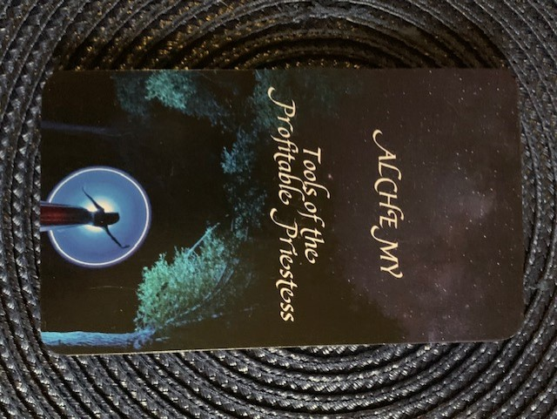
Module 5
Elemental Forces of Creation Wisdom
The Unified Field of Creation
Activate Your Inner Oracle
Naming Your Business

Slide 4
Call in Sacred Space

Slide 5
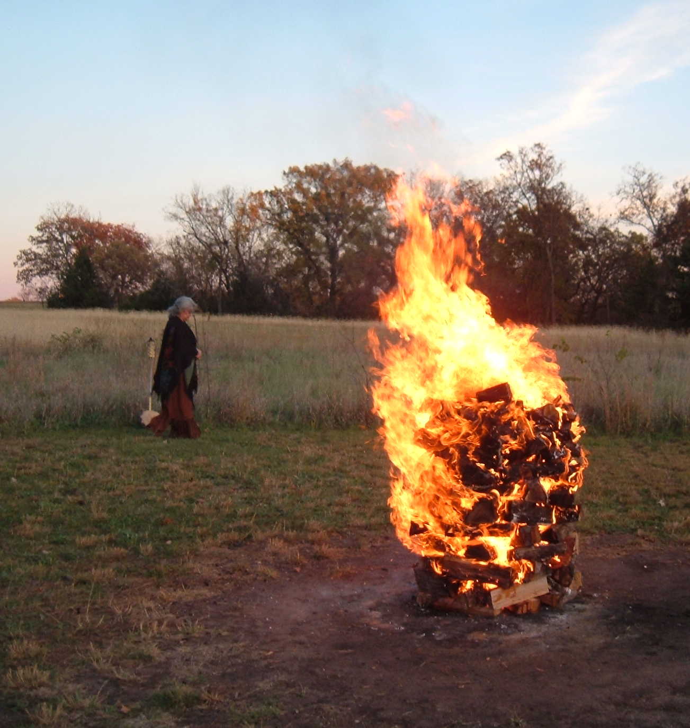
Your Creation Vessel
Open to Receive

Slide 6
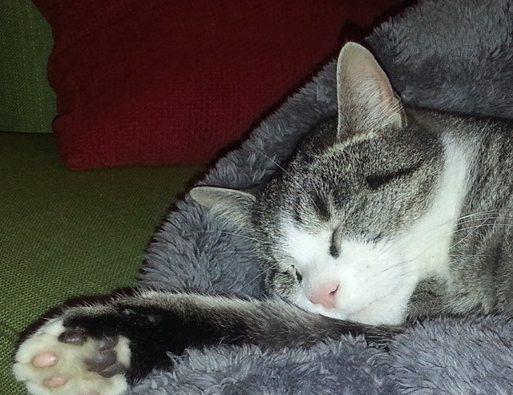
Be Gentle
with Yourself
Old Model of Perfection New Feminine Model Not Being Graded
No Right or Wrong
No Perfection
Everyone is in a different place in their life work

Slide 7
Your Process
What arises for you during the process is important.
Pay attention to what is moving in you. Journal with it. Dance with it.

Slide 8
Your Priestess Relationship to the Living Field of Creation

Slide 9
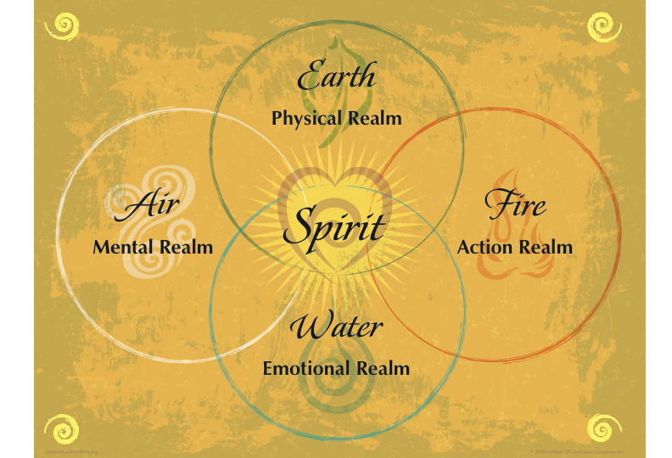

Slide 10
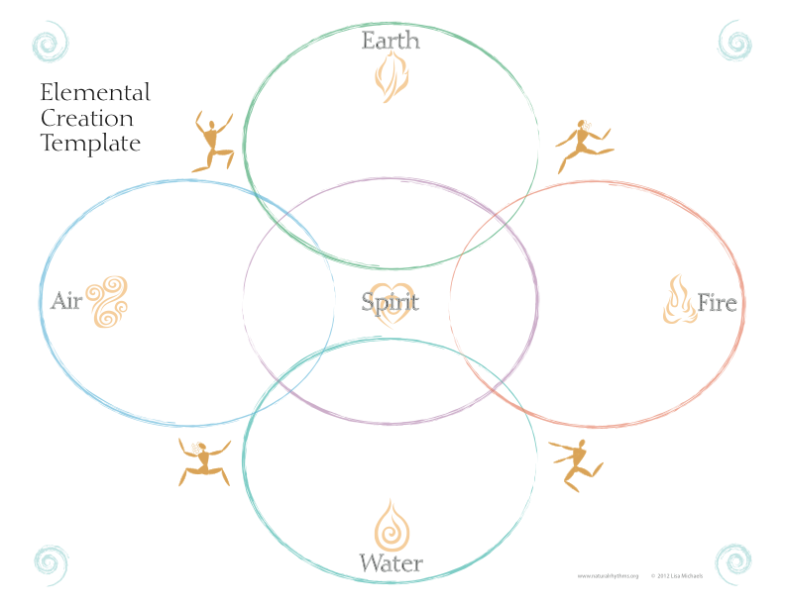
The Structures necessary to contain our business
The Goals and Plans we need
The Money Making Activities We need to engage in
Getting Clear on the Core of What
We are here to do…What our Business is about
The flow of our IDEAL Clients to our business

Slide 11
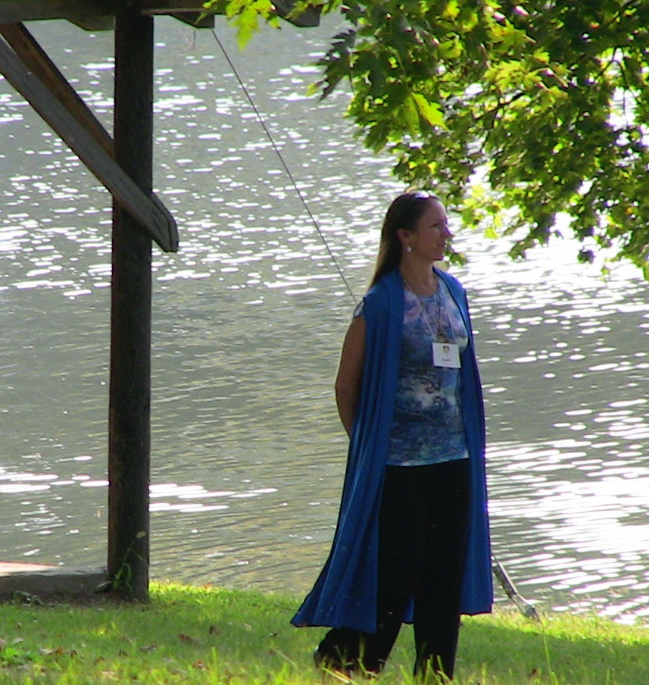
Spirit
Your Priestess Divine Connection Call the Sacred into every aspect of your life, relationships, and business.

Slide 12
Earth Your Priestess Connection to the Physical Realm
Honoring Nature and the Earth and holding the physical matter of your life as sacred.

Slide 13
Water Your Priestess Connection to the Emotional Realm
Honoring the sacredness of Water and your emotions and feelings.

Slide 14
Air Your Priestess Connection to the Mental Realm
Honoring the element of Air and the sacred power of intention and vibration.

Slide 15
Fire Your Priestess Connection to the Action & Energy Realm
Honoring the element of Fire and the sacred power of energetic transformation.

Slide 18
Oracle of Delphi
Priestess Divine Inner Sight

Slide 19
Activating Your Inner Priestess Oracle
Ask for a Direct Connection Ask to be a Clear Channel
Open to Receive
Activate Your Inner Priestess Oracle

Slide 20
Open Deeply
to Receive

Slide 22
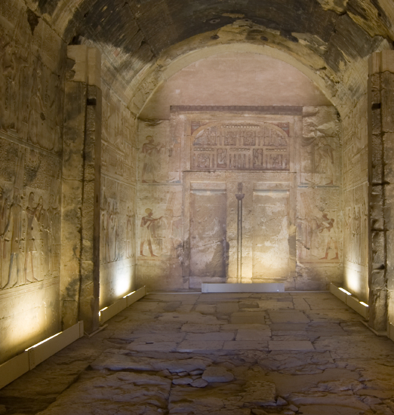
Inner Temples
Dream Realm

Slide 23
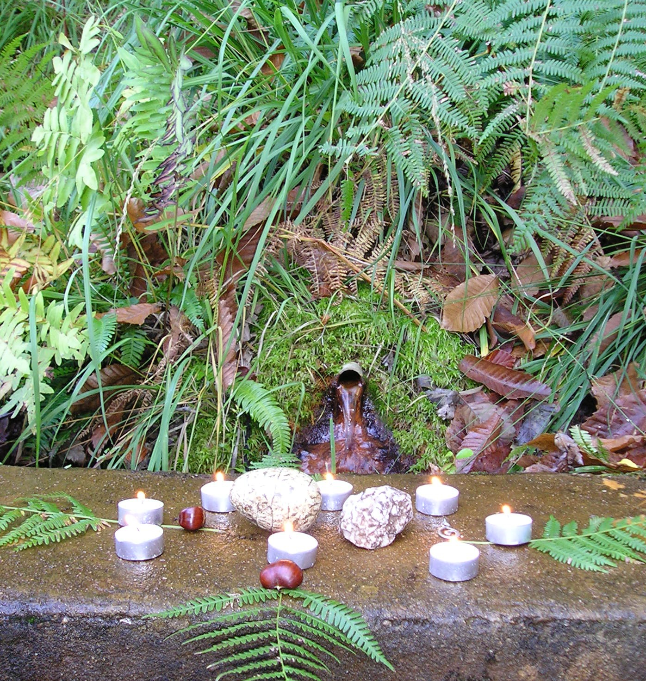
Gratitude
&
Closure

