Slide 1

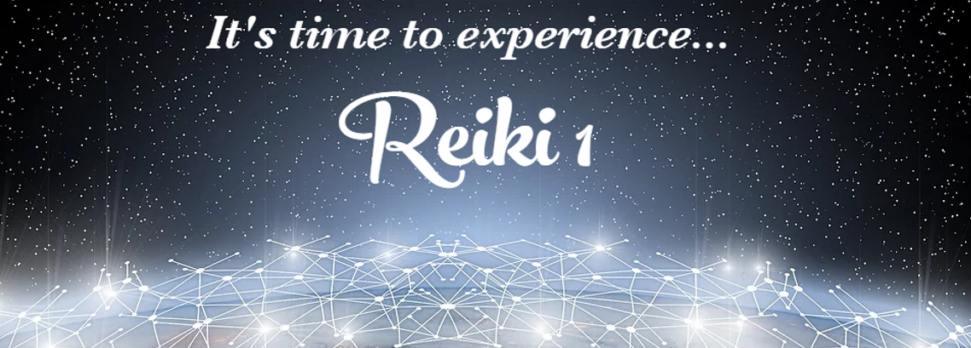

Slide 2

Welcome to Reiki I
What you will learn and receive…
Definition and History of Reiki
All about the Anatomy of the Human Energy Field
Reiki 1 Attunement
Follow-up and homework

Slide 3
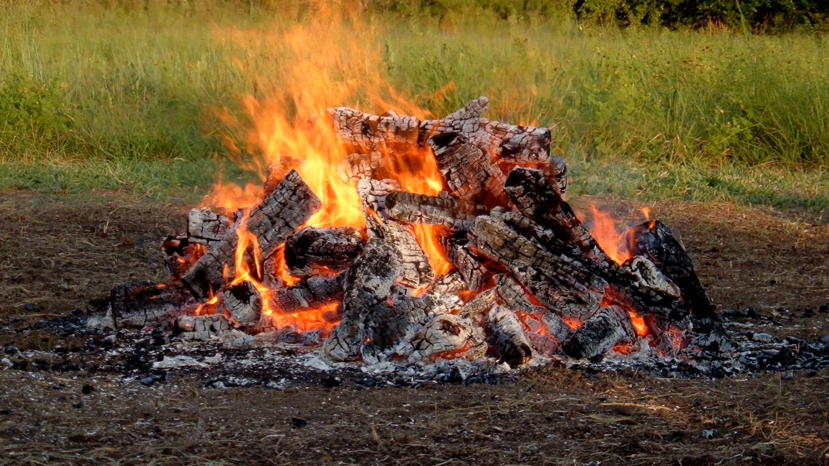
Calling In Sacred Space…
Open to receive…

Slide 4
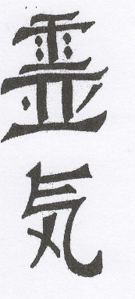
What is Reiki?
Reiki (pronounced ray-key) is a Japanese technique for stress reduction and relaxation that also promotes healing. It was discovered by Mikao Usui in March 1922. Reiki is administered by “laying on hands” (or now through the Crystalline Grid) and techniques such as this have been practiced for thousands of years. Reiki is a very simple yet powerful technique that can be easily learned by anyone.
Reiki is a special kind of Chi (energy). It is Chi that is guided by spiritual consciousness and is defined as spiritually guided life energy. This is a meaningful interpretation of the word Reiki. It more closely describes the experience most people have of it: Reiki guiding itself with its own wisdom, rather than requiring the direction of the practitioner.

Slide 5
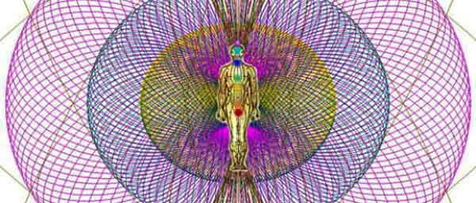
Anatomy of the Energy Field
The Electromagnetic Field extends 2-5 feet around you
Operates as Earth’s atmosphere in protection
When it’s not whole, ripped or torn, creates problems for the other systems of the body – IT LEAVES THEM VULNERABLE.
As our Earth is stressed so is our EM Field
Reiki is a valuable tool to alleviate this stress and repair this field. The beauty of Reiki is that you don’t need to know where any of that is. It has its own intelligence and repairs it automatically.

Slide 6


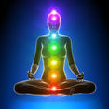

The Chakras
The seven main chakras are represented by the different colored circles on the figure to the left. The chakras are actually transformers of subtle energy. They take the Ki that is always around us and transform it into the various frequencies our subtle energy system needs to keep us healthy. The lowest or root chakra brings in the lower frequencies that are needed for physical survival and each higher chakra brings in higher energies such as those for healthy physical pleasure, expressing your will in the world, love of self and others, communication and creativity, with the highest or crown chakra bringing in the spiritual levels of energy. Each chakra corresponds with a layer of the aura. Negative feelings or thoughts can become lodged in the chakras reducing the amount of subtle energy they are able to provide and adversely affecting one’s health.

Slide 7
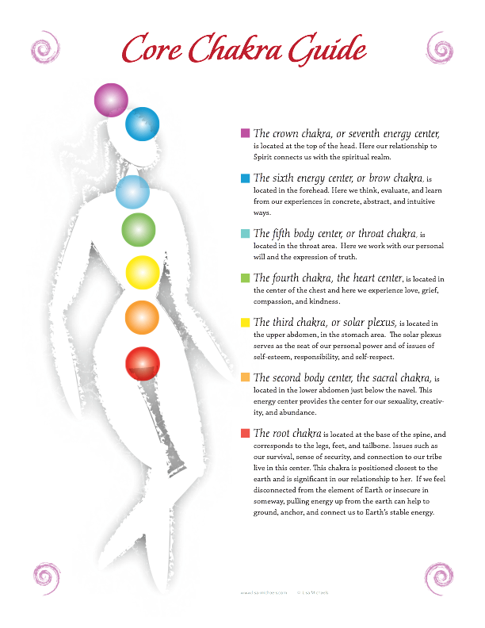

Slide 8
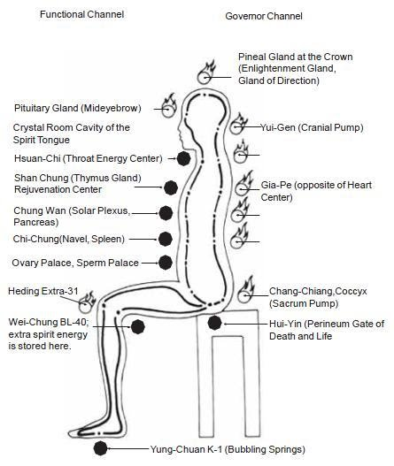
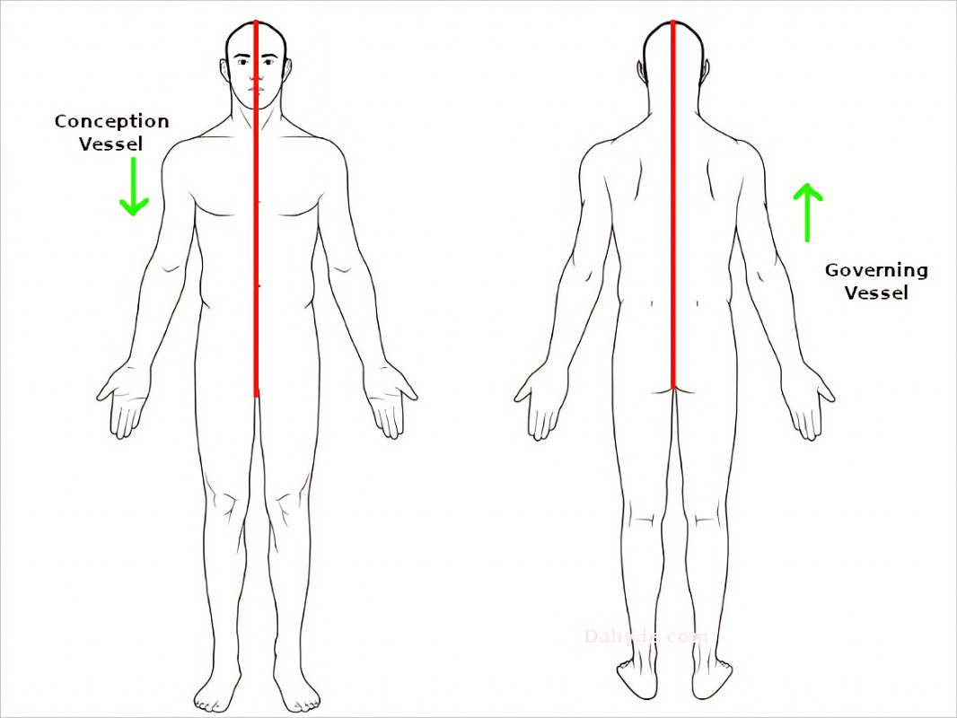
The Hara Line and the Microcosmic Orbit
Microcosmic Orbit Hara Line

Slide 9


Now, let’s talk about Reiki…
A Reiki attunement is a sacred spiritual initiation that connects the initiate with higher levels of consciousness and an unlimited source of healing energy. It heals and conditions the crown, heart, and palm chakras for their use in channeling Reiki and makes other adjustments in the student’s energy system necessary on an individual basis.
Reiki is not taught in the way other healings techniques are taught. The ability to channel Reiki energy is transferred to the student by the Reiki Guardians, through Reiki Master during the attunement process. During the attunement, the Rei or spiritual consciousness makes adjustments in the student’s chakras and energy pathways and also in deeper parts of one’s consciousness to accommodate the ability to channel Reiki energy; it then links the student to the Reiki source. These changes are unique for each person. The Reiki Master does not direct the process and is simply a channel for the attunement energy flowing from spiritual consciousness.
The Reiki attunement is a powerful spiritual experience and is the most important part of a Reiki class. The process is guided by Rei or spiritual consciousness, which fine tunes the experience for each student depending on what is needed. Some report having mystical experiences involving personal message, healing, visions, and past-life experiences.

Slide 10

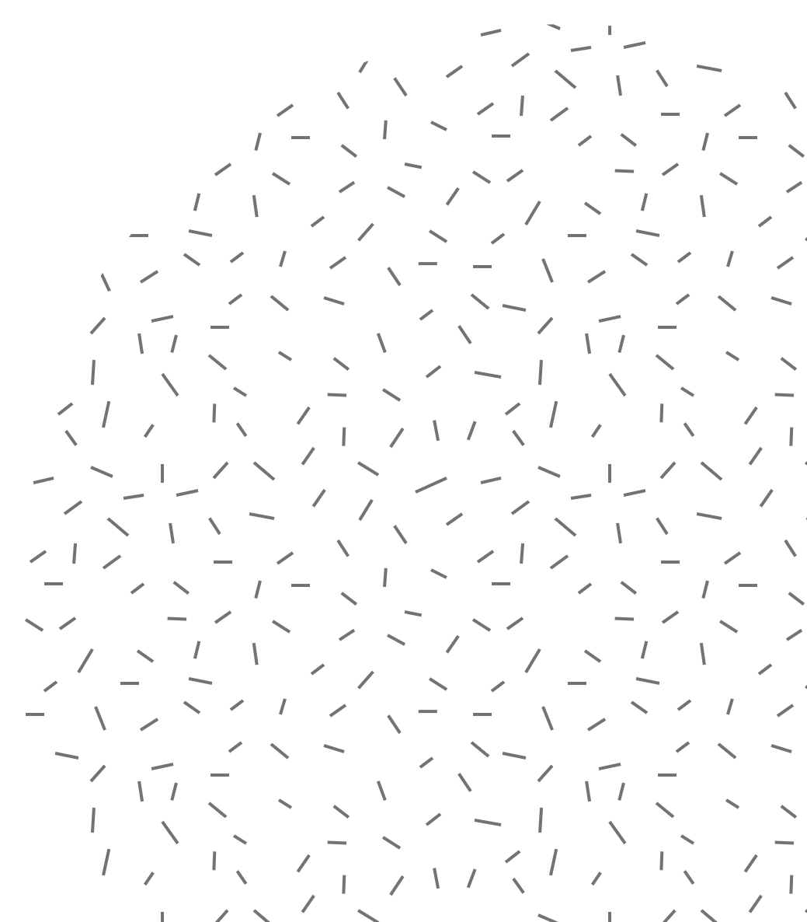
Reiki Can Never Cause Harm
Because Reiki is guided by a spiritual consciousness of its own, it can never and WILL NEVER cause harm. It can never be used inappropriately. It will always turn itself off if someone tries to use it inappropriately. It always knows what a person needs and will adjust itself to create an effect that is appropriate. One never needs to worry about whether to give Reiki or not. It is always helpful and always safe. But it will not enter where it is not wanted. In addition, because the practitioner does not direct the healing and does not decide what to work on, or what to heal, the practitioner is not in danger of taking on the karma of the client. Because the practitioner is not doing the healing, it is also much easier for the ego to stay out of the way and allow the loving presence of spiritual consciousness to clearly shine through.
Reiki Never Depletes Your Energy
Because it is a channeled healing, the Reiki practitioner’s energies are not part of the session are never depleted. In fact, the Reiki consciousness considers both practitioner and client to be in need of healing, healing so both receive benefit. Because of this, giving a session always increases one’s energy and leaves one surrounded with loving feelings of well-being.

Slide 11
Anyone Can Learn Reiki
The ability to learn Reiki is not dependent on intellectual understanding, nor does one have to be able to meditate. It does not take years of practice. It is simply passed on through the teacher to the student during the attunement process. As soon as this happens, one has Reiki and can use it. Because of this, it is easily learned by anyone. Reiki is a pure form of healing not dependent on individual talent or efforts by the individual to acquire it. Because of this, the personality of the practitioner is less likely to cloud the significance of the experience. The feeling of being connected directly to God/Goddess’s healing love and protection is clearly apparent.
Self-Treatment
In addition to using Reiki on others, you can also treat yourself and are encouraged to do so, especially right after receiving your Attunements. This is one of the wonderful advantages of Reiki. It works just as well on you as it does on others.

Slide 12
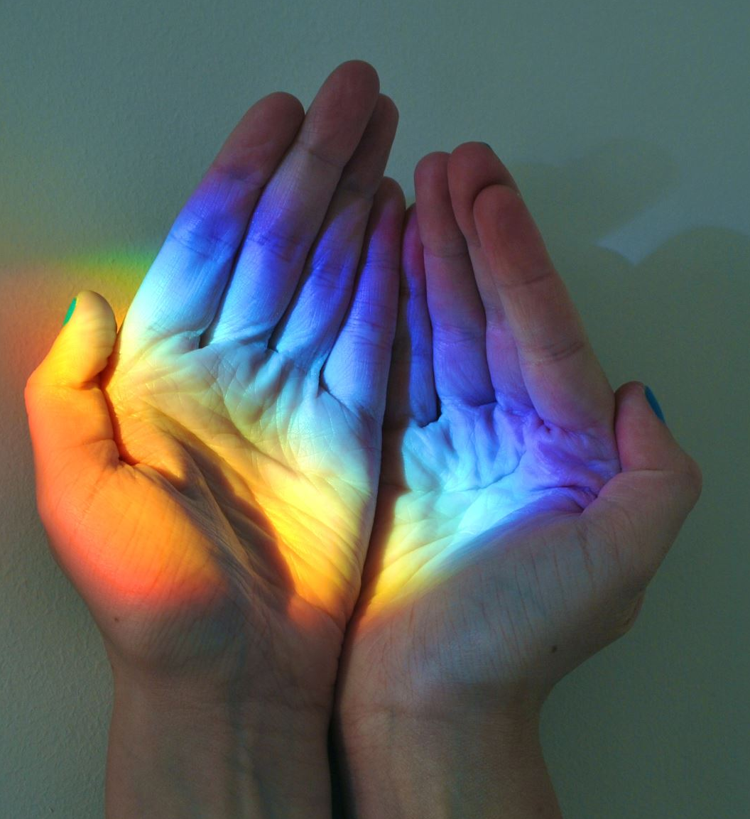
Giving Reiki
After the attunement, all that is necessary to use Reiki is to place their hands on themselves or another with the intention of healing. The Reiki energies will begin flowing automatically. You may notice that your Reiki will turn on by itself. You may notice this by the heating up of your hands. It is suggested that after Reiki 1, the practitioner only use Reiki on themselves and use the time of at least 30 days to tone their own energy body to the energy of Reiki .
It is not necessary to direct the Reiki energy. It has its own awareness and intelligence, and by connecting with your own or the client’s energy field, it will know how to work and what to do. The best results are achieved by simply remaining calm and relaxed and enjoying the soothing energies that are flowing through you.
Note that while Reiki often goes to areas other than where one’s hands are placed, it doesn’t always do this. This is why it’s important to use all the hand positions in a session and to follow the guidance you receive while you are doing a session.

Slide 13


What can be Treated?
Reiki is both powerful and gentle. In its long history of use it has aided in helping to heal virtually every known illness and injury including life threatening problems like multiple sclerosis, heart disease, and cancer as well as skin problems, cuts, bruises, broken bones, headaches, colds, flu, sore throat, sunburn, fatigue, insomnia, and impotence. It is always beneficial and works to improve the effectiveness of all other types of therapy. A session feels like a wonderful, glowing radiance and has many benefits for both client and practitioner, including positive states of consciousness and spiritual experiences.
And that’s just on the body. You can literally use Reiki on anything…interpersonal relationships, events and situations, mechanical appliances, cars, animals, the planet…you name it, Reiki can help!

Slide 14
Reiki Attunements
There are three levels of attunements, one each for a different level of Reiki. Traditionally there is a minimum of 2-3 months between levels one and two, and 4-6 months (or up to two years for some teachers) between levels two and three. Because of the way the energies have shifted on the planet, now you can typically do them at one-month intervals. Additionally, you can repeat the attunements periodically as they are healing in and of themselves.

Slide 15

More about Reiki…
The Reiki Principles
Just for today I will give thanks for my many blessings.
Just for today I will not worry.
Just for today I will not be angry.
Just for today I will do my work with integrity.
Just for today I will be kind to myself and every living thing.
The story of Dr. Usui

Slide 16
Your Reiki 1 Attunement will be like a Guided Meditation…
I will open a circle and call in the directions and the Reiki guides in each direction, and the Reiki Guardians. The Reiki Guardians are Light Beings of great power that can be found at the further most edges of your light body and are responsible for bringing Reiki to the planet. They are also responsible for the evolution of Reiki as the planet’s energy continues to increase. They are not to be confused with Reiki Guides, who are closer to our physical reality. Your Reiki Guides can be people you knew who have transitioned or who were with you if you used Reiki in other lifetimes. Reiki guides can also be pets who have transitioned and continue to participate with you in your healing work. Your personal Spirit Guides may show up as well.
After I call in the directions, I will lead you in a short relaxation to tone your body to receive and then connect you to the Reiki Guardians and lead you through the Attunement. Reiki is brought into your body at two points: Center Above and Center Below. These are two chakras that are located about 12 inches above the Crown Chakra and below the feet. The Reiki Symbol, Cho Ku Rei, is anchored into the hands, third eye and Hara Line. Also, during this attunement process, the Reiki Principles are anchored into your heart. These five principles are part of the traditional Reiki training that all practitioners and Reiki Masters aspire to live by. To have them anchored into your heart is an amazing experience.
Reiki 1 Attunement

Slide 17
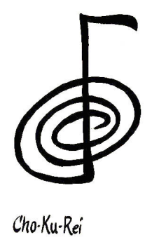
Reiki Level I
This level of Reiki brings the newcomer into the energy field of Reiki, opening energetic channels in the body to the flow of Reiki. During the attunement, you’ll receive a symbol that you will start to work with. Called Cho Ku Rei (choe koo ray), this symbol “turns on” the flow of Reiki when you begin to work, essentially acting like an amplifier. The physical body particularly likes this symbol. Spend some time each day with this symbol so that it becomes embodied before preceding to the next level of Reiki. ).
Cho Ku Rei: The Connector Element: Earth
This is a beautiful symbol that can be used to consciously connect you to the Reiki energy at the beginning of each session. It has a warm, vital, loving feel to it. It says “Remember who you are.” Traditionally it is considered the symbol for physical body healing. It helps to remove energetic blocks in the body so that all energies flow through the body more evenly. It also brings into the conscious mind the unconscious attitudes, feelings or beliefs that are affecting us in a subtle way.

Slide 18
Reiki Symbol and How to Use It
Learn the symbol by drawing it in the air or on paper and saying its name three times. When using it in a healing session draw it in the palm of your hands while saying its name three times, then tap your palm or clap your hands together softly (three times).
Some suggestions for its use are:
Draw it clockwise for increasing energy, counter-clockwise for decreasing.
Increase positive qualities in a home or office by beaming it with the palms of your hands into a room or imagine drawing it on all four walls, ceiling and floor.
Amplify nutritional value of food by drawing and invoking it over the food.
Program a crystal for a specific purpose. Clarify your intention for the crystal, then invoke Cho Ku Rei and link it to the intention. Place your hands on the crystal and let Cho Ku Rei carry the intention into the crystal.
Amplify positive effect of medicine. Invoke Cho Ku Rei and hold the medicine as you let the symbol flow into the medicine

Slide 19
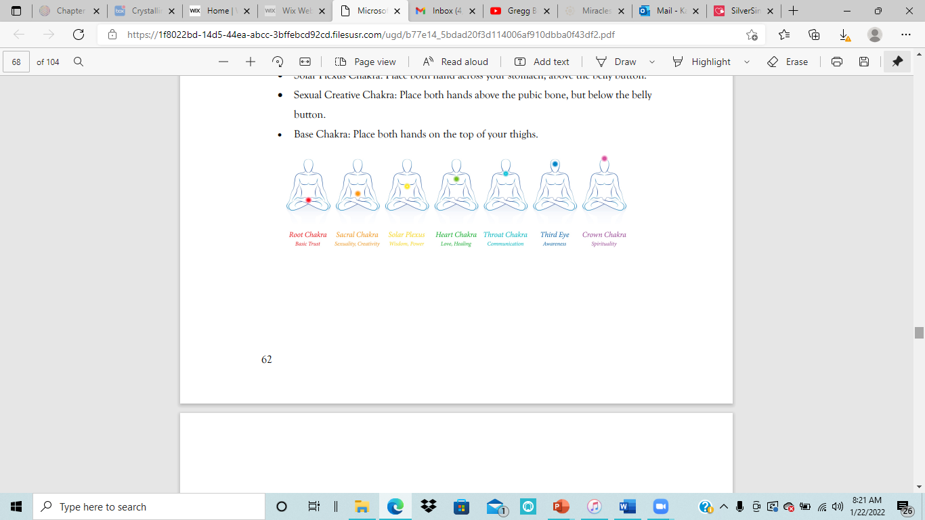
Self-Healing Session
To do a self-healing session with the traditional chakras you’ll start from top and move down. Invoke Cho Ku Rei in your hands then hold the hand position and wait for an indicator signal such as a sigh or shift in your body or awareness before moving on. You can also muscle test, if you’re not sure of the timing. Note: Working on yourself is one of the toughest things to do because we are taught to care for others but not for ourselves. Make it part of your yoga, meditation or bath routine so it becomes second nature.
After each attunement, do self-healing daily for 3 weeks.
• Crown Chakra: Place the palms of your hands on either side of your head above the ears. Let the fingers be open at the midline of the top of your head. Don’t cover the crown chakra.
• Third Eye Chakra: Place one hand on your forehead and one on the back of the skull at the base (just above the neck).
• Throat Chakra: Place one hand on the front of your neck and one hand on the back.
• Heart Charka: Place both hands on your chest with fingers overlapping at the midline. An excellent position for falling asleep.
• Solar Plexus Chakra: Place both hand across your stomach, above the belly button.
• Sexual Creative Chakra: Place both hands above the pubic bone, but below the belly button.
• Base Chakra: Place both hands on the top of your thighs.

Slide 20

What Now?
Connect to your Reiki every morning and evening or at least twice a day.
Do a healing session on yourself everyday for 21 days.
Do the Embodied Reiki Meditation whenever you feel you need an extra boost.
(Found below and on your After Your Reiki 1 Handout)
Use Reiki on anything in your own environment for the first 21 days…pets, appliances, vehicles, anything. Experiment.
After 21 days, you can experiment working on others if you feel confident. If you don’t, that’s ok. We will learn more about that and how to do it in Reiki 2, which I will offer whenever you are ready.

Slide 21
Embodied Reiki Symbol Meditation
Use this meditation to embody and activate your own conscious and energetic connections with the symbols. After this meditation you’ll have a more innate sense about when and where to use the symbols. Essentially they’ll begin to create with you as they speak through your consciousness. After each level, return to this meditation and embody the new symbols with it. Typically, once is enough when doing this meditation, but if you found yourself forgetting the symbols, do it several times.
Activate Reiki in your hands.
Invoke Cho Ku Rei (say it three times and draw it in the air). Picture it above the crown of your head. With your intent, see, perceive or imagine the symbol coming into the crown, slowly moving down through your head, throat, chest, stomach and then into the small intestines. Here you will embody this symbol. Observe what shifts and changes for you. When the energy completes shifting, move to the next step.
State the Reiki Principles with both hands on your chest. Invite them to become embodied within you.
Reiki Principles
Just for today I will give thanks for my many blessings. Just for today I will not worry. Just for today I will not be angry. Just for today I will do my work with integrity. Just for today I will be kind to myself and every living thing.

Slide 22
The Reiki Principles
Just for today I will give thanks for my many blessings.
Just for today I will not worry.
Just for today I will not be angry.
Just for today I will do my work with integrity.
Just for today I will be kind to myself and every living thing.

