Slide 1
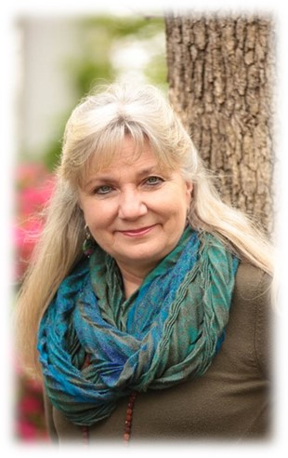
New Earth Priestess
With
Kathy Forest
Module 23

Slide 2
Module 23
Honoring and Weaving the Threads of Your Spiritual Life Journey

Slide 3
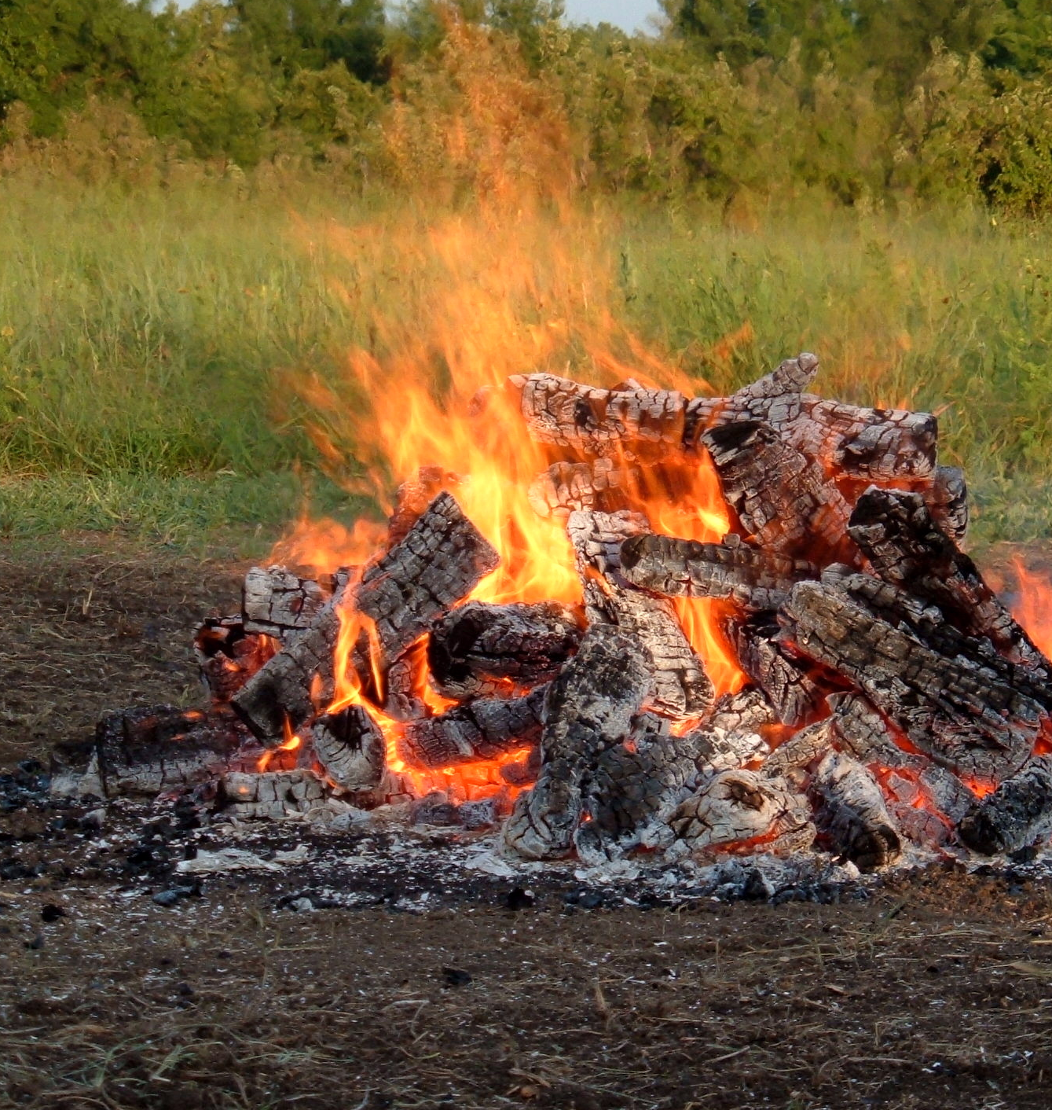
Connect,
Call in Sacred Space,
Call on Oversoul,
Open to Receive

Slide 4
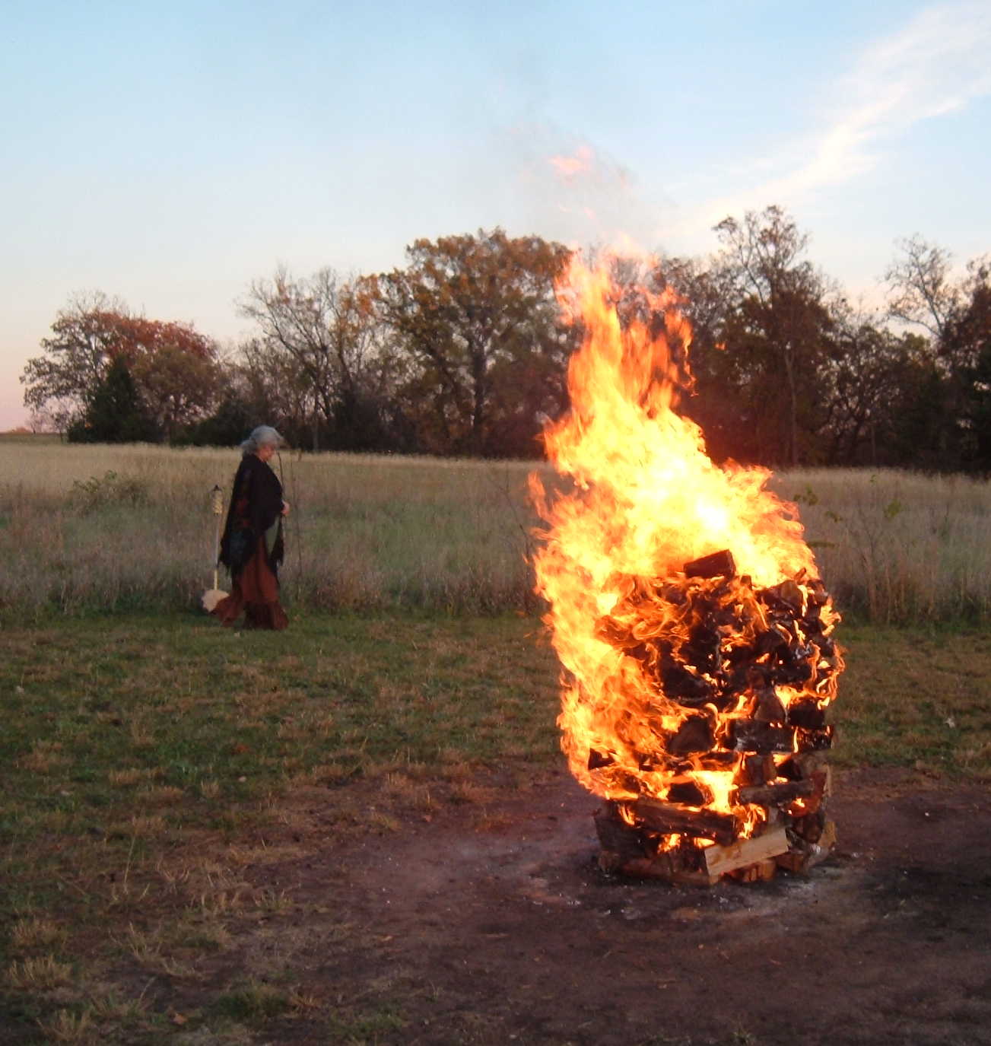
Your Creation Vessel
Open to Receive

Slide 5
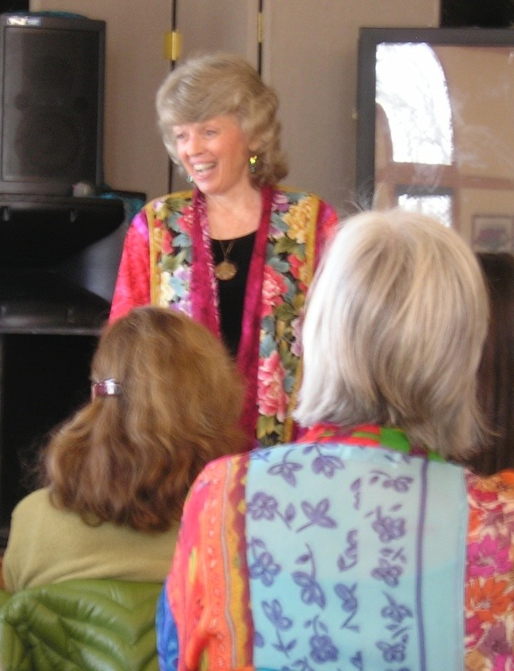
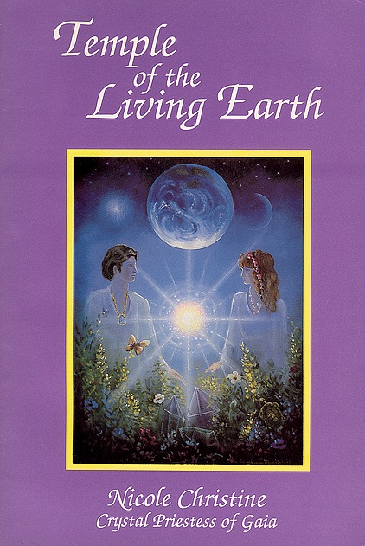
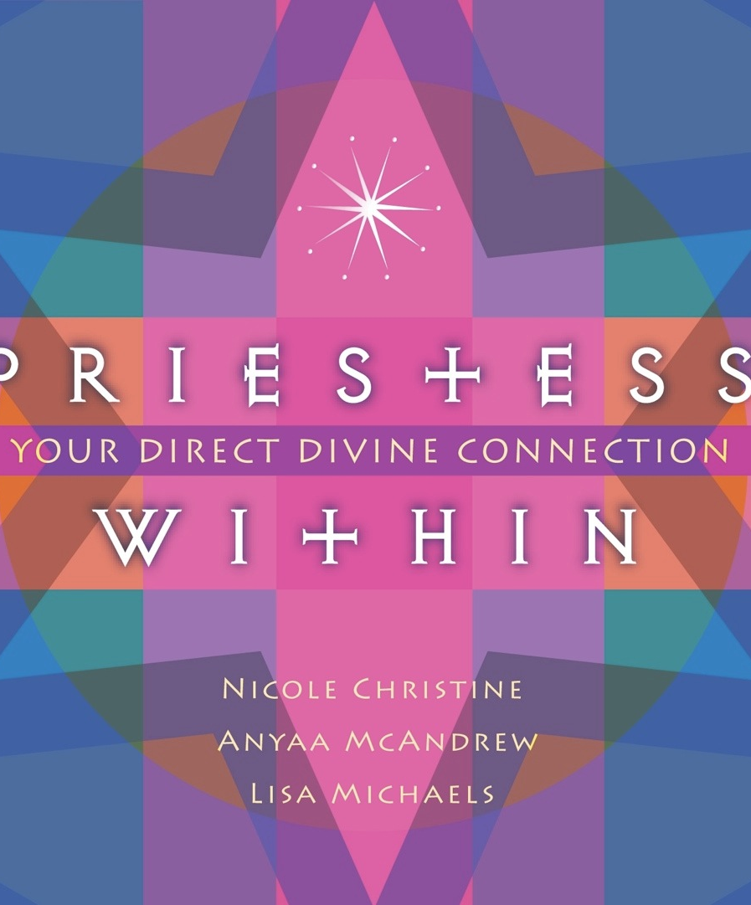

Slide 6
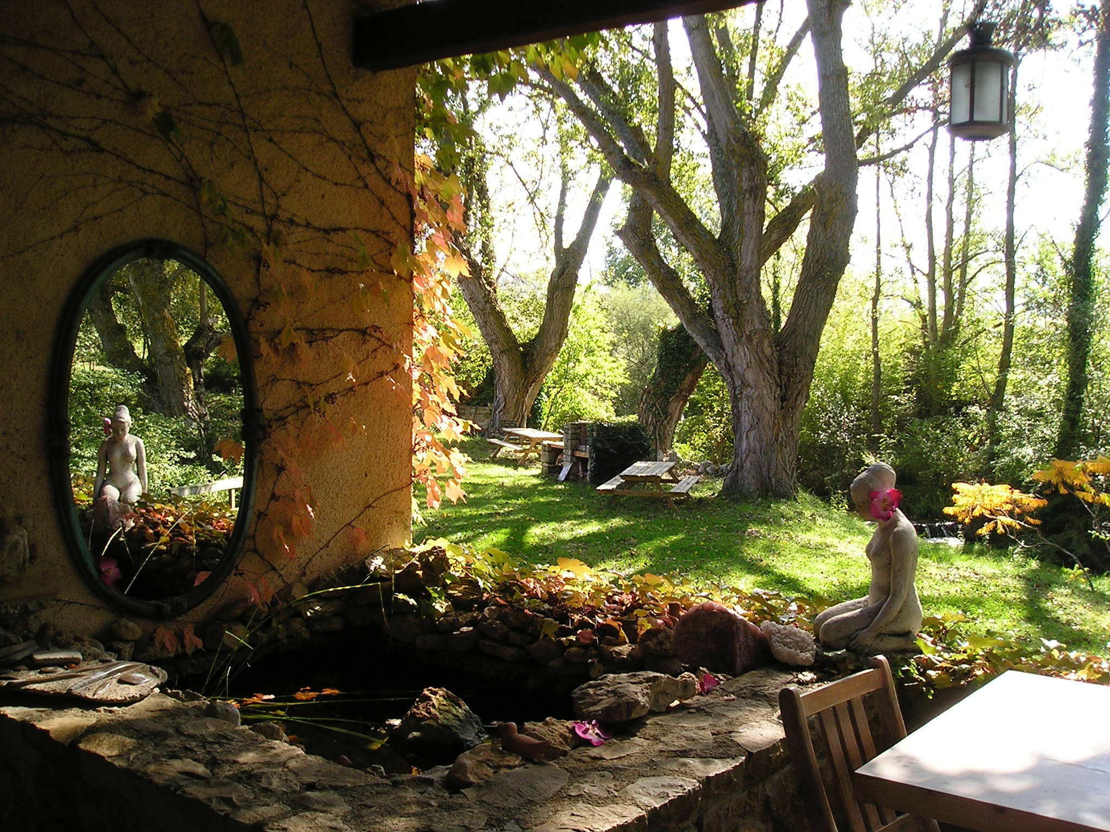
from…
Temple of the Living Earth by Nicole Christine

Slide 9
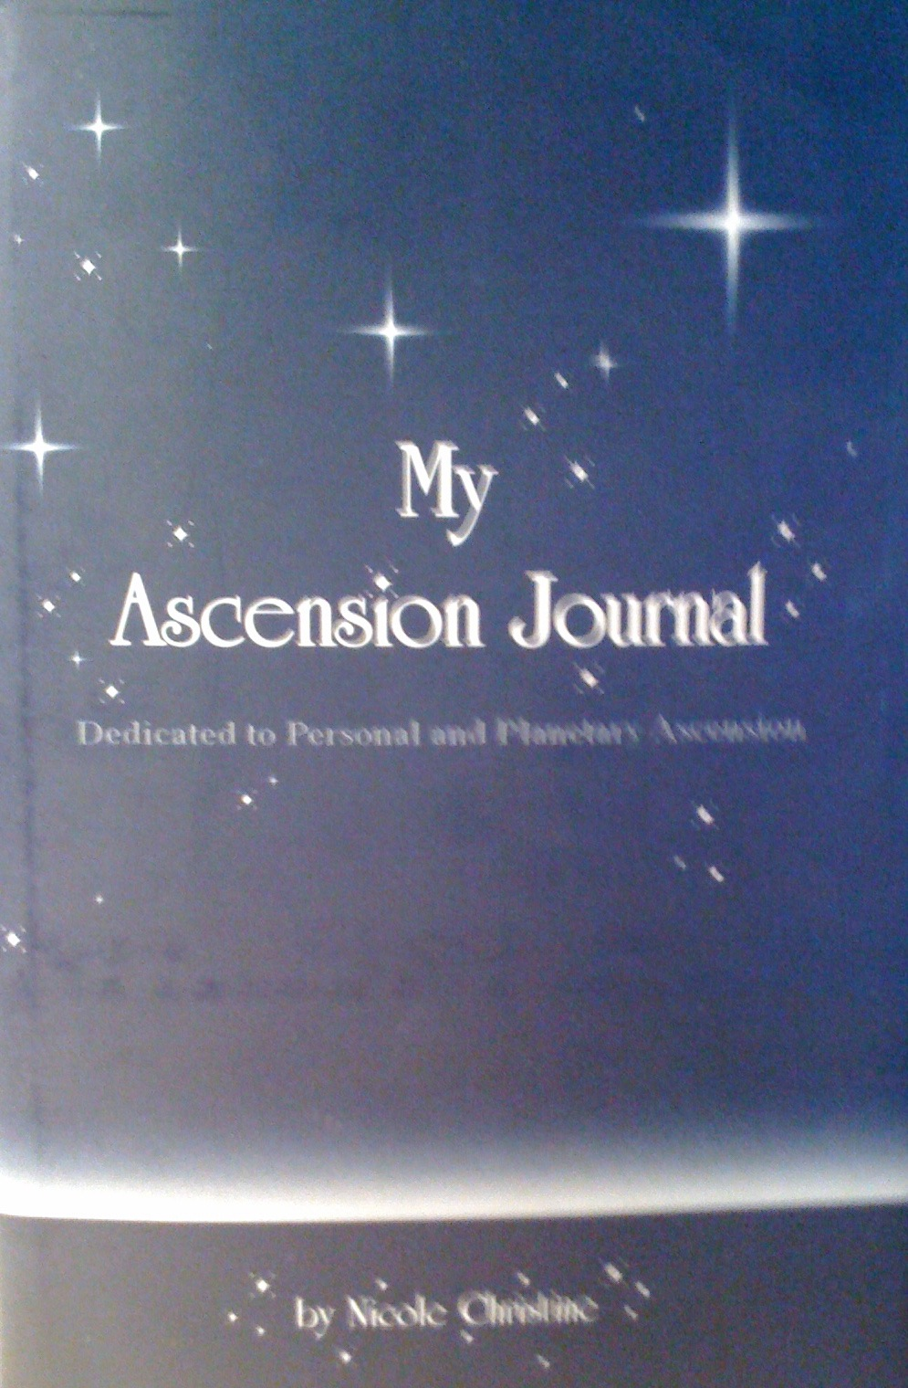

Slide 10
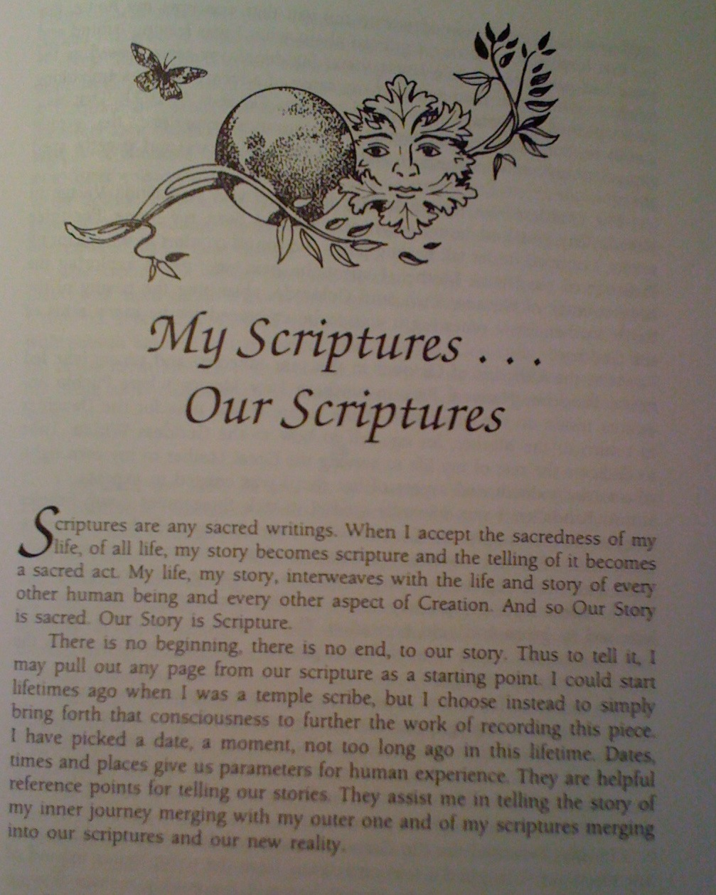

Slide 11
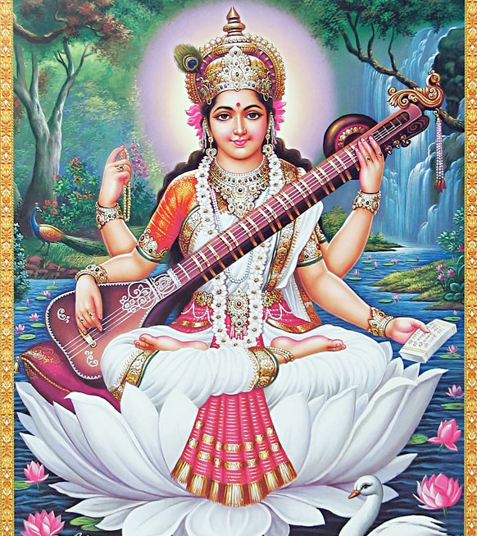
Goddess Saraswati

Slide 12
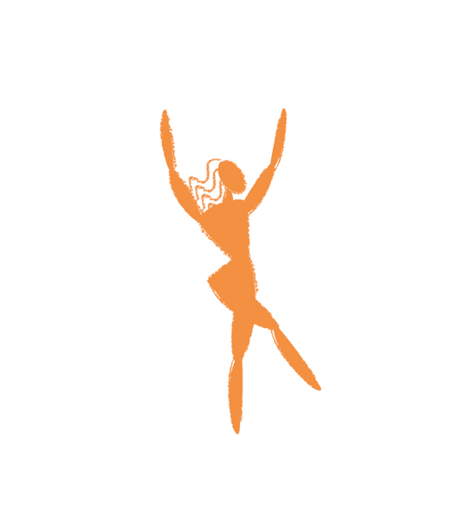
Life Thread Integration

Slide 13
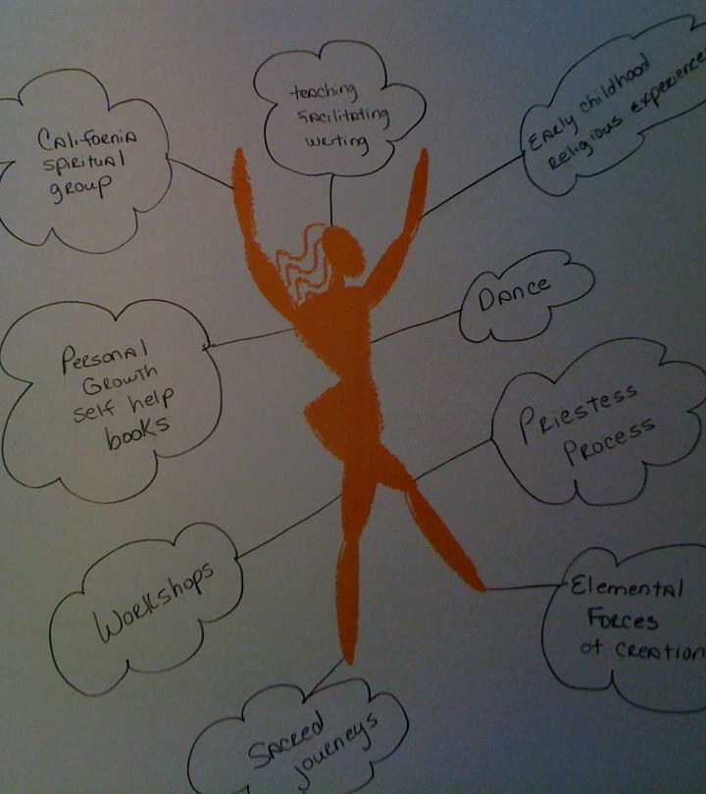
Spiritual Threads

Slide 14
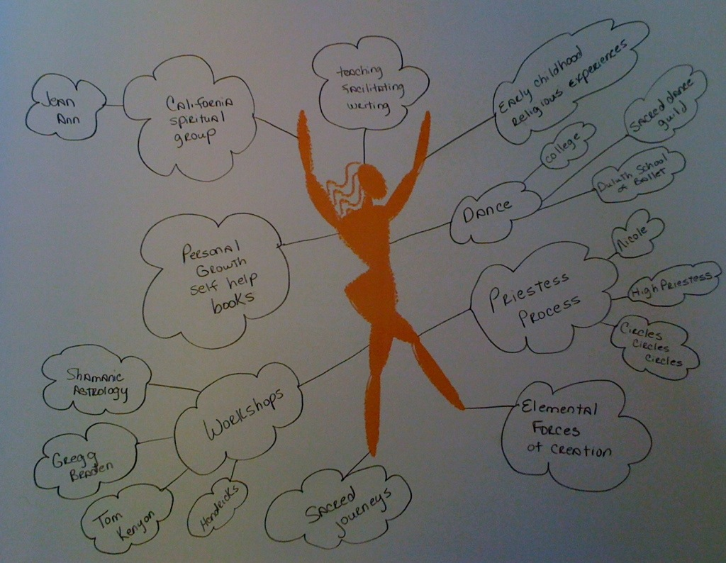

Slide 15
Integration Before Sleep

Slide 16
Integration of all of your story that has come before now to prepare you to express your next vibrational frequency after your shamanic death and rebirth.

Slide 17
Activate and Integrate

Slide 18
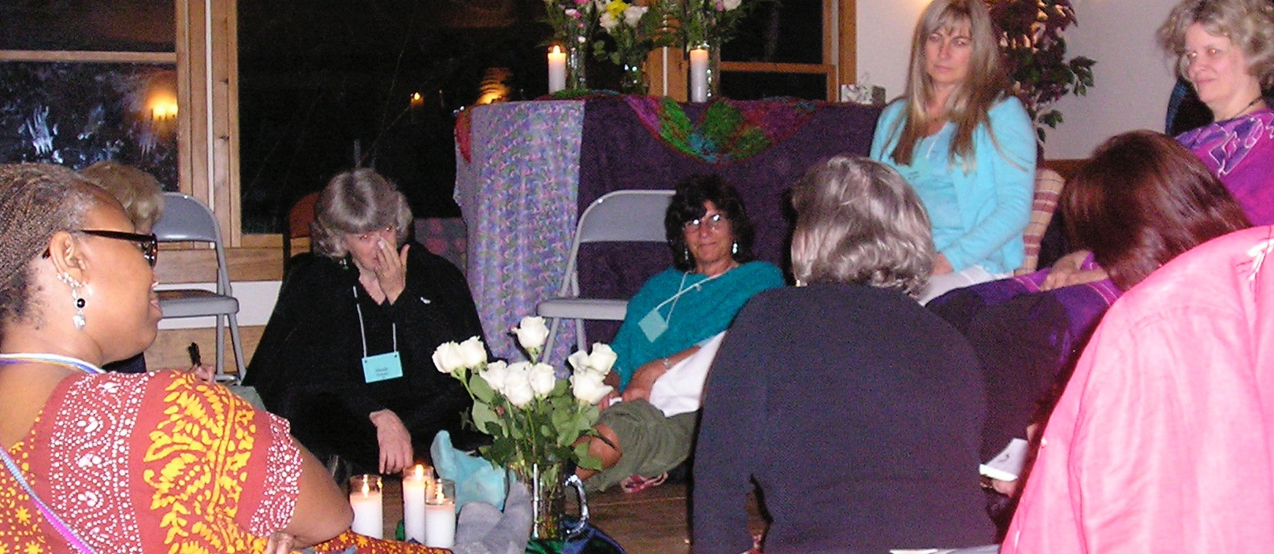
Next Sacred Story Sharing Preparation Discussion & Questions

Slide 19
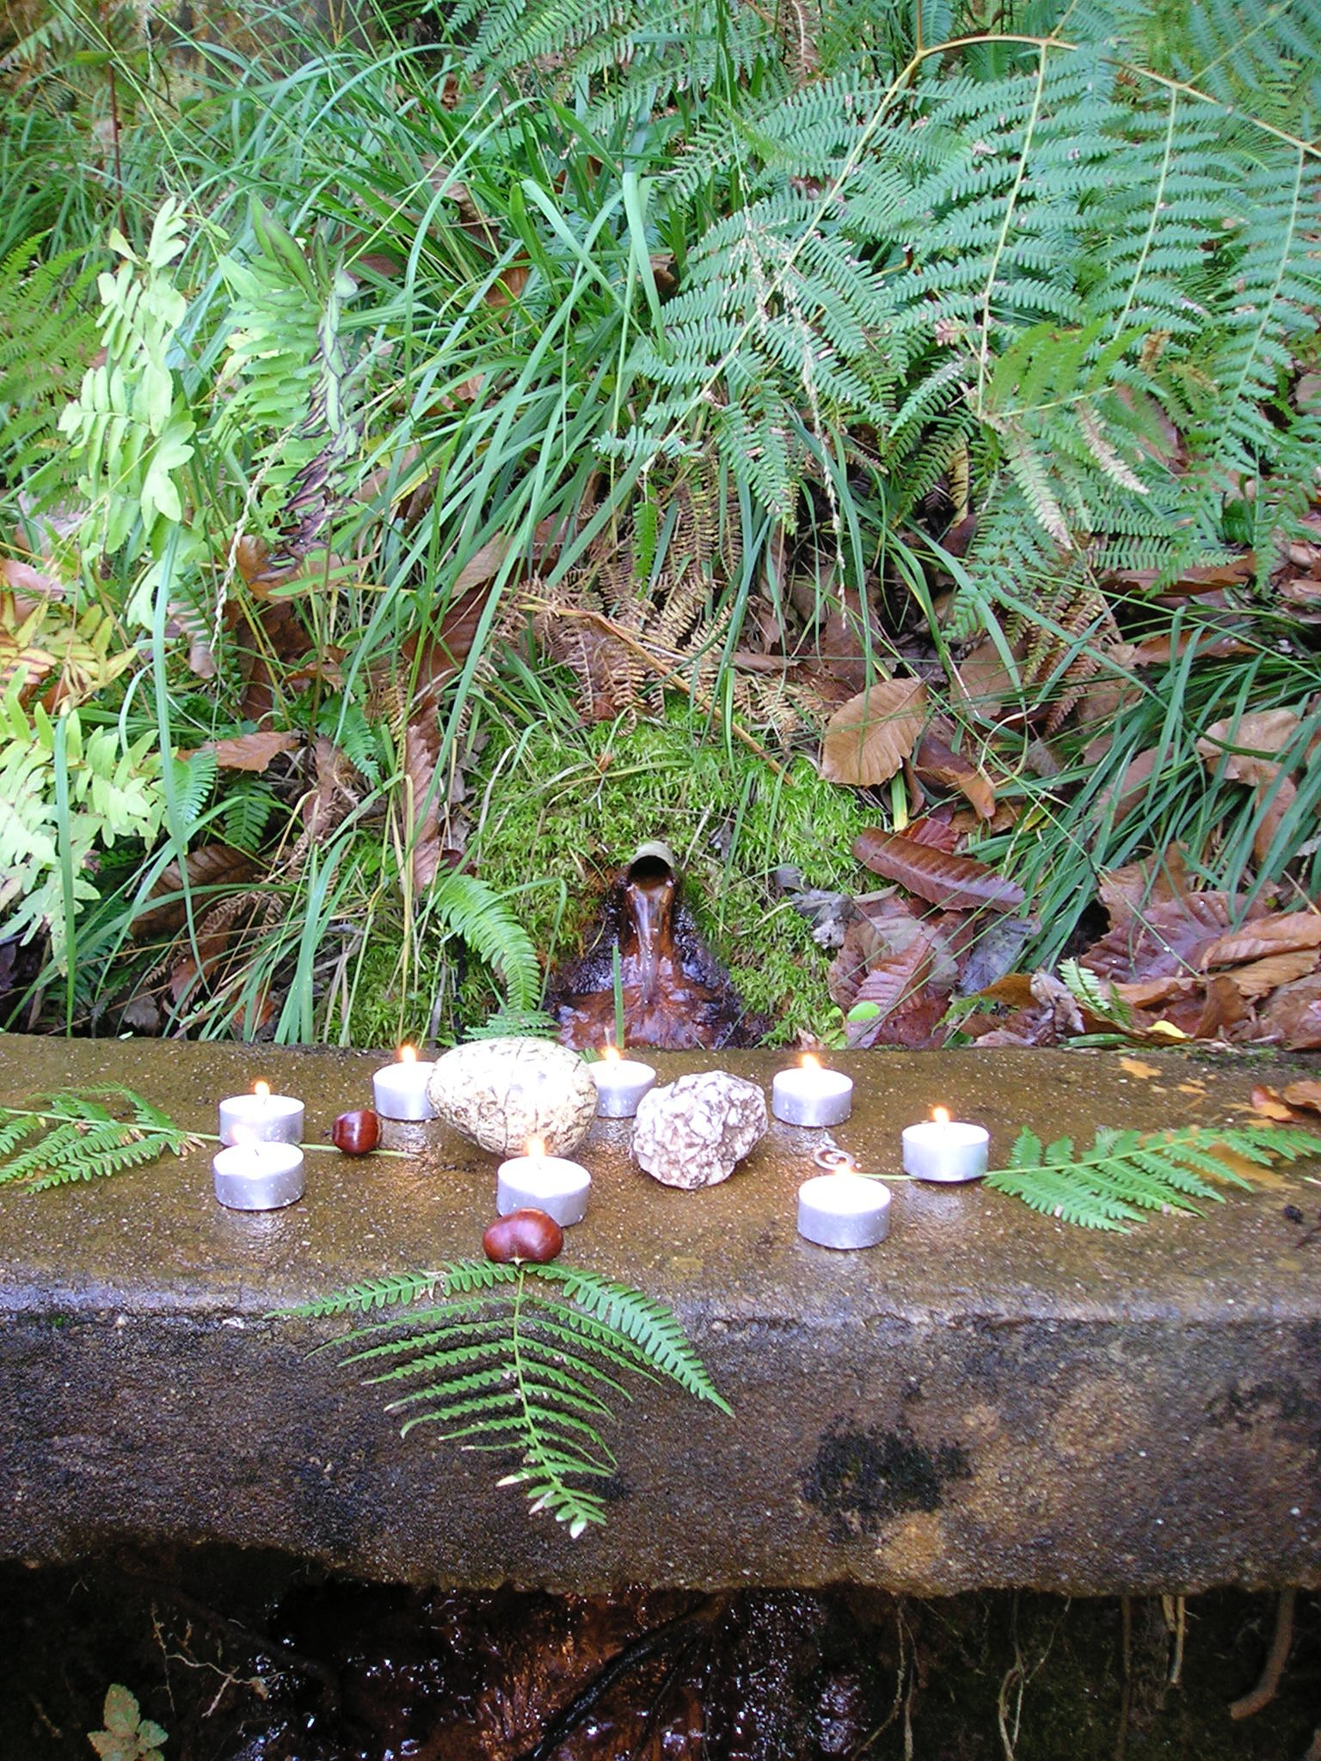
Gratitude
Ground
Close

