Slide 1
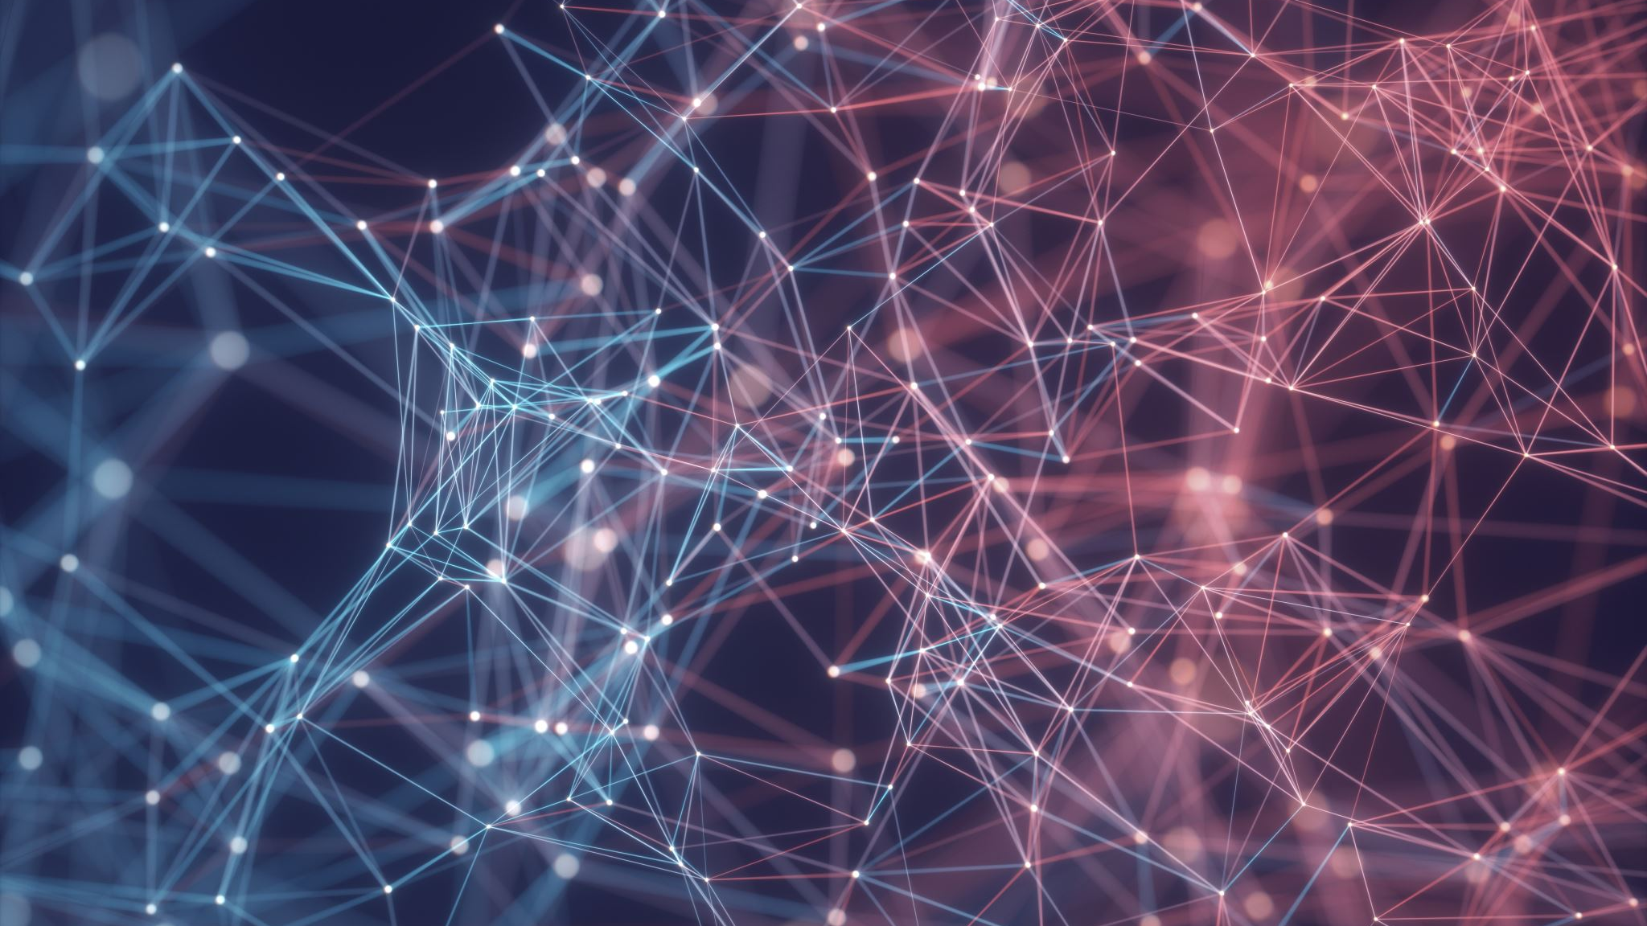
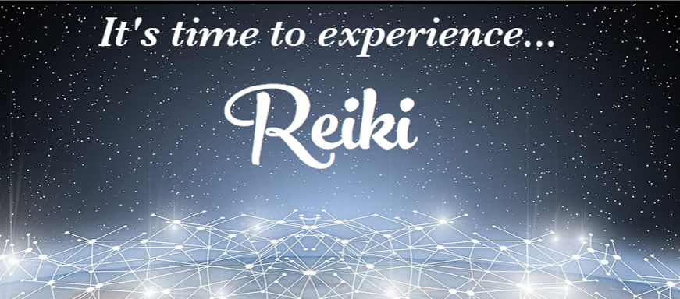

Slide 2

Welcome to New Earth Reiki 2
What you will learn and receive…
A mini-review of the human energy system.
An in-depth look at the symbols and why they are used.
The first 3 Reiki Symbols
Reiki 2 Attunement
Hand positions and how to use Reiki on others
What to do after class…resources.

Slide 3
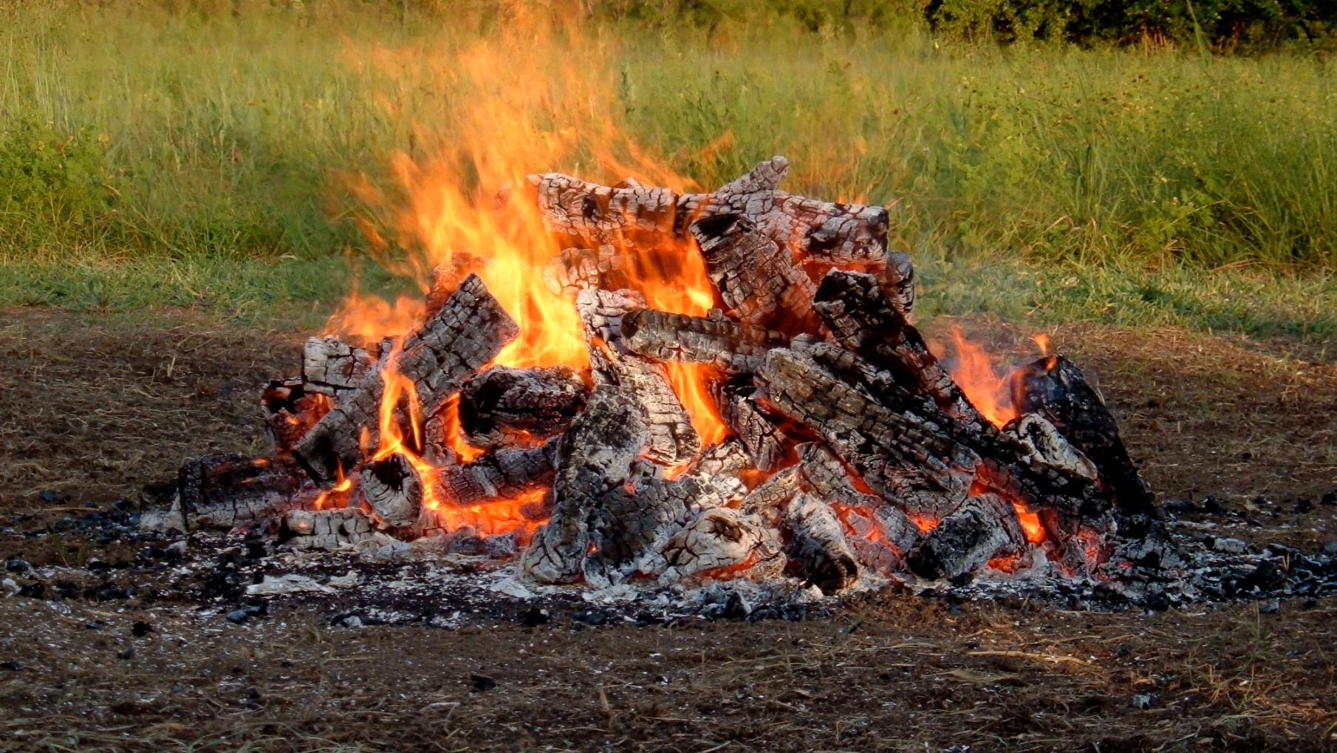
Calling In Sacred Space…
Open to receive…

Slide 4
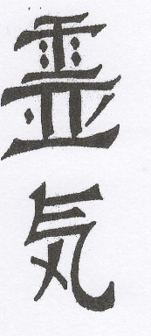
What is Reiki?
Reiki (pronounced ray-key) is a Japanese technique for stress reduction and relaxation that also promotes healing. It was discovered by Mikao Usui in March 1922. Reiki is administered by “laying on hands” (or now through the Crystalline Grid) and techniques such as this have been practiced for thousands of years. Reiki is a very simple yet powerful technique that can be easily learned by anyone.
Reiki is a special kind of Chi (energy). It is Chi that is guided by spiritual consciousness and is defined as spiritually guided life energy. This is a meaningful interpretation of the word Reiki. It more closely describes the experience most people have of it: Reiki guiding itself with its own wisdom, rather than requiring the direction of the practitioner.

Slide 5
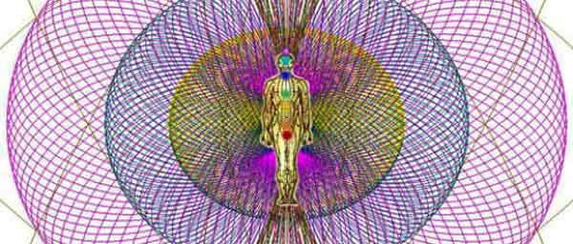
Anatomy of the Energy Field
The Electromagnetic Field extends 2-5 feet around you
Operates as Earth’s atmosphere in protection
When it’s not whole, ripped or torn, creates problems for the other systems of the body
As our Earth is stressed so is our EM Field
Reiki is a valuable tool to alleviate this stress and repair this field. The beauty of Reiki is that you don’t need to know where any of that is. It has its own intelligence and repairs it automatically.

Slide 6
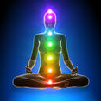
The Chakras
The seven main chakras are represented by the different colored circles on the figure to the left. The chakras are actually transformers of subtle energy. They take the Ki that is always around us and transform it into the various frequencies our subtle energy system needs to keep us healthy. The lowest or root chakra brings in the lower frequencies that are needed for physical survival and each higher chakra brings in higher energies such as those for healthy physical pleasure, expressing your will in the world, love of self and others, communication and creativity, with the highest or crown chakra bringing in the spiritual levels of energy. Each chakra corresponds with a layer of the aura. Negative feelings or thoughts can become lodged in the chakras reducing the amount of subtle energy they are able to provide and adversely affecting one’s health.

Slide 7
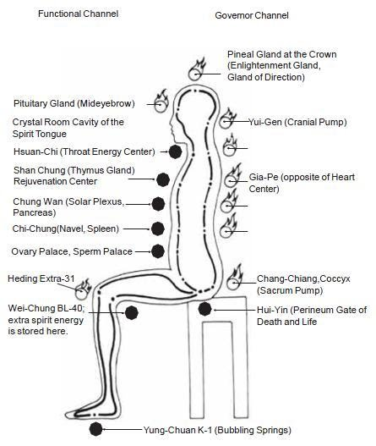
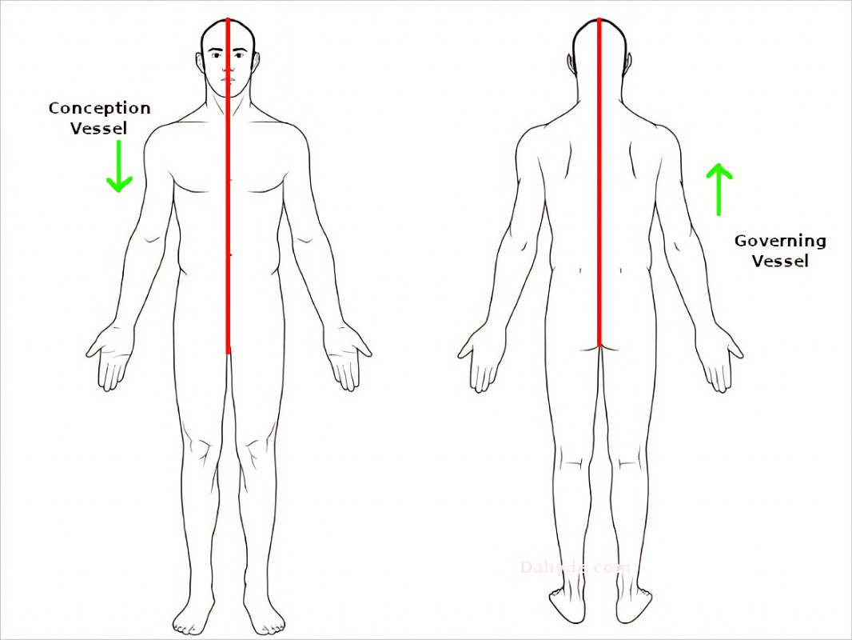
The Hara Line and the Microcosmic Orbit
Microcosmic Orbit Hara Line

Slide 8
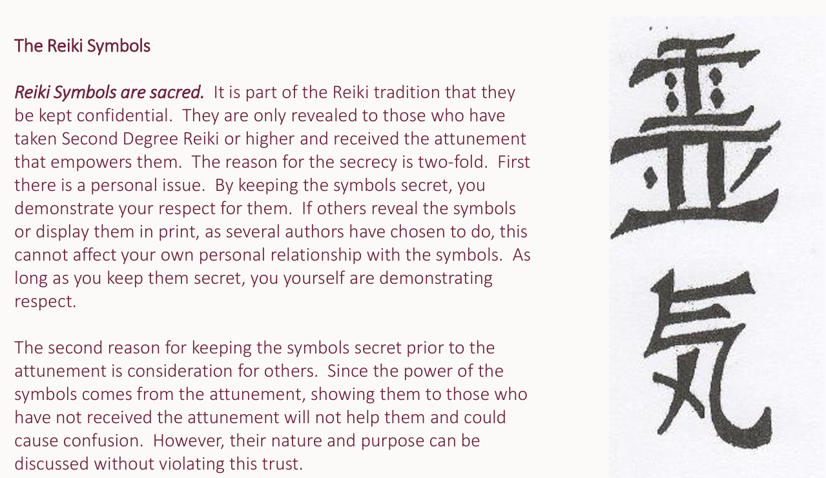

Slide 9
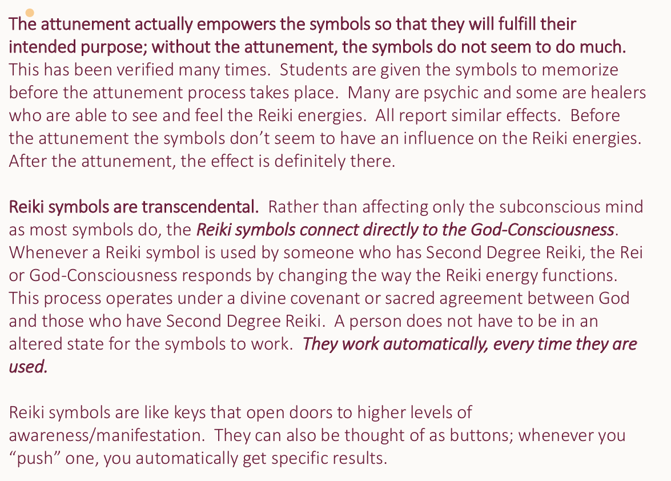

Slide 10
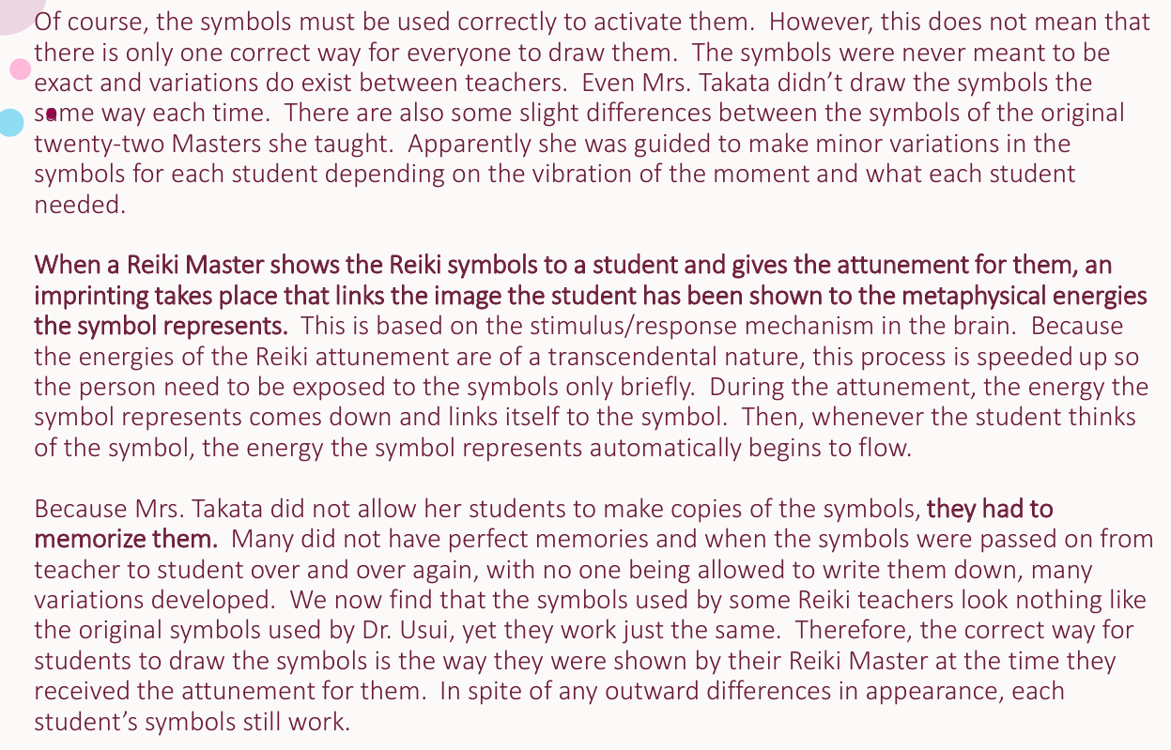

Slide 11


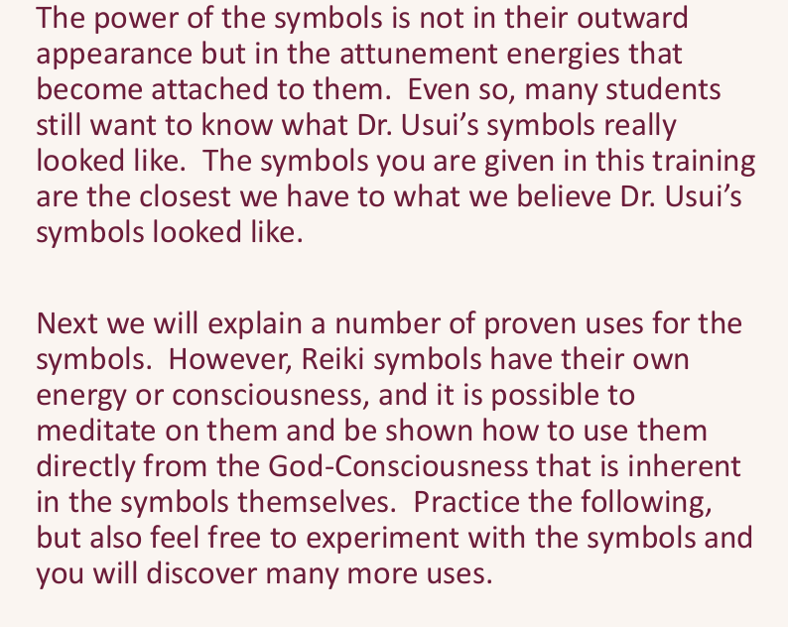

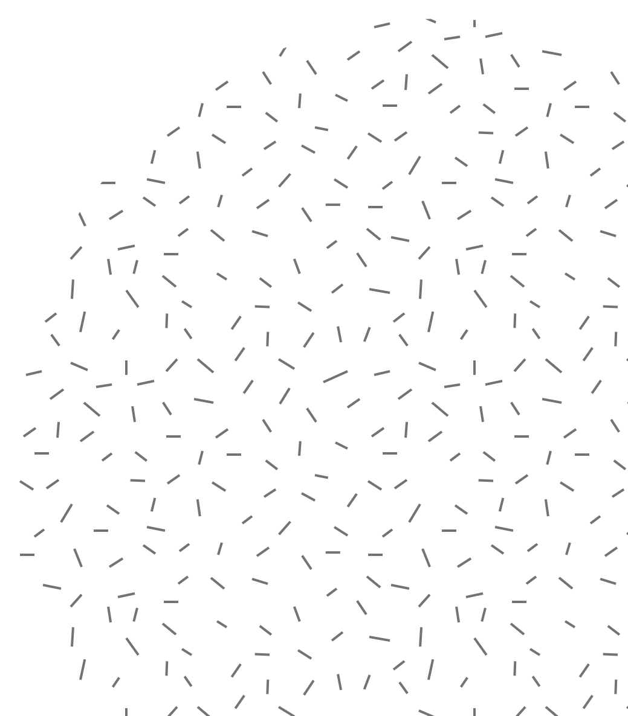

Slide 12
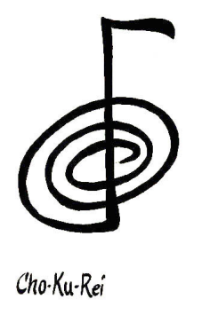
The Symbols ~ Level 1 Symbol:
Cho-Ku-Rei
This Reiki symbol is used to bring you into the energy field of Reiki, opening energetic channels in the body to the flow of Reiki. During your first attunement, you received this symbol in your field whether you knew it or not. But if you have been using Reiki, this is what you have been working with. Called Cho Ku Rei (choe koo ray), this symbol “turns on” the flow of Reiki when you begin to work, essentially acting like an amplifier. The physical body particularly likes this symbol.
Cho Ku Rei: The Connector Element: Earth
This is a beautiful symbol that can be used to consciously connect you to the Reiki energy at the beginning of each session. It has a warm, vital, loving feel to it. It says “Remember who you are.” Traditionally it is considered the symbol for physical body healing. It helps to remove energetic blocks in the body so that all energies flow through the body more evenly. It also brings into the conscious mind the unconscious attitudes, feelings or beliefs that are affecting us in a subtle way.

Slide 13
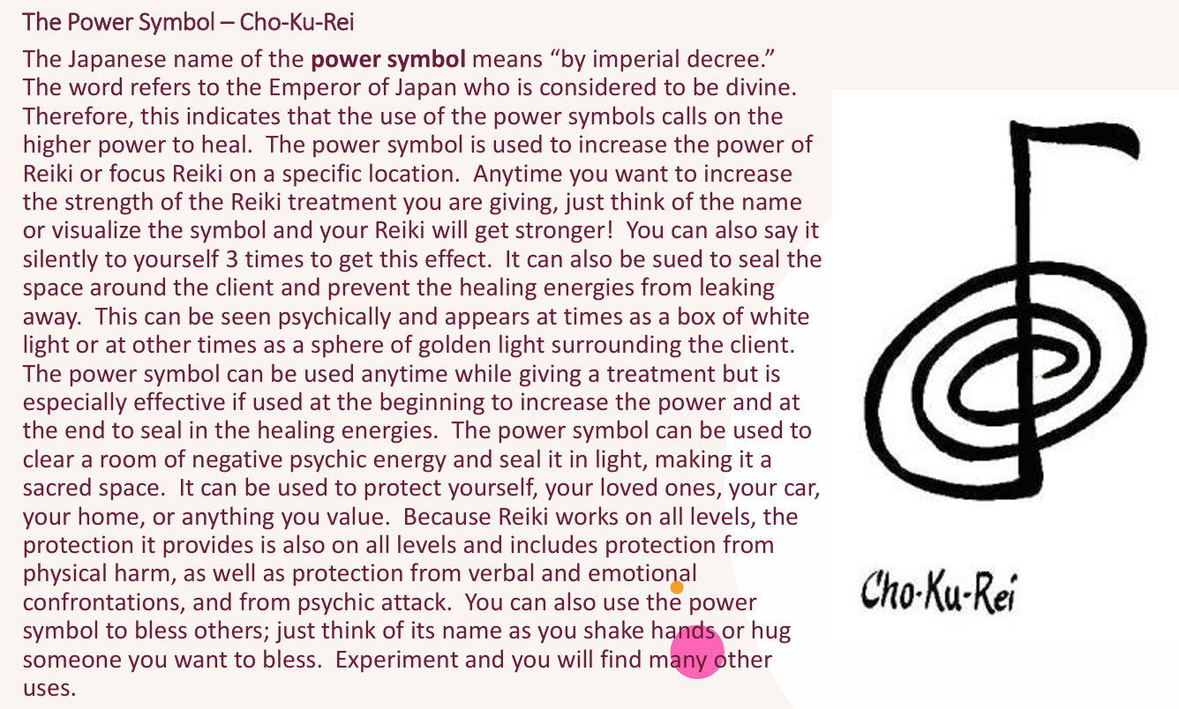

Slide 14
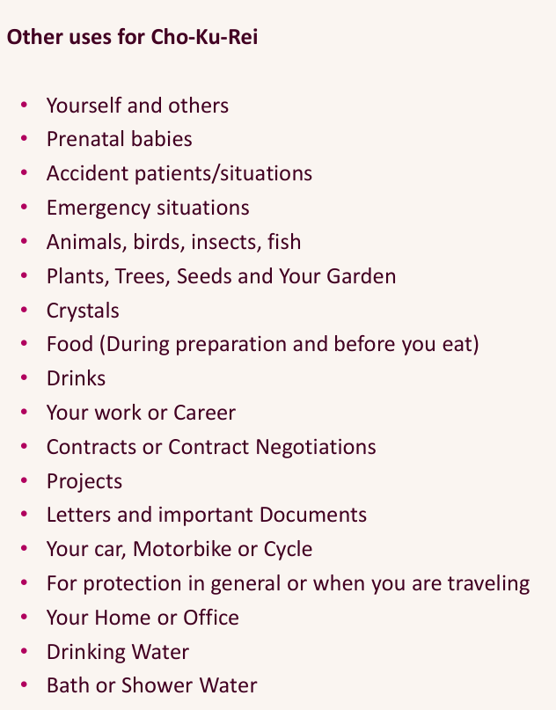




Slide 15
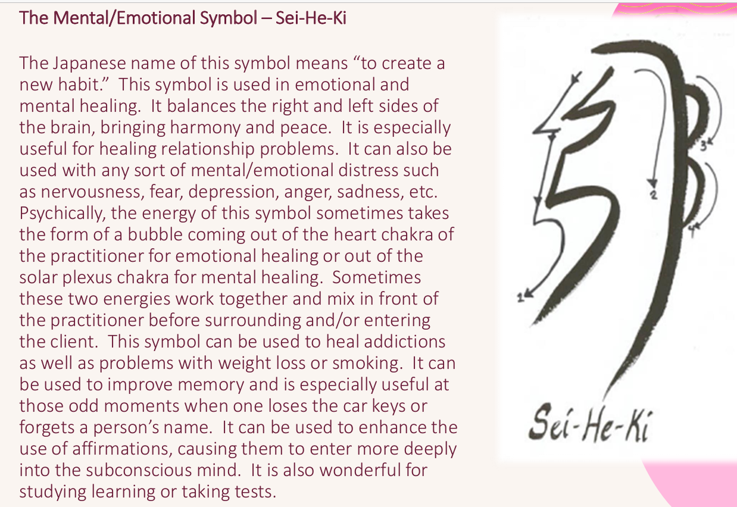

Slide 16
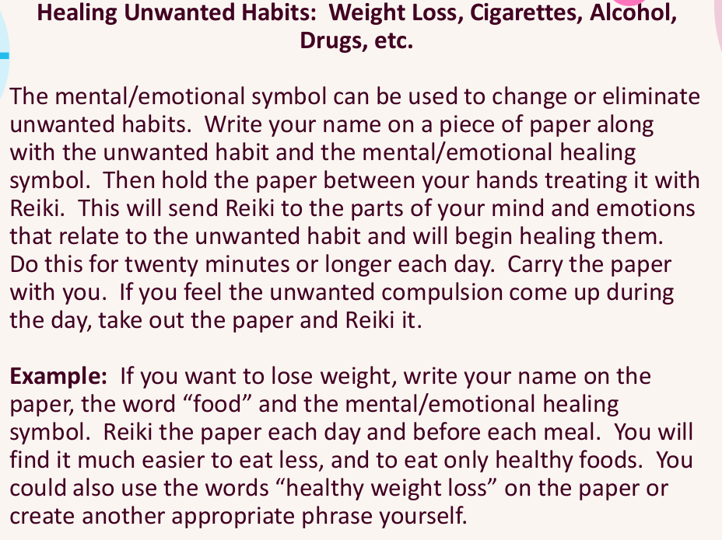

Slide 17
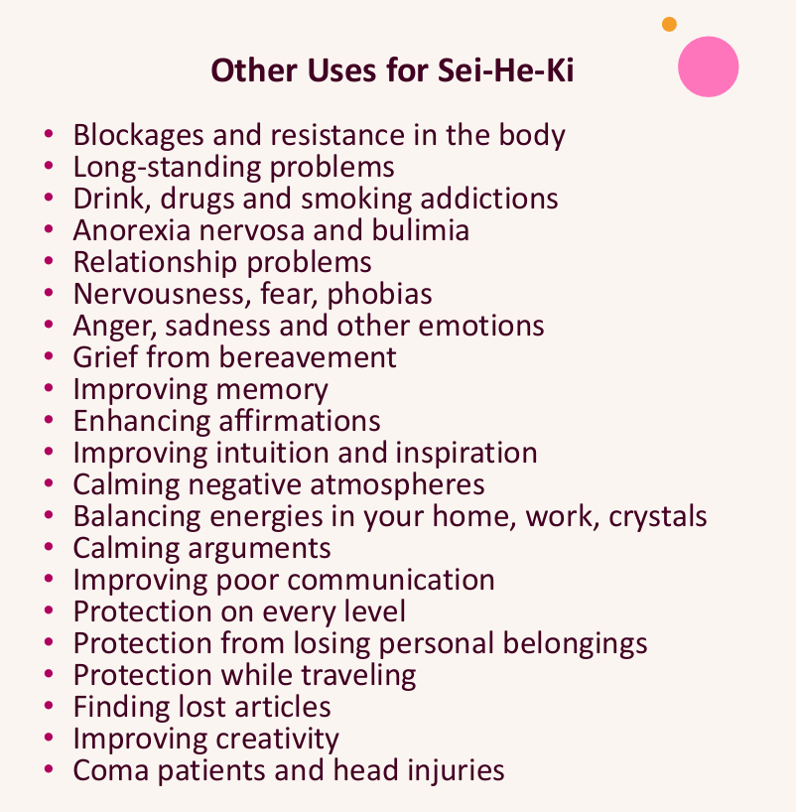

Slide 18
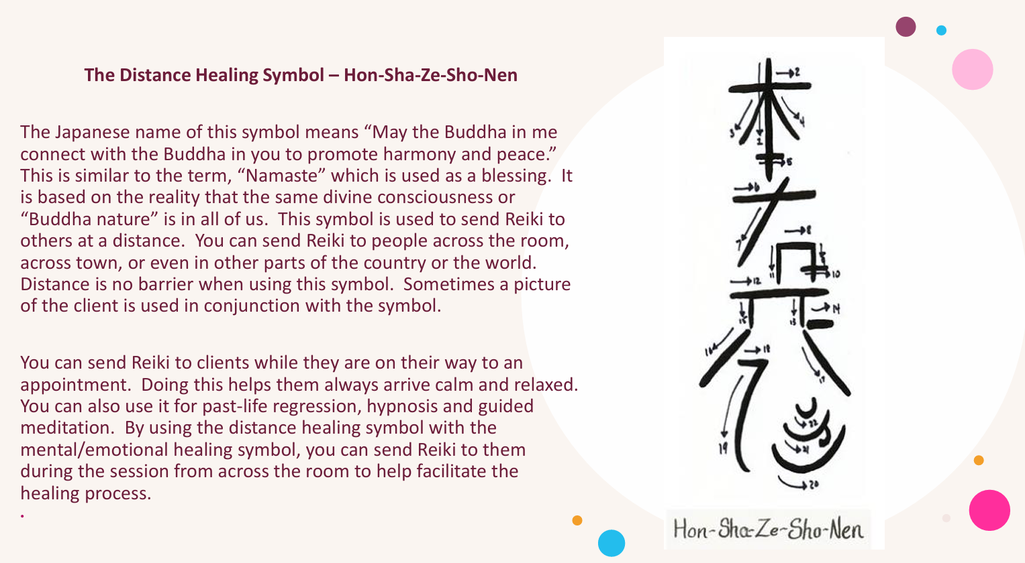

Slide 19
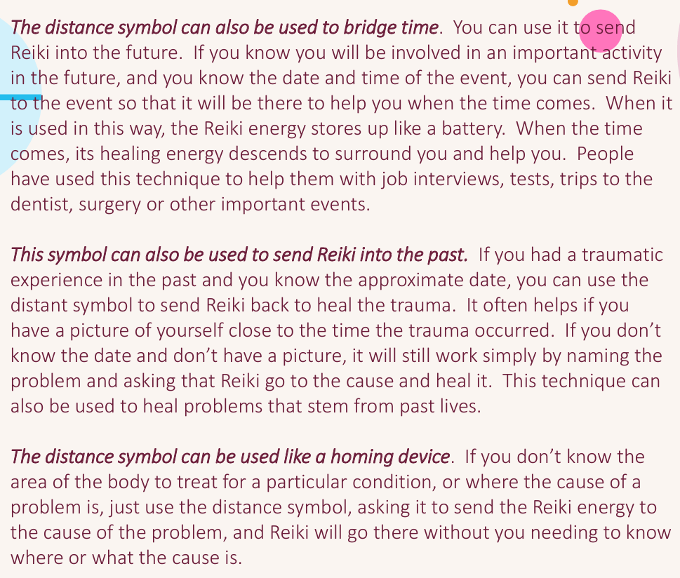

Slide 20
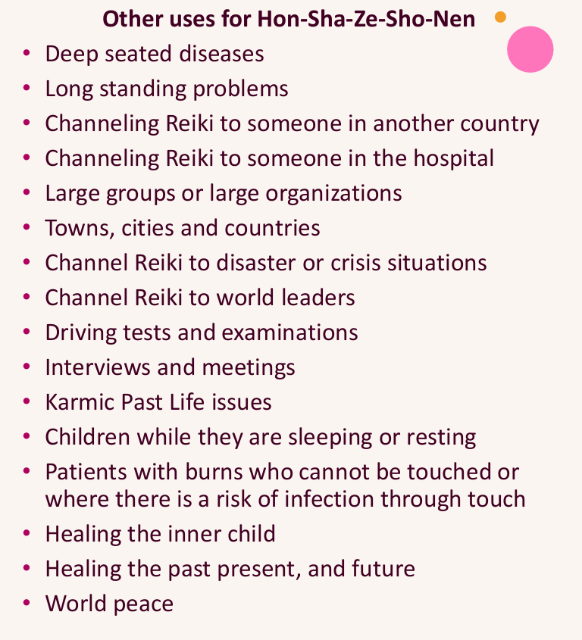

Slide 21
Your Reiki 2 Attunement will be like a guided meditation but much deeper.
In the beginning I will open a circle and call in all the Reiki Guides and the Reiki Guardians. These Light Beings of great power can be found at the further most edges of your light body and are responsible for bringing Reiki to the Planet. They are also responsible for the evolution of Reiki as the planet’s energy continues to increase. At the beginning of the Attunement meditation, you will be asked to connect with them. They are not to be confused with your Reiki Guides who are closer to our physical reality. Reiki Guides can be people you knew who have transitioned or who were with you if you used Reiki in other lifetimes. Reiki guides can also be pets who have transitioned and continue to participate with you in your healing work. Your Personal Spirit Guides may also show up as the meditation progresses.
After you have connected with the Reiki Guardians who will be conducting much of the attunement, you will be asked to connect to the Microcosmic Orbit and your Hara Line. You don’t have to do anything but open to receive. There will be pauses between each command to allow the energy to move through your body.
Reiki is brought into your body at 2 points: Center Above and Center Below. These 2 chakras are located about 12 inches above the Crown Chakra and below the feet. The Reiki Guardians will anchor the Reiki Symbols into the hands, third eye and Hara Line. Also, during this attunement process, the Reiki Principles are anchored into your heart. These five principals are part of the Reiki Tradition that all practitioners and Masters aspire to live by. To have them anchored into your heart is pure magic.
Reiki 2 Attunement

Slide 22
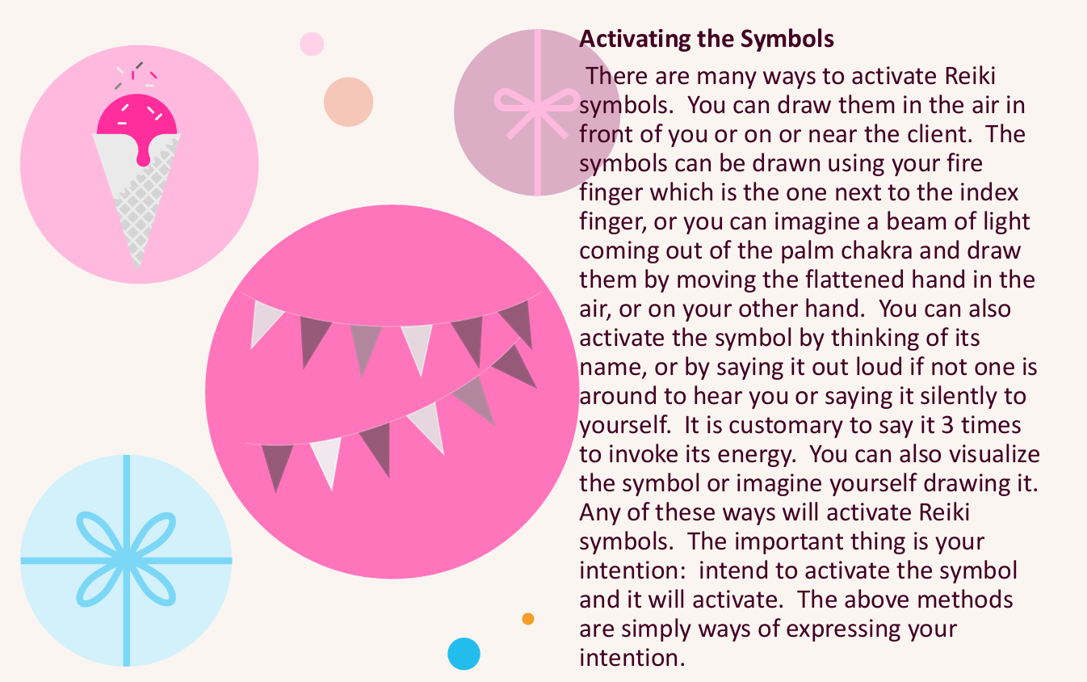

Slide 23
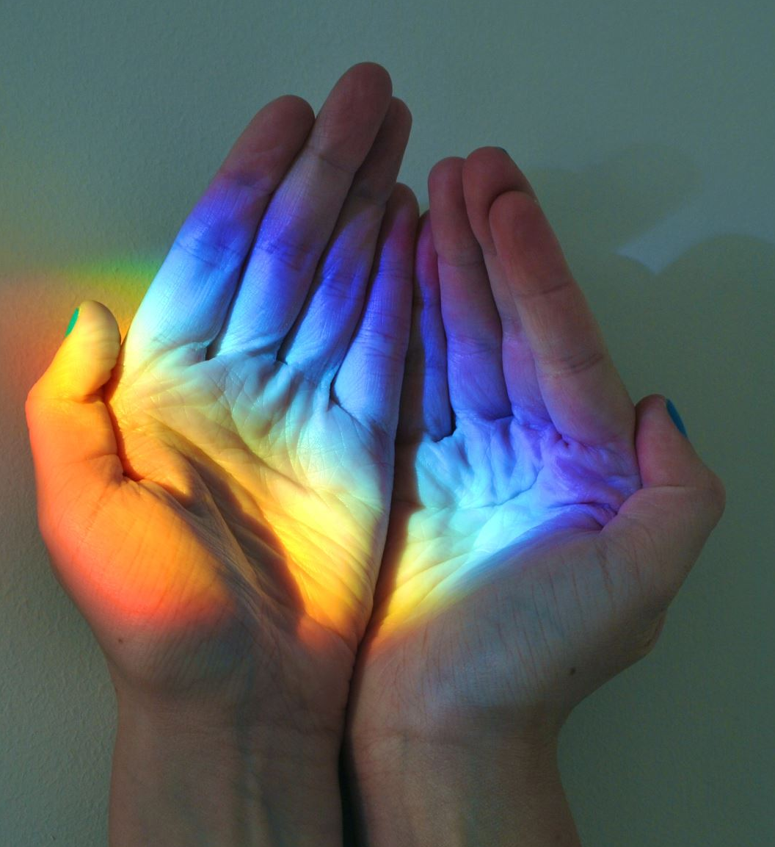
Giving Reiki
After the attunement, all that is necessary to use Reiki is to place your hands on yourself or another with the intention of healing. The Reiki energies will begin flowing automatically. You may notice that your Reiki will turn on by itself. You may notice this by the heating up of your hands.
It is not necessary to direct the Reiki energy. It has its own awareness and intelligence and by connecting with your own or the client’s energy field will know how to work and what to do. The best results are achieved by simply remaining calm and relaxed and enjoying the soothing energies that are flowing through you.
Note that while Reiki often goes to areas other than where one’s hands are placed, it doesn’t always do this. This is why it’s important to use all the hand positions in a session and to follow the guidance you receive while you are doing a session.

Slide 24
Working on Others…Right Energetic Attitude
Check your assumptions at the door about what is possible or what needs to happen.
Always honor a person’s innate wisdom about their time of healing.
Be careful of your language, which can unnecessarily limit another. Preface intuitive insights with “in my perception…” If a person asks for advice, make statements like, “If it were my problem or situation, I would…”
Have the intention of connecting core essence to core essence.
Let Reiki do the work. Check your ego at the door. Don’t worry about “if you did a good job” or not. You are not doing anything. Reiki is.
The psychic energy of the mind is an open, receptive state and becomes the observer. Do not send it into the client’s body. Reinforce this by connecting with the Reiki Symbols and your Reiki Guides.
Set up the room before the client arrives by drawing the Reiki Symbols around the room, the floor and ceiling and the table.
You may have a unique signature in the way you get intuition. The challenge isn’t to perceive the way someone else does but to understand how you perceive. Begin to observe when you self-edit your perceptions. Develop your intuition about when to speak and when not to speak about your insights. When in doubt, ask the client if they want your insight.
Observe how a person looks, feels, or sounds before and after working with them. If they aren’t noticing any changes in themselves, bring it to their attention.

Slide 25
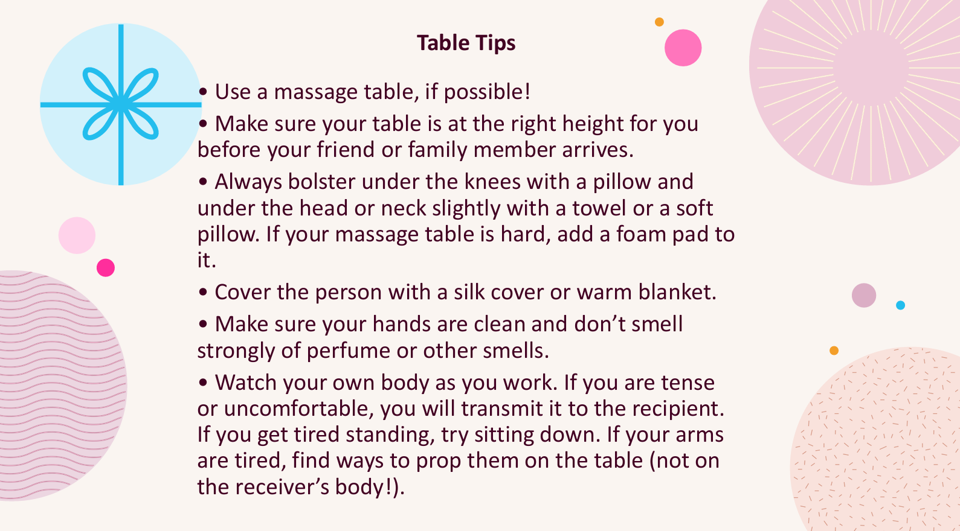

Slide 26
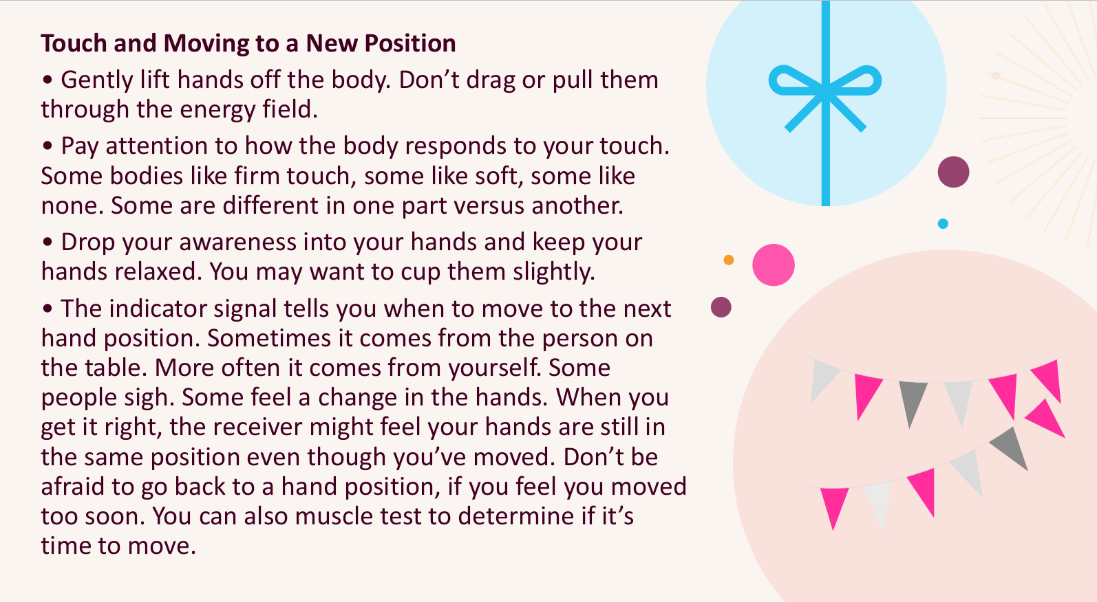

Slide 27
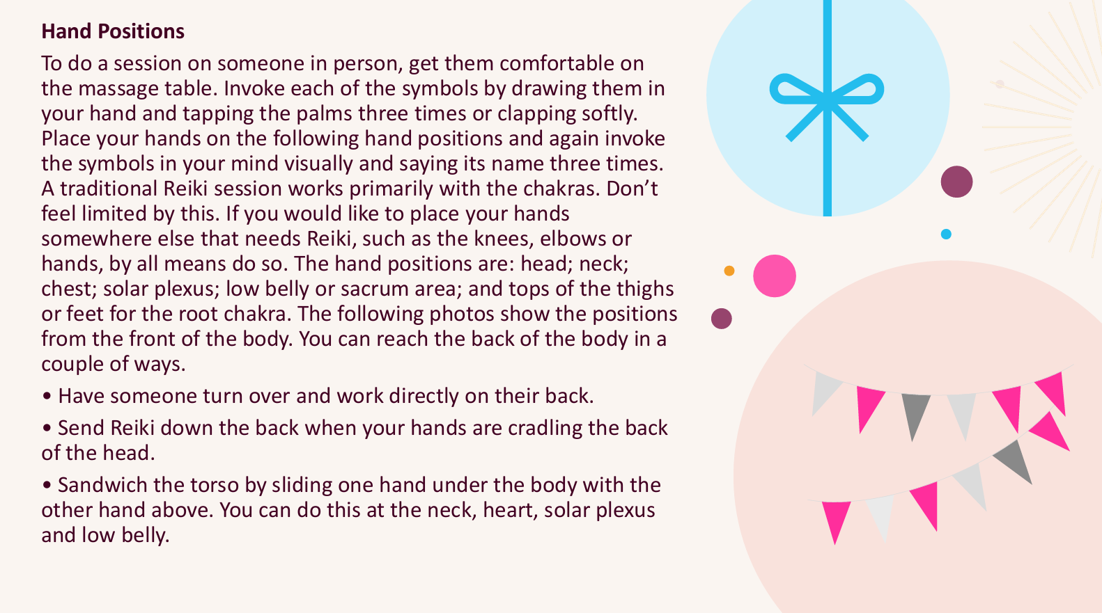

Slide 28
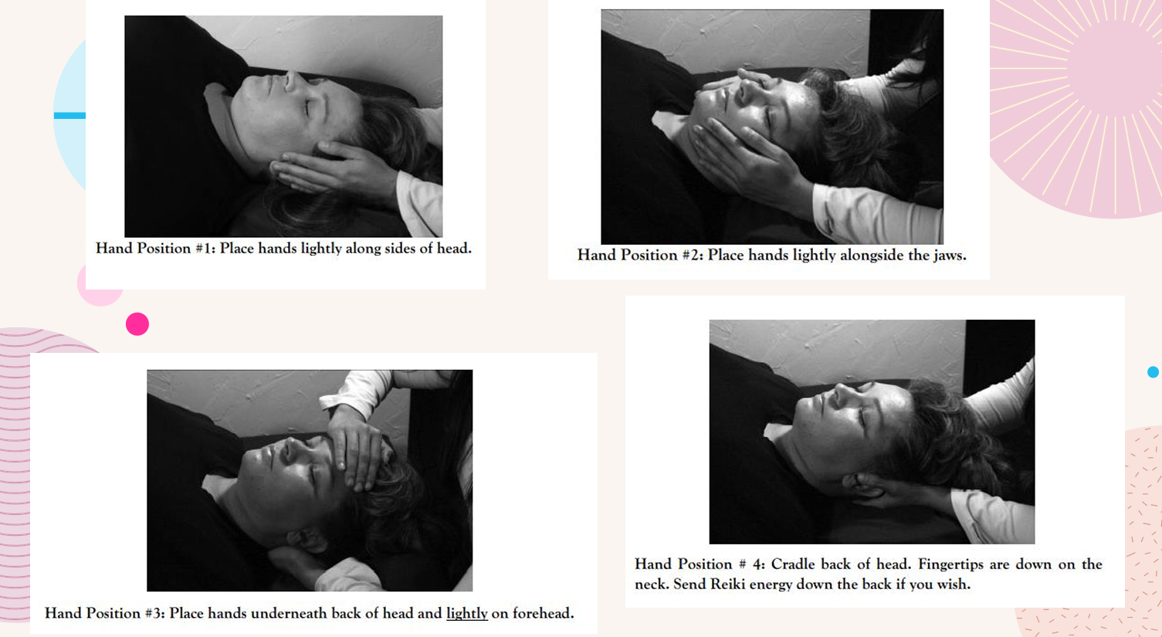

Slide 29
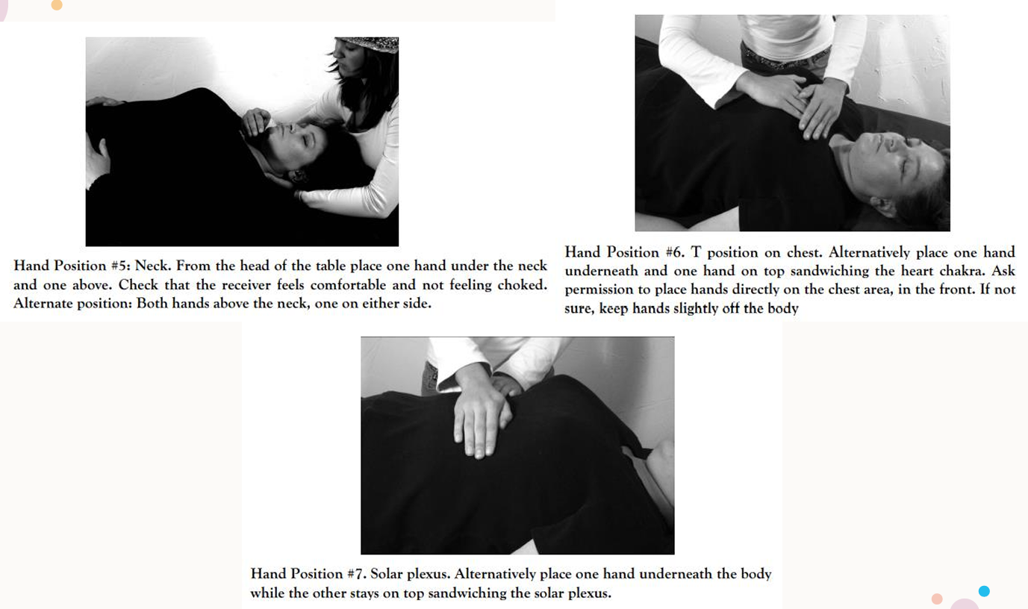

Slide 30
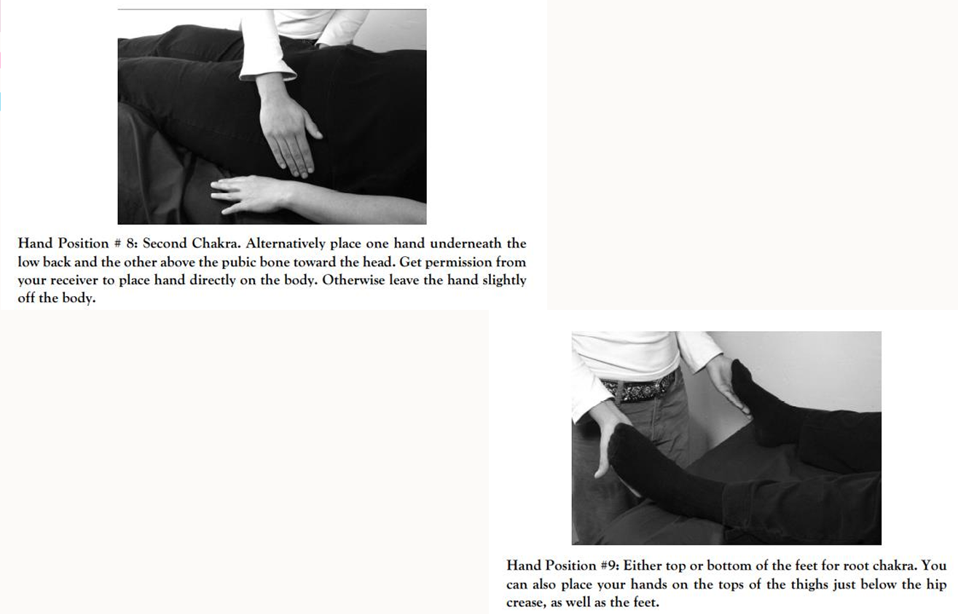

Slide 31
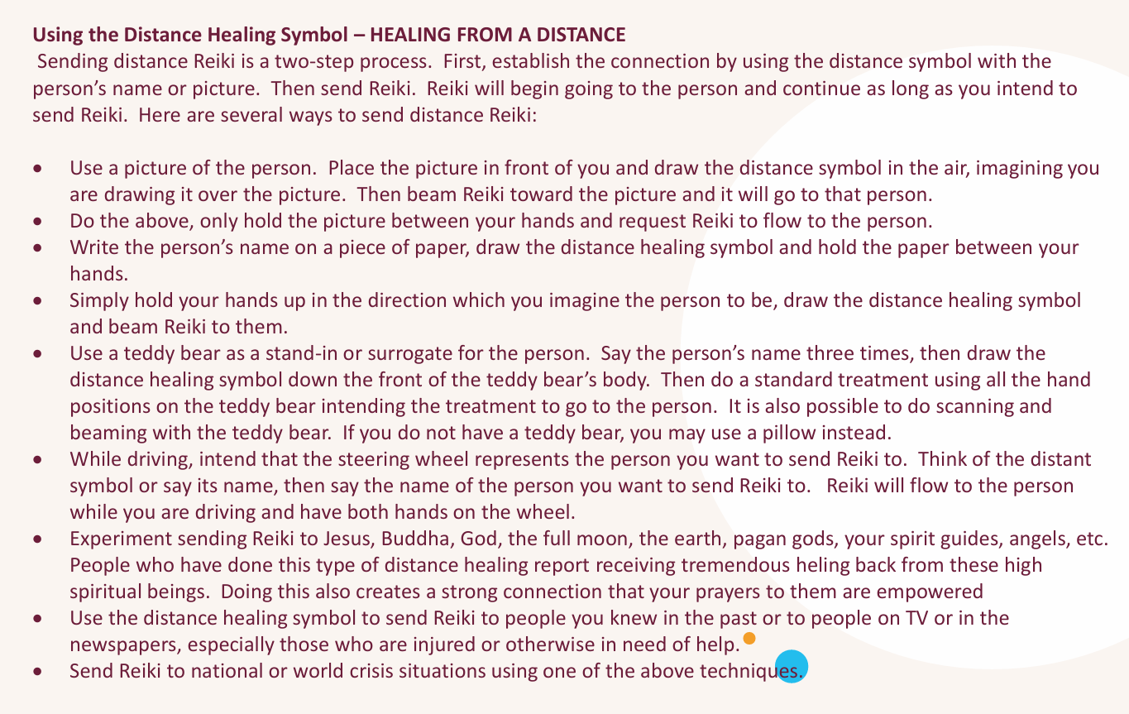

Slide 32
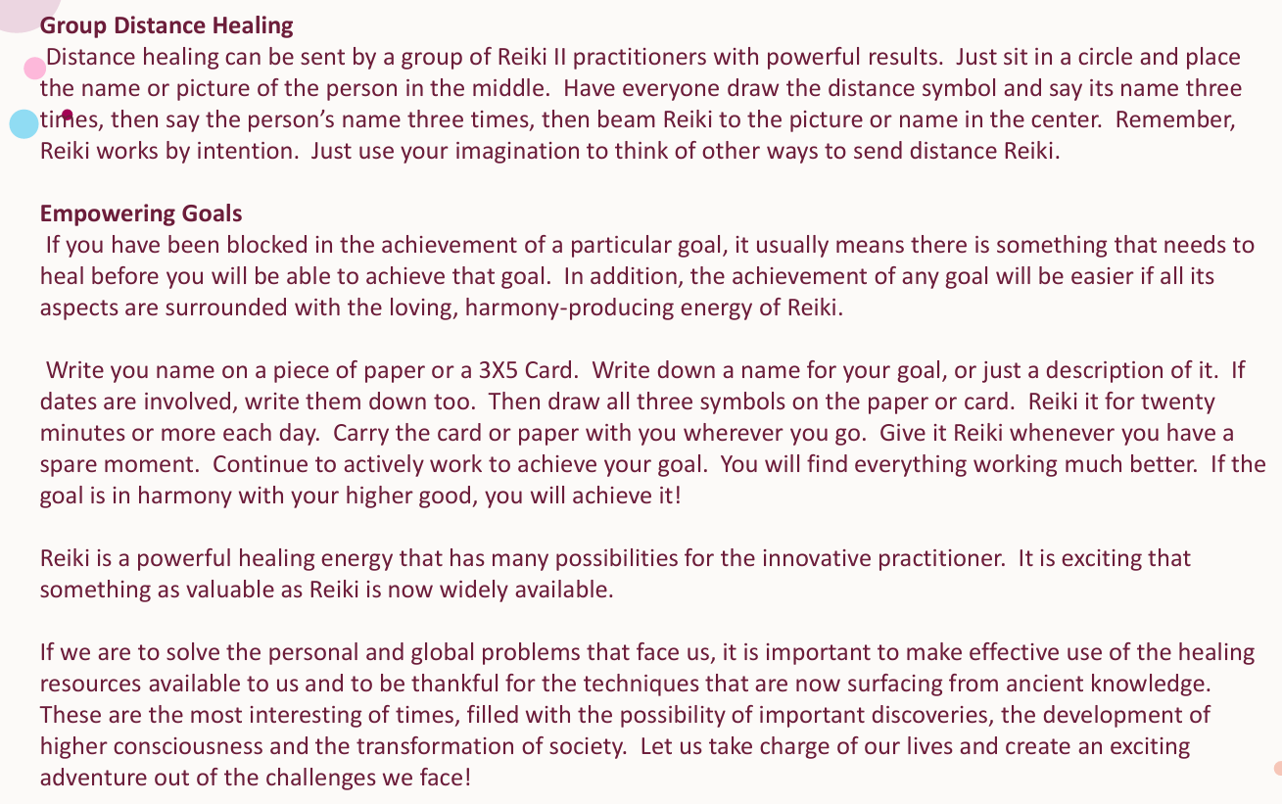

Slide 33

What Now?
Do a healing session on yourself everyday for 21 days.
Do the Embodied Reiki Meditation whenever you feel you need an extra boost. (Found below and in the After Reiki 2 handout)
Practice drawing the symbols. Learn them. Drawing them is a very meditative practice. Try drawing them and putting them around your home. Use Sei-he-ki to find lost items.
Use Reiki on anything in your own environment…pets, appliances, vehicles, anything. Experiment.
Begin working on others when you feel ready. Practice, Practice, Practice!

Slide 34
Embodied Reiki Symbol Meditation
Use this meditation to embody and activate your own conscious and energetic connections with the symbols. After this meditation you’ll have a more innate sense about when and where to use the symbols. Essentially, they’ll begin to create with you as they speak through your consciousness. After each level, return to this meditation and embody the new symbols with it. Typically, once is enough when doing this meditation, but if you found yourself forgetting the symbols, do it several times.
Invoke Cho Ku Rei (say it three times and draw it in the air). Picture it above the crown of your head. With your intent, see, perceive or imagine the symbol coming into the crown, slowly moving down through your head, throat, chest, stomach and then into the small intestines. Here you will embody this symbol. Observe what shifts and changes for you. When the energy completes shifting, move to the next step.
Do this with the other two symbols, one at a time. Sei-He-Ki and Hon-Sha-Ze-Sho-Nen
State the Reiki Principles with both hands on your chest. Invite them to become embodied within you.
Reiki Principles
Just for today I will give thanks for my many blessings.
Just for today I will not worry.
Just for today I will not be angry.
Just for today I will do my work with integrity.
Just for today I will be kind to myself and every living thing.

Slide 35
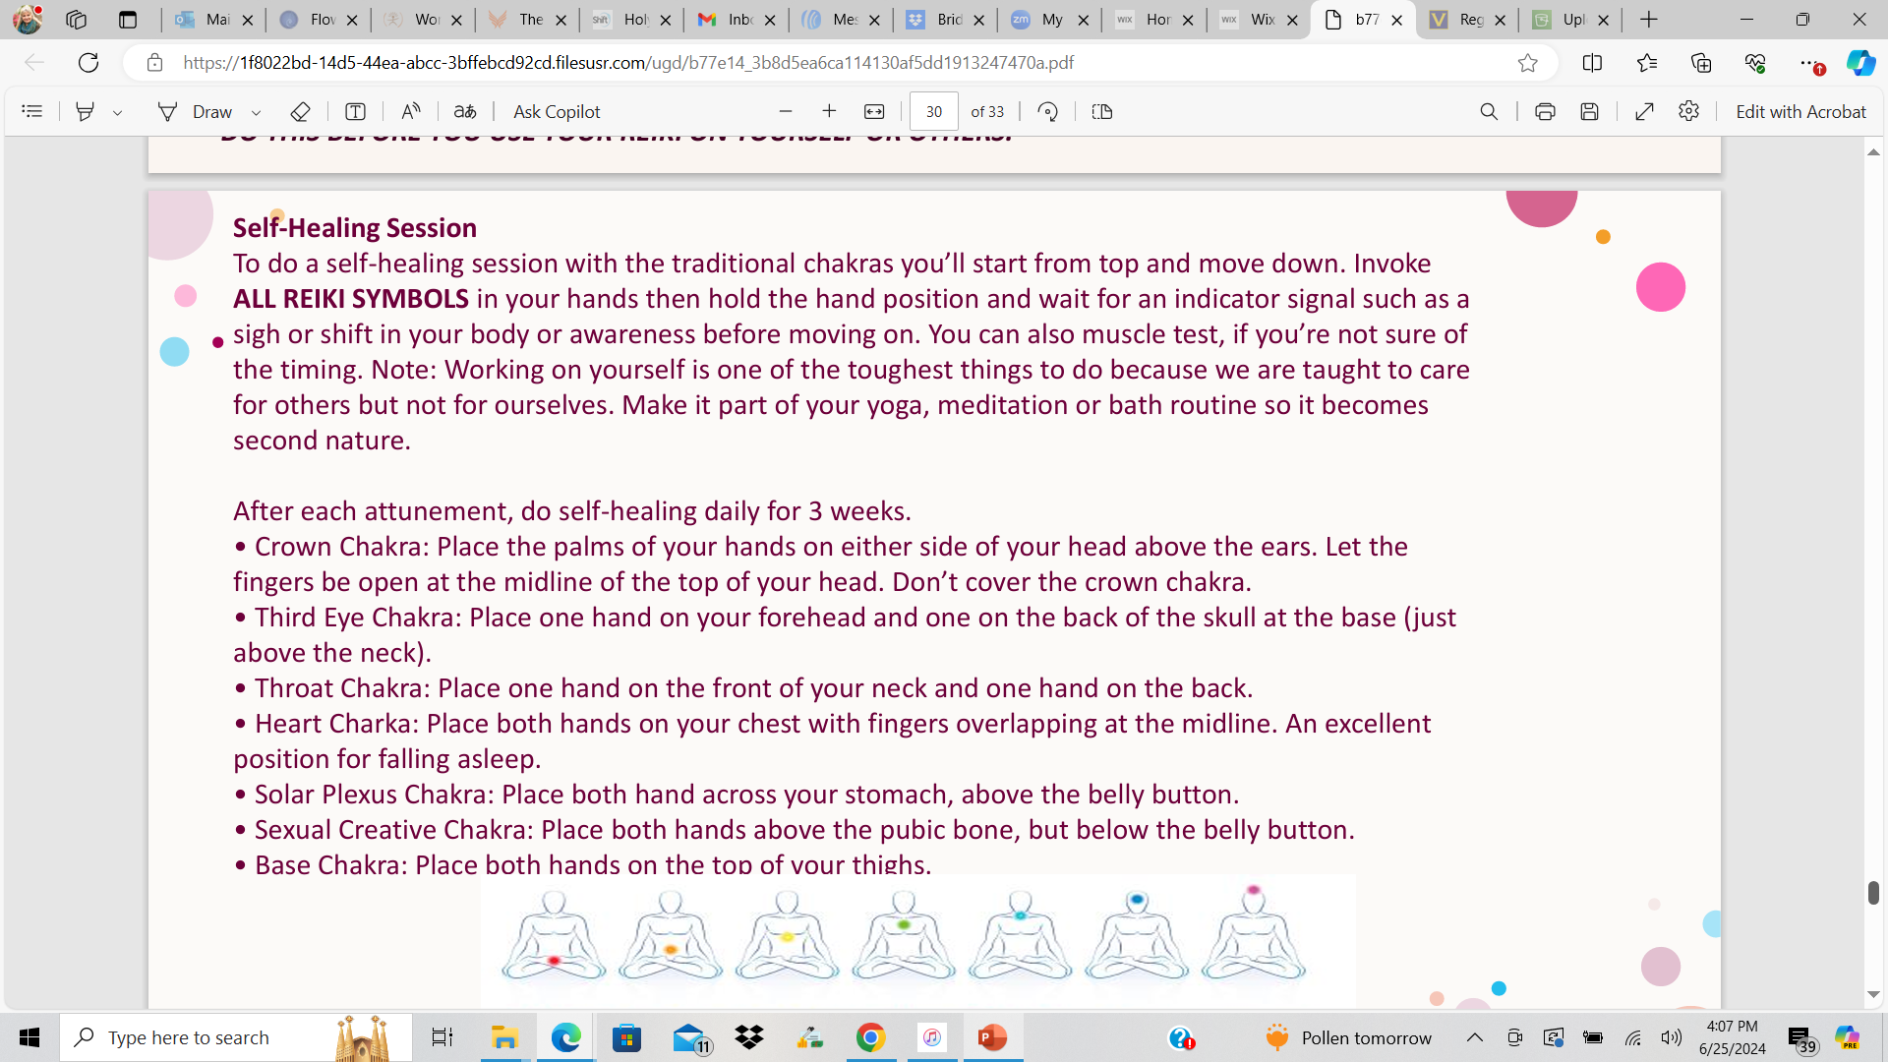
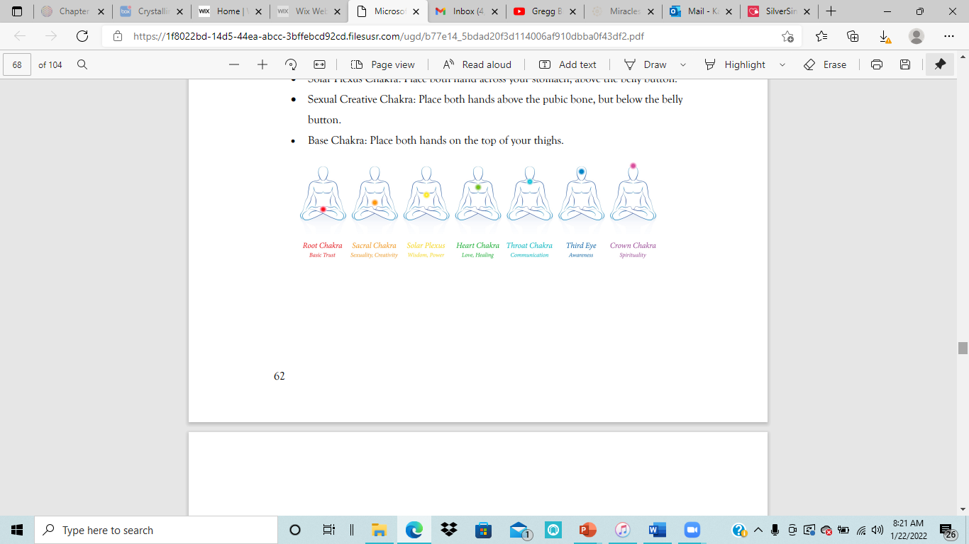

Slide 36

The Reiki Principles
Just for today I will give thanks for my many blessings.
Just for today I will not worry.
Just for today I will not be angry.
Just for today I will do my work with integrity.
Just for today I will be kind to myself and every living thing.

