Slide 1
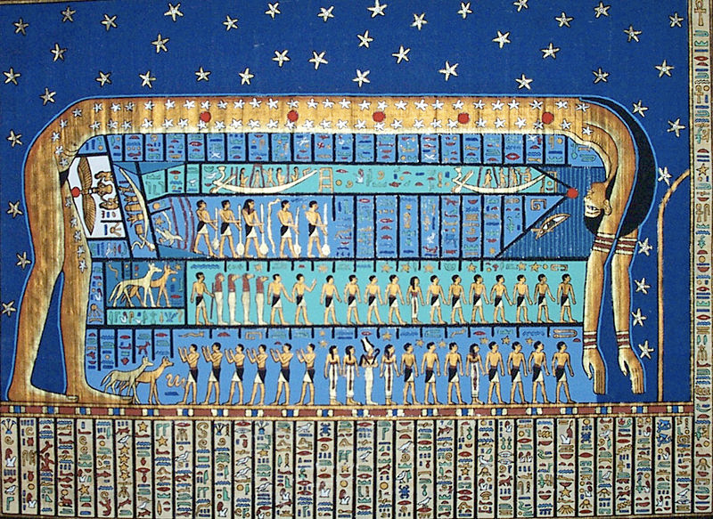
May be a old vow to the Goddess

Slide 2
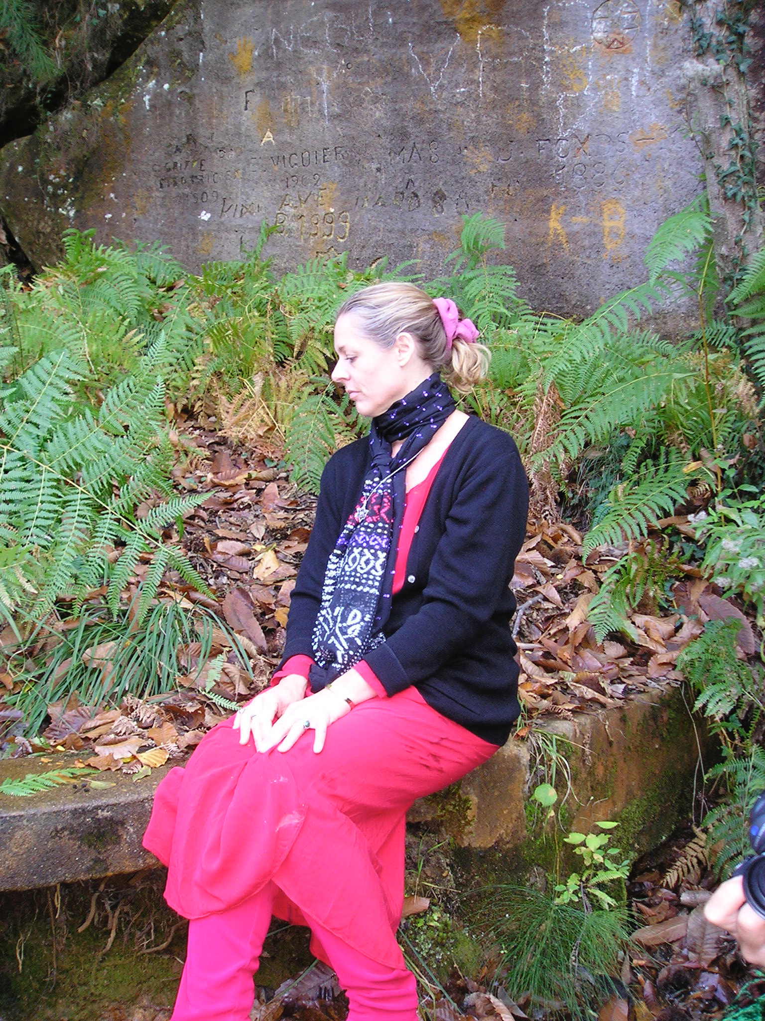
Family Lineage
Childhood Program
Past/Simultaneous Soul Expressions
Something in the collective field
Mass Consciousness Pattern

Slide 3
On Any Elemental Realm

Slide 4
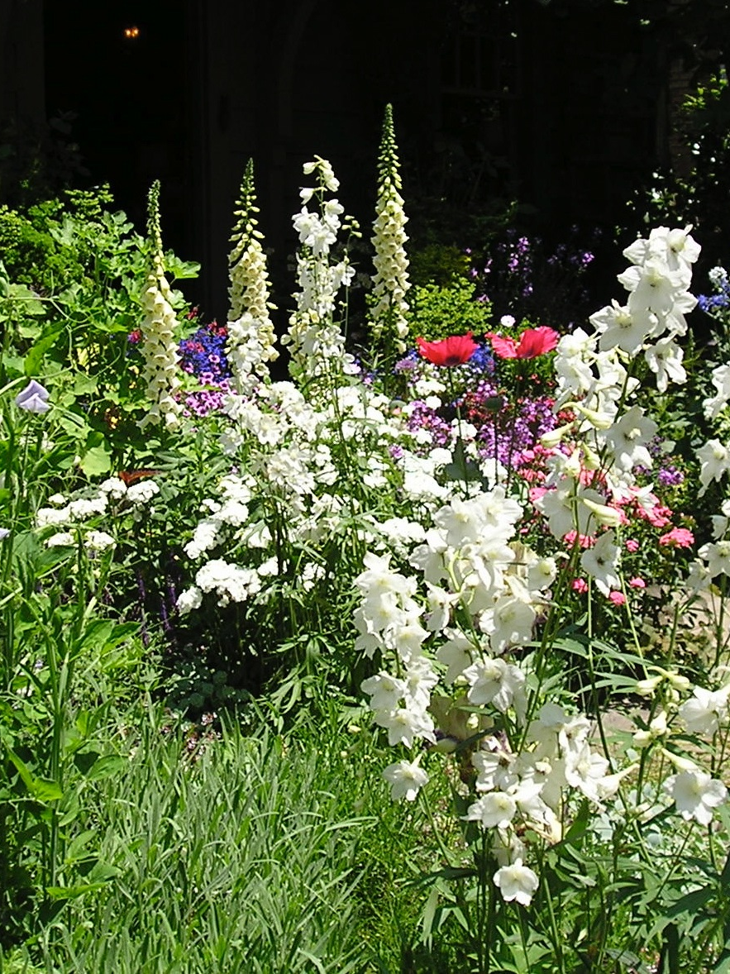
Earth Physical
May need physical ceremony
Bury something
Clearing physical space
Give away old objects with memories attached or clear well

Slide 5
Water Emotional
Take a clearing bath, epsom salts, sea salt, clay, essential oils
Feel your feelings, cry
Dance with your feelings No matter what you are feeling be mindful not to make it about others

Slide 6
Air Mental
Journal
Clear old beliefs
Deep breathing
Dance to release old beliefs
Mediate
Call on the priestess oversoul
Call on unseen help…Goddess, Nicole, angels, guides, ancestors

Slide 7
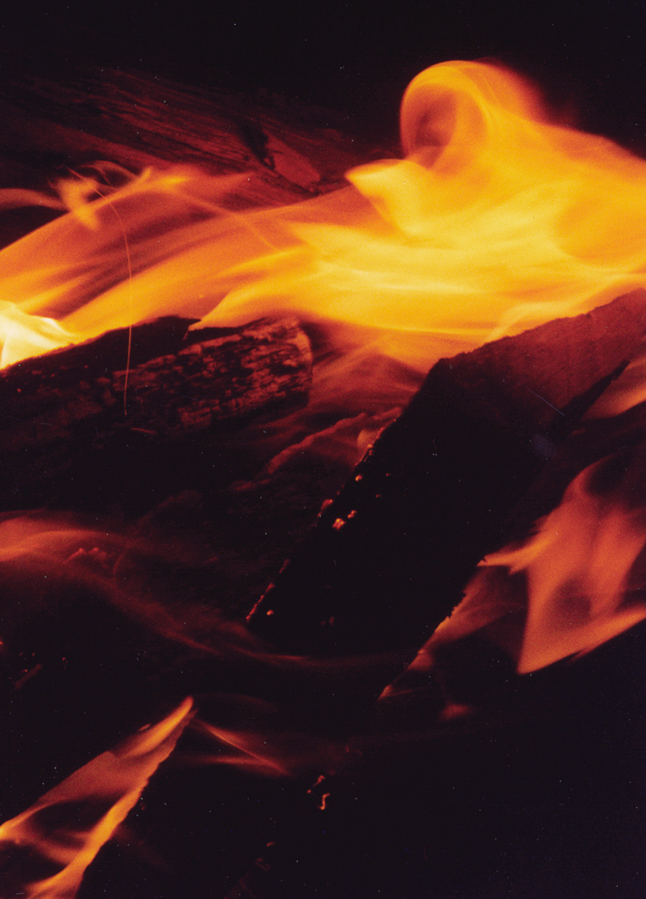
Fire Action Dance, Dance, Dance, DANCE!
Dance to release anger, fear, self-doubt, energetic blocks
Safely burn paper or old items
Light a contained candle

Slide 8
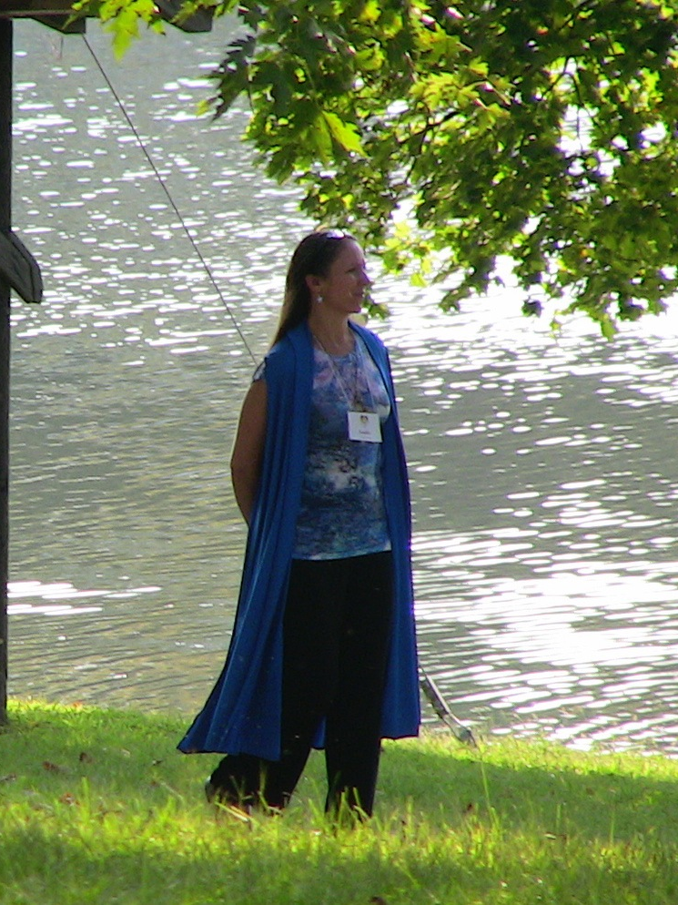
Spirit Realm
Old spiritual messages Notice, how is it influencing you?
Clear
Archetypal influences
Goddess/God pieces
Masculine/Feminine
Express your essence to clear
Make art, dance, sing, drum, collage,
call on the Divine

Slide 9
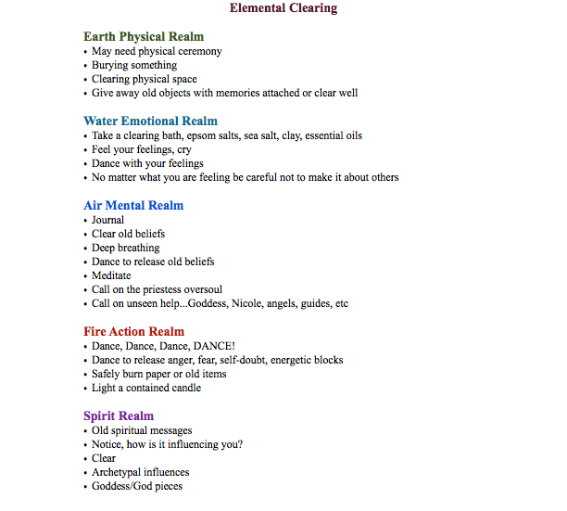

Slide 10
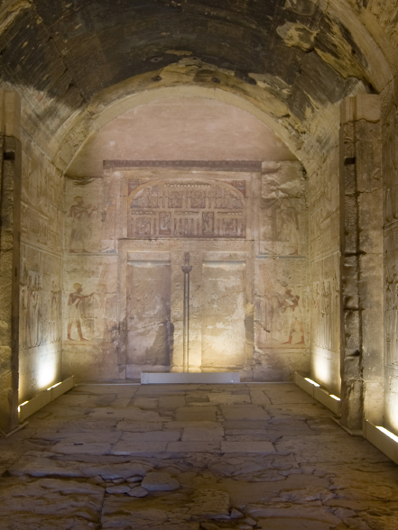
Clearing the Priestess Archetype Meditation

Slide 11
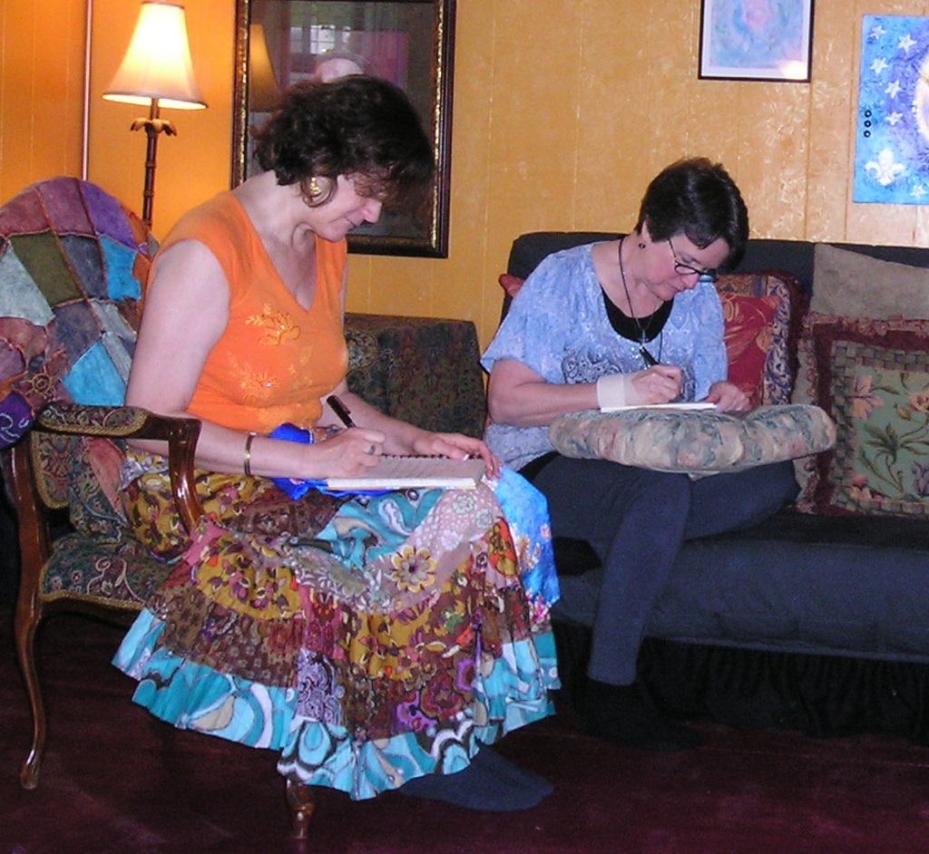
Journal Your Insights

Slide 12
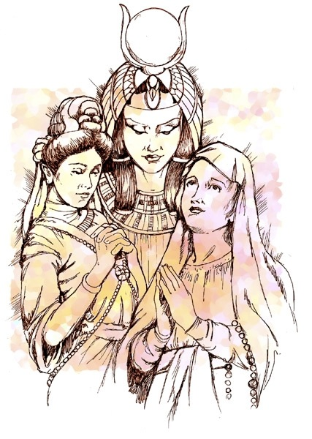
Ceremonial Preparation
Artistic Intention Statement Gift for the Goddess Candle to light and lighter or match
Prepare your space - turn off all distractions
Prepare yourself with a ceremonial bath
Dress as simply or elaborately as you like
Call in if you want to share your intention with the group (otherwise you’ll have a number to call to read it to me - so I can absorb the vibration)

Slide 13
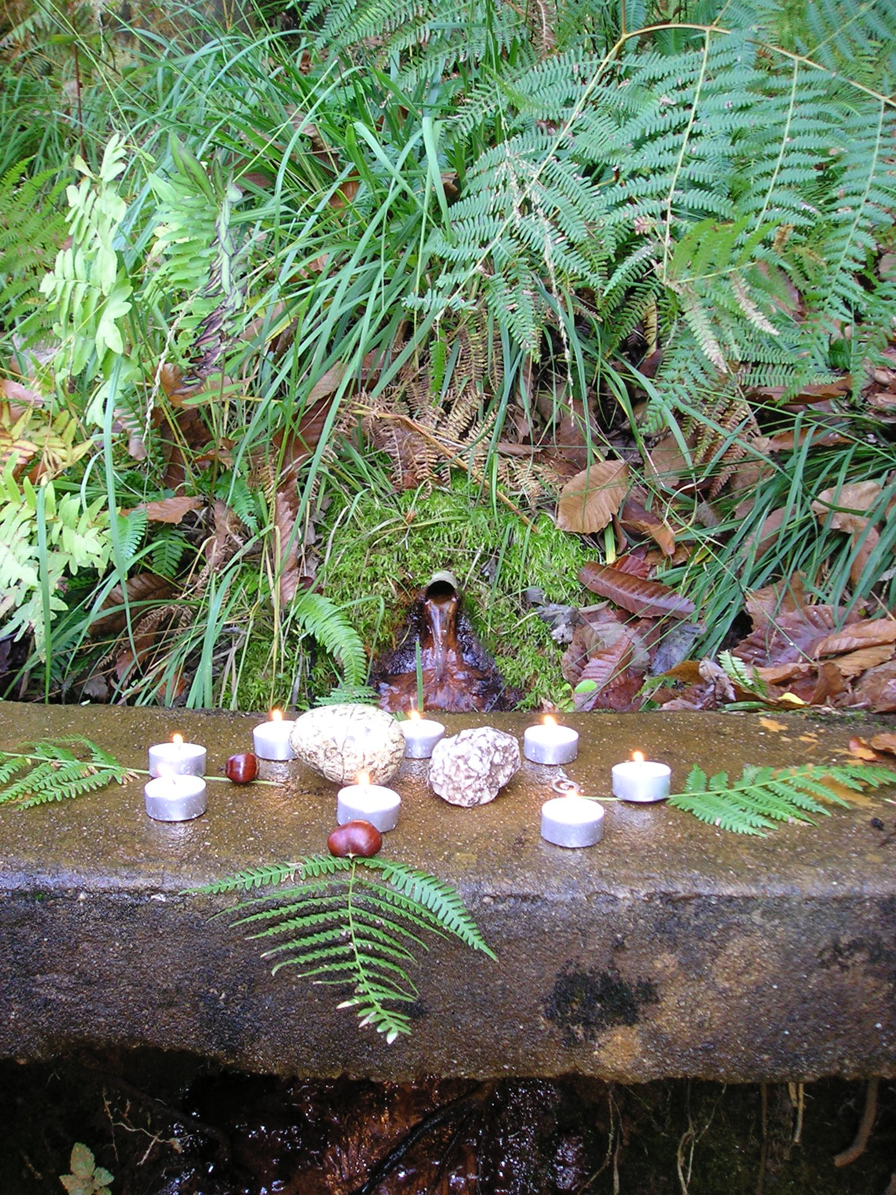
Contribute to Your Tracking Sheet
Gratitude
&
Closure

