Slide 1
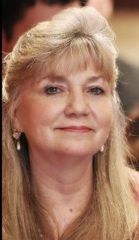
Class 1 Body Wisdom Boot-Camp
with Kathy Daugherty

Slide 2
Laying the Groundwork for our practice, Setting our Intention,
Structure and Process

Slide 3
Calling in Sacred Space

Slide 4
Open Your Creation Vessel
To Receive

Slide 5
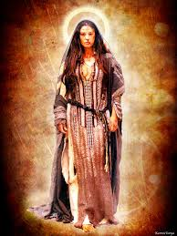
"The information—the tools—necessary to make
the radical shift needed on this planet in a
very short period of time are housed
within the wombs of women of this age.
You have the ability to heal your planet and
save your world. It is up to you.
Do you desire to keep this beautiful haven a
safe place for the next seven generations and
beyond? Do you desire a place for your
children to grow and learn? " --Mary Magdalene

Slide 6
My Intention for this program is to train as many women as I can to:
honor the Divine Feminine in herself, and to teach the next seven generations to do so.
raise her vibratory rate, knowing that as she does, she raises the vibration of the planet and all of humanity.
see this as her Sacred Duty and consider it an honor and privilege to serve her fellow beings in this way.

Slide 7
What is Your Intention for this Process?

Slide 8
The path back to your power is through your body. Your body holds the key. This is the very important thing that most women forget..

Slide 9
Our bodies are literally keyed in to the rhythms of this planet. By knowing this rhythm and aligning with it, you harness the energy of the Universe in your very own body. The methods used to do this, have been with us for centuries, but they have been hidden. Many of them are so simple that we may take them for granted. Others we may have never heard of. But they are easy to use and learn…and when you do, magic happens.

Slide 10
This body of knowledge is based on the premise that in order for our physical body to remain healthy, our spiritual life must be healthy. Much of this information revolves around the health of the female womb space. It has sometimes been called a woman’s second brain, because it controls so many of her hormonal cycles which in turn influence her brain chemistry and ultimately every other aspect of her life. This information is not only important to women, but to all of us who dwell on the planetary womb of the Earth. As long as this part of a woman’s body is disrespected by society, planetary health will suffer. But when this part of a woman’s body is honored and treated with respect by all of humanity, our planet will again begin to flourish. When we all, men and women, begin to remember the birthing place as the center of our universe and our existence, both in a literal and metaphorical sense, we will come to know that when our physical body temples and minds are healthy, we can effect change in our outside world.

Slide 11
Our culture has given us a legacy that, in ancient times, was unheard of. Traditionally, a woman’s menstrual period was a very sacred time, for this is when a woman is most spiritually in tune and most sensitive to her surroundings. She is more open and able to receive messages from Spiritual guidance that will aid her in living a more harmonious existence. Indigenous peoples incorporated systems into their cultures that made use of this time in a powerful way for their tribes. They created a “moon” lodge or “bleeding” lodge where women could learn from other women how to care for their bodies. They could share with other women about their feelings and concerns, and utilize this time to receive messages from higher forms of guidance. They would also do this on behalf of the tribe. As they learned how to care for their bodies in an appropriate way, their wombs, and consequently the earth, remained healthy.
However, as these traditions were lost, life on this planet became a bit more dicey. As these systems have become non-existent, our lives and our relationships have become more and more dysfunctional. Women are no longer connected to their sacred center. They are usually “working” during their bleeding time and experiencing all forms of discomfort during this time that our western world has come to know as symptoms of PMS. Anyone who has had this experience or been on the receiving end of someone having this experience, knows how miserable it can be for everyone. Because women are in such pain, men no longer respect them or their womb space during this time. It is a time we all tolerate, but really don’t enjoy…at all!

Slide 12
But none of this chaos is necessary. PMS and it’s symptoms can become non-existent by re-establishing a few simple practices. And these practices not only benefit women who do them, but men can also benefit from many of the practices that in the past were reserved for women’s circles. None of them are unusual or strange. They are simple, practical practices to keep your energy body fed, your chakras open, and your physical body healthy. These practices help you WAKE UP your Spirit Self and enliven the passion you were born with. I will be introducing you to practices that allow you to access your intuition, anchor your consciousness deeply within your physical body and thereby, enhance your physical experience. These practices will follow the wheel of the year as most of this information is “keyed in” to the cycles and seasons of the Earth itself.

Slide 13
Practices we want to start incorporating…
*A Daily Spiritual Practice – a quiet time, at least 15 minutes, but preferably an hour, to connect with yourself and your intuitive guidance;
*A Healthy diet – live food…period. I am personally a vegan because it is the best way of eating to support my spiritual pursuits. You may find this is too strenuous for you. We will discuss it in depth and let you make any changes you desire at your own pace;
*The Use of Energetic Tools – I will be suggesting tools for you to use such as herbal tea, crystals, bath salts, flower essences, essential oils. THIS IS ONE OF THE MOST IMPORTANT PARTS OF THE PROGRAM! All of these tools will help you begin to lift the toxic emotional debris that tends to cling to us and keep us heavy rather than light. They are designed to raise your vibration and eliminate resistance to doing that.
*Guided Meditations and Movement Activations -- Because I will be offering these tools online, I want to make sure the teachings go deeply in to your psyche. I have found that moving the body is a great way to “ground” teachings into our core. I will be offering time during and throughout this class for you to “move your body” during class. These are called activations, and trust me, they will activate and enliven the teachings you will be receiving. I will also offer guided meditations to further anchor the teachings within you.

Slide 14
Re-connecting to the Sacred Cycles
Because we are endeavoring to reconnect with the cycles of the planet, a good time to spend extra time connecting is during the new and full moon windows.
The beginning cycle for this year begins on the new moon, January 27, 2017 at 6:07 pm Central Time. This is the turning point when we begin fresh for the year. The energy of the new and full moons shows up at least a day before and lingers for a day after the event, so it is always good to pick one of these days to do a little extra altar time and connect with this energy.
One tradition that lends itself well to this is the Seneca tradition written about in Jami Samms’ book, The 13 Original Clan Mothers. This tradition holds that each of these cycles are governed by or “vibrate with” a special grandmother that holds an aspect of Mother Earth’s personality and helps us understand healthy living practices upon the earth.

Slide 15
The SACRED WINDOW
This year, we receive a bonus!
A whole Moon Cycle with the
13th Grandmother, Becomes Her Vision!
She joined us December 29, 2016 at 12:54 am Central time. This particular Grandmother is special, in that she holds the energies and, therefore, the gifts of the Moon Cycle Portals of all the other 12 Grandmothers.
That means we have access to the whole year of learning for the next 28 days! Talk about a timely life review right at the beginning of the coming year: 2017!
If you do a personal altar for your personal practice, connecting with this grandmother at this time would do wonders to enhance your process during our time together.
Other archetypal energies that lend themselves well to this Portal are Lakshmi, Parvati, or Saraswati of the Hindu tradition, Isis of the Khamitic tradition, the Goddess Dianna, and of course, Mother Mary and Mary Magdalene from the Christian tradition. Connecting with any of these guardians will allow you to make a connection to the real you, the Divine You that dwells within. Allow them to help you purify your heart within and without, so our outer world reflects our inner world.

Slide 16
The Grandmother this Month: Becomes Her Vision
The Guardian of Transformation and Transmutation
The Keeper of the Emergence of Spirit into Physical Form
The Mother of Alchemical Changes and Rites of Passage into Wholeness
The Guardian of Personal History, Becoming, and Myth
She teaches us:
How to become our visions and own our wholeness;
How to release the old Self and step into the realized dream;
How to honor the process that brought us through the changes and transformation;
How to mark the Rite of Passage into Wholeness and Celebrate the Vision we have become;
How to BE THE TRUTH.

Slide 17
The Importance of
A Daily Spiritual Practice
My definition: Anything that opens your heart, that gives you joy, and connects you to your Higher Wisdom and Noble Thought.
I teach this first is because your physical body needs a Spiritual practice of some sort like it needs food! Notice I said Spiritual Practice—not religion. The religions of this planet, up to this point have been vehicles for encouraging and training in Spiritual Practice. However, many have a tendency to focus on the “type of religion” and skip the practice. The practice is the point of religion and not the other way around. If you skip it, you miss it, and your body pays for it.

Slide 18
This…
verses this…

Slide 19
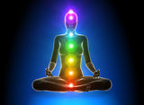
The Human Energy Field
Scientists have now coined the word, “bio-photons” to refer to the tiny particles of actual physical light that make up this electro-magnetic field. This field “Sources” the physical body and keeps it functional. It literally feeds and supports the physical body and actually keeps it functioning in a healthy way. It holds the physical parts together and keeps them bathed in nourishment.
But this field needs attention and support in order to function properly, as well. So how do we feed and Source our Energy Body—the beautiful field of living light that surrounds our physical body and holds it in form? What does it need to be healthy? This is the part of you that houses your soul. So another way to ask that question is, “How do you feed your soul?”

Slide 20
NECESARRY INGREDIENTS
FAITH: Trust in “The-Spirit-that-moves-in-All-Things;”
PRAYER and/or MEDIATATION: A way to communicate with that energy that feels good to you; and
TIME: set aside to make that connection for yourself.
PURPOSE
To raise the vibration of the physical body to keep it healthy;
To Source your energy body to allow you to maintain your presence here on this physical plane as long as you desire.

Slide 21
Things you might want to include in your quiet time:
Prayer
Silence
Music
Create an Altar
Meditation
Candles
Dirt time
Chanting
Affirmations
Painting
Reading Sacred Material
Divination Tools
Dancing
Yoga
Sacred Bath
Energetic cleansing tools (essences and oils)
Walking or running
Journaling

Slide 22
Energetic Events
I want to mention a word here about what some would consider “strange” things that might happen as a result of taking this course, and doing these practices (or even attending this class today.) Your body records every event that happens in your life. It is not ignorant. It is your WISDOM! So when you chose to pay a bit of attention to it, (and for women, especially when you pay attention to your womb space) you may have experiences that let you know that you are on the right track. These can show up as simple synchronicities or intuitive hits. For women it can be anything from starting your menses to skipping a cycle altogether and anything in between. You may also start to “hear” your inner voice or the voice of your womb or another part of your body. This is normal and will usually pass after the first month or so. But it might be wise and fun to record the event and even dialog about it in your journal. If it causes you concern, please feel free to contact me.

Slide 23
Homework – The Basics…
•Begin Daily Epsom Salt Baths
•Drink 8 glasses of water a day
•Begin your day with warm lemon water
•Gather your Energetic tools
Portal 0:
Flower Essence: Star of Bethlehem
Essential Oil: Frankincense
Raspberry Leaf Tea
Begin a Daily Spiritual Practice
Begin to look at your diet-incorporate
more live whole foods and eliminate
processed foods.
Dirt time!!!

Slide 24
SACRED JOURNAL QUESTIONS
Each class we will have a new set of questions to journal about as we embark on this sacred journey together.
For today, for our New Beginning, as you prepare your intention statement,
Ponder this…
We are getting ready to enter the portal of the Root Chakra…
What is the one thing, that if you changed it, it would change everything?

Slide 25
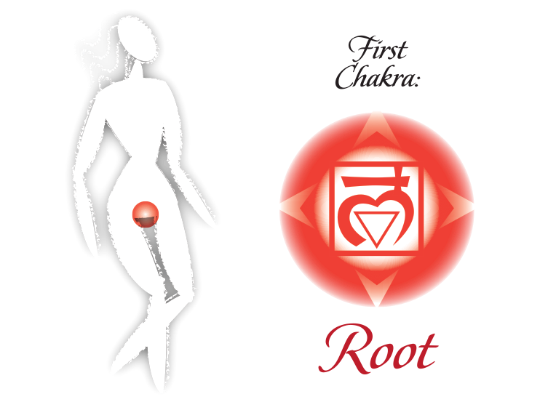

Slide 26
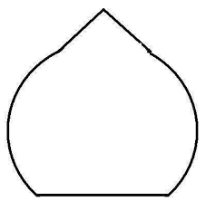
Air
Mind
Earth
Physical Body
Spirit
Core Essence
Fire
Action/
Movement
Water
Emotion

Slide 27
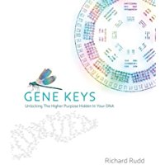
“Fractal – refers to a phenomenon found in natural systems whereby patterns are found to endlessly repeat themselves holographically. The more you magnify a fractal image the more more self-similar patterns you will find hiding within it…No matter where you go in the fractal, yuou find the same patterns repeating infinitely into inner space.”

Slide 28
First Chakra is foundational – the baseline. It is where you develop your internal relationship with the elemental forces. It contains how you relate to them to formulate your existence. This happens mostly on the unconscious level. But the more we begin to make this work conscious, the more we can begin to effect serious change in our lives. The reason is because, when you begin to shift things at this level, we are working to shift the fractal. So especially in the beginning, it may feel dense and heavy. But its because we are here at the root. So if you feel resistance during this process, that is why.
It’s also why rather than battle it, we take the approach of excellent self-care. Our plan is to give ourselves 21 days of being ask kind to our body as possible, so we can begin to awaken and re-engage her in her sacred work

Slide 29
Guided Meditation

Slide 30
Integration Dance

