Slide 1



Slide 2

Welcome to Reiki III
Giving Attunements
What you will learn and receive…
A mini-review of REIKI
How to do all 3 attunements by hand.
How to use the guided meditations!
Where to find all the resources
What to do after class…resources.

Slide 3
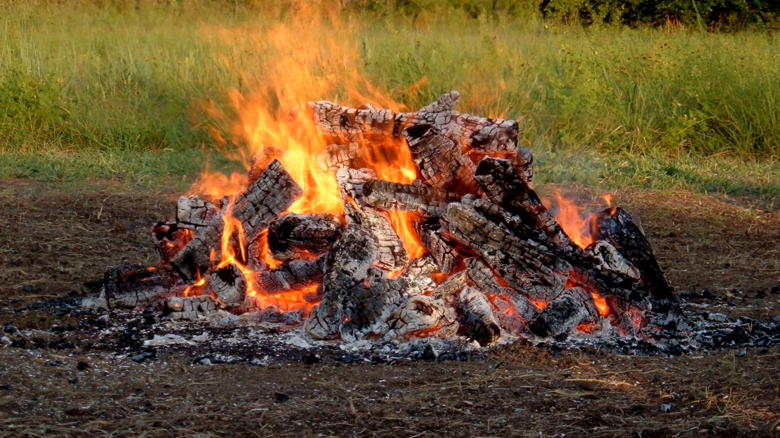
Calling In Sacred Space…
Open to receive…

Slide 4
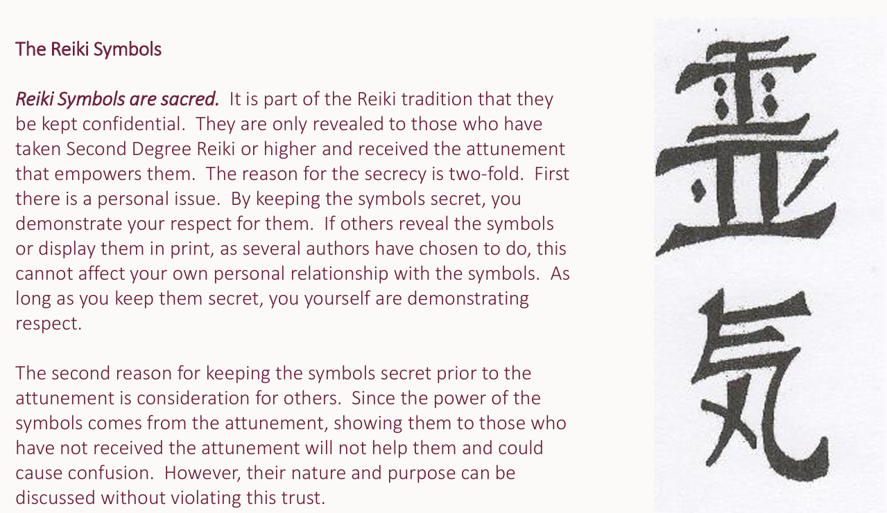

Slide 5
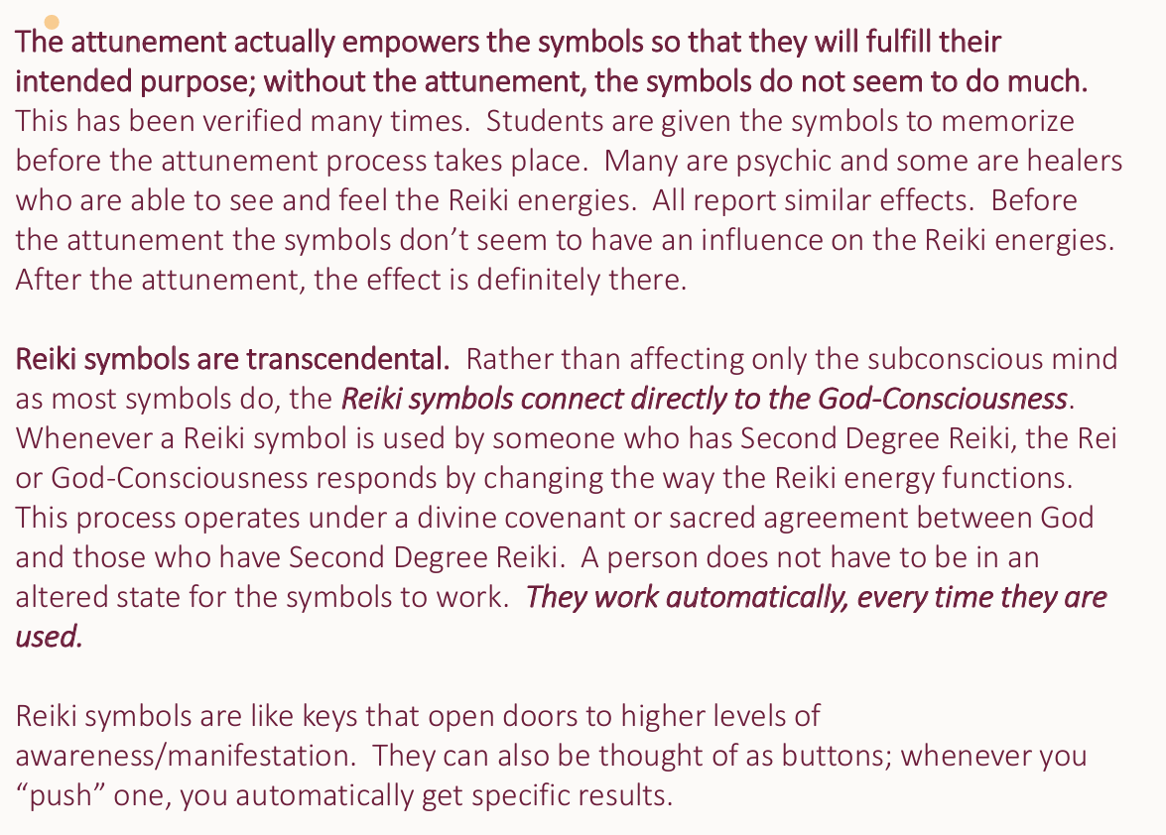

Slide 6
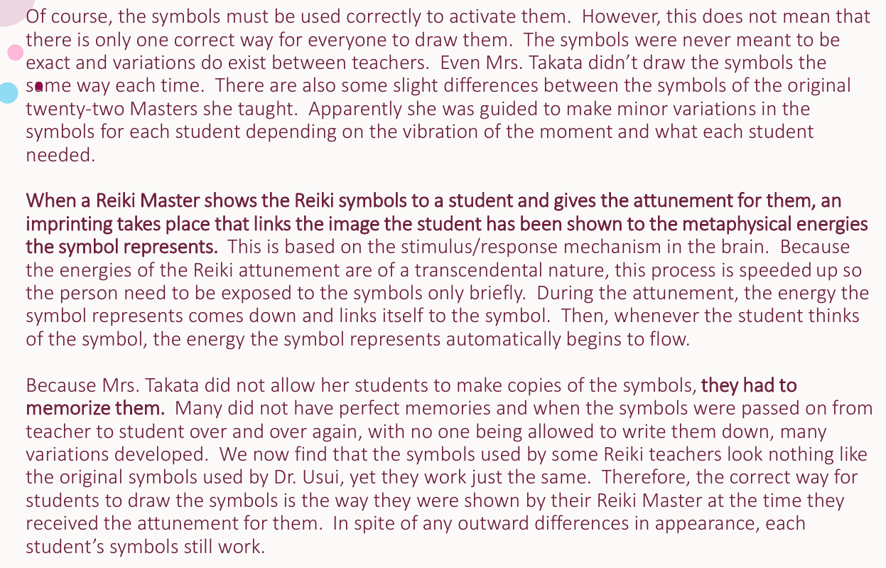

Slide 7
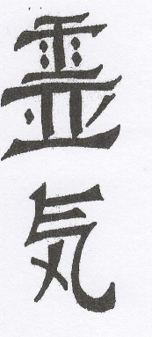
Reiki Attunements
The Reiki attunement is a sacred spiritual initiation that connects the initiate with higher levels of consciousness and an unlimited source of healing energy. It heals and conditions the crown, heart, and palm chakras for their use in channeling Reiki and makes other adjustments in the student’s energy system necessary on an individual basis. Reiki is a gift which comes directly from the highest spiritual source and as such, should be treated with the greatest respect. It is unique in that there are no requirements of spiritual purification necessary for it to work and in order for a person to receive the attunements. This includes the Reiki III attunement wherein one can go on to become a Reiki Master/Teacher. Therefore, the term “Master” in connection with Reiki is a special one that does not carry with it the same meaning as a spiritual master who is free of all karma, completely purified and enlightened. In fact, the Japanese word for this level is Shinpiden which means mystery teaching.

Slide 8
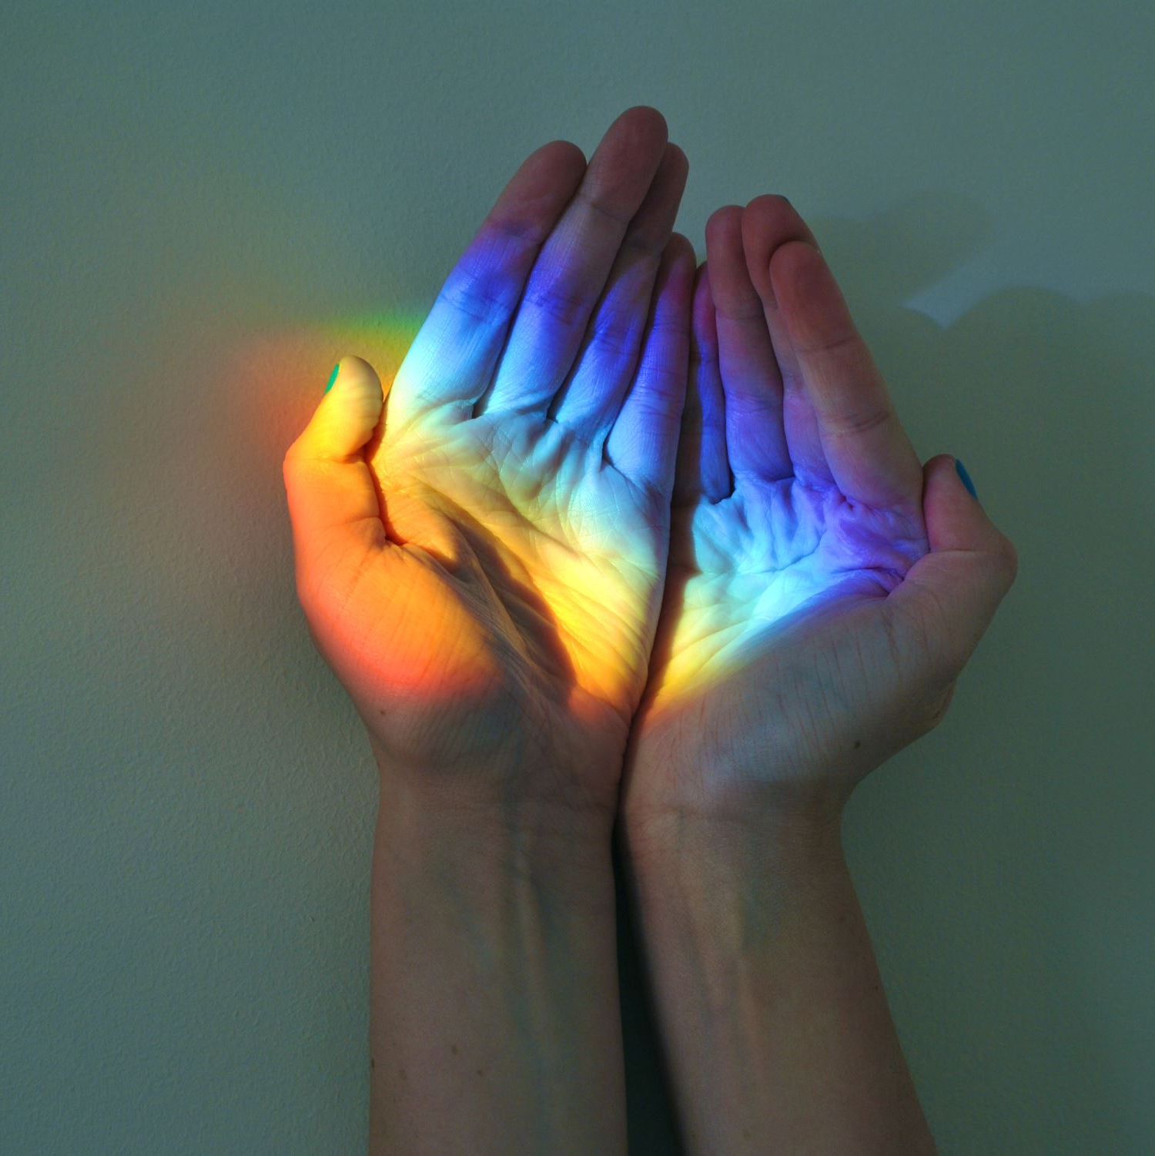
Anyone, regardless of the degree of their spiritual development can receive the ability to pass on Reiki to others. Because of this, the level of spiritual development may very from student to student, but all have the ability to heal. Therefore, all Reiki Masters/Teachers are equal in that they all have the ability to pass on Reiki to others. However, their ability as teachers and their understanding of Reiki does vary and is determined mainly by the standards of the individual teacher or school where they have studied, along with personally developed skills and experience.
If it were necessary for a person to be completely pure and free of fault in order to teach Reiki, we would have very few Reiki teachers on this planet. This is the unique value of Reiki; anyone can receive the ability and in a matter of a year or so of dedicated practice become a qualified teacher. This makes Reiki a healing technique of special importance for the period of development in which we presently find ourselves when the consciousness of the planet is advancing so qu9ckly and there is a significantly increased interest in spiritual healing.

Slide 9

Giving Reiki Attunements
There are several different techniques in use for giving Reiki attunements. All of them are effective. I do both in-person and online attunements. The in-person are traditional and have been distilled to include the use of the two Tibetan Reiki symbols and four Usui symbols. It is a powerful, yet very simple technique. The on-line version is a guided meditation that engage the Reiki Guardians, the Masters who brought Reiki to the planet. Both of these techniques work remarkably well.
Intention is the most important in giving the attunements. The Reiki spirit guides who work with you get their cue as to which energies to use and what to do from your intention. This is why you should include a statement in the beginning prayer as to which attunement you intend to do. This also means that even if you are unable to visualize clearly or even not at all, or if you don’t draw the symbols perfectly, or if you don’t feel anything happening, or if your confidence is low, it doesn’t matter. The attunement will take place anyway simply because of your intention. Attunements work in the same way that Reiki healing energies do. They flow automatically whenever you intend them to.

Slide 10
Preparations Before Beginning an Attunement
Before actually beginning the attunement, follow these steps:
Before students arrive, draw all 4 of the main Reiki symbols: Choku Rei, Sei-he-ki, Hon-Sha-Zi-Sho-Nen, and Dai-Ko-Myo on each wall ceiling and floor. Draw Choku Rei in each of your chakras as well.
After you have taught the class and introduced whatever symbols you are attuning, briefly explain the attunement process to your students and especially that you will be touching their head, shoulders, hands, etc.
If you choose, you can open a Reiki Wheel, inviting the Reiki Guides of each direction to join you. You can also state which attunement you are doing.
Have the students place their hands in the Gassho (prayer) position and lead them in a centering/grounding meditation.
Draw the 6 Reiki symbols in the air in the center of the room intending that their energy fill the room.
Draw the Tibetan Dai Ko Mio, Usui Dai Ko Myo and Choku Rei on your palm chakras. Draw Choku Rei down the front of your body.
Move behind the student, place your hands on their shoulders, meditating briefly to gain rapport. Then pray out loud or to yourself, asking for the help of your Spirit Guides, Reiki Guides and helpers, and the angels and archangels. Silently state to yourself and your Reiki Guides which attunement this will be.

Slide 11




The Violet Breath
The Violet Breath is used to place the Tibetan Dai Ko Mio into the base of the skull for attunements. It is the use of the Violet Breath and the use of the Master Symbol that begins the attunement process.
Contract Hui Yin point and place your tongue on the roof of your mouth. (You will hold this for the rest of the attunement.)
Draw in a breath imagining it as white light coming down through the crown chakra, through the tongue, down the front of the body (Functional channel) through the Hui Yin point and up the spine (Governing channel) to the center of the head. Imagine the white mist filling your head.
Allow the white mist to turn to blue and to begin rotating clockwise. As it rotates, imagine it turning violet.
Within the violet light picture the Tibetan Dai Ko Mio.
Place your hands on the top of the student’s head and blow the Tibetan Dai Ko Mio and violet light into the student’s crown chakra. The tongue remains at the top of the mouth as you blow out and you continue to hold the Hui Yin point.
Proceed to whichever attunement you are doing.

Slide 12
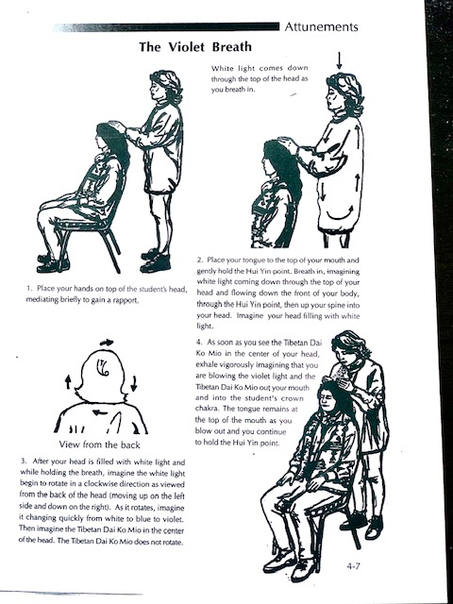

Slide 13
How to Give a Reiki Attunement
Remember to do the “Preparations for Giving an Attunement” (in your Reiki III Attunement Handout) before your students arrive.
Before starting the attunement process, ask your students to sit in a row or a circle in straight back chairs. Make sure there is enough room in front and in back for you to walk.
Explain about the hands being the prayer position to start and that touching the left shoulder is a signal to raise the hands to the top of the head. Demonstrate this so everyone understands. Also explain that you will be placing your hands on top of the head, and that a certain point you will be lightly “slapping” their hands.
Sometimes during an attunement, a person will get confused and bring the hands up when you place your hands on the top of the head instead of when you touch their shoulder. If this happens, gently move their hands back down. They may also forget to bring them up when you touch their shoulder. If this happens, gently reach over and bring them up. Next guide them into a meditation grounding them into the earth and connecting them to the spiritual energy above.

Slide 14
Four Parts
While the attunement process is an individual experience and unique adjustments and healing of the student’s energy field do take place, generally speaking it seems that the four parts of the attunement process each have a different purpose and cause different things to happen. Part One opens the crown chakra of the student and brings the energies down into your aura and the aura of the student. In Part Two, the energies enter the hands, the body and the chakras of the student. In Part Three, the process is completed by sealing in the attunement, disconnecting the student from the teacher, and permanently connecting the student to the Reiki source. Part Four is a blessing for all the students.
Note: If you have any problem visualizing, simply do the best that you can and imagine that the symbols are where you want them to be. It will work just fine and be just as powerful as if you were visualizing them perfectly. It is your intention that is important. Keep in mind that there are powerful Reiki guides who will be working with you. In fact, one way to look at it is that they are doing the attunement, and you are simply acting as a channel.

Slide 15



Technique for Each Attunement
As stated, your intention is the most important part of the attunement process so make sure that you state in your mind which attunement you are about to do before you begin, and then simply follow the directions exactly.
It is what goes into the hands that makes the difference between the Reiki Attunements. This includes when the hands are on top of the head as well as when they are open in front of the heart. In the Reiki I Attunement, only Choku Rei goes into the hands. In the Reiki II Attunement the three Reiki II symbols go into the hands. In the Master attunement, the two Tibetan symbols and the four Usui symbols go into the hands.

Slide 16
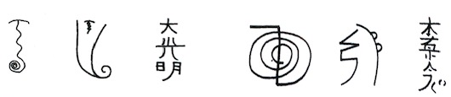

Reiki I Attunement
Note in the Reiki I attunement, only Choku Rei goes into the hands, both when they are on top of the head and when they are open in front.
Preparation: Prepare yourself and the room as described above.
Part 1
Fire Serpent: Move behind the student and hold the space with your non-dominant hand (I sometimes place that hand on their shoulder.). point and do the Violet Breath. Draw the Fire Serpent down the back starting with the arch over the top of the head, then undulating down the back and coiling at the base of the spine.
Rapport: Place both hands on top of the head and close your eyes, meditating briefly to gain an energetic rapport with the student.
Violet Breath: Bring your tongue to the top of your mouth, contract the Hui Yin point and do the Violet Breath. (Remember, you must continue holding the Hui Yin point and continue to keep your tongue touching the top of your mouth throughout the remainder of the attunement.) Open your hands and exhale into the crown chakra, picturing the Tibetan Dai Ko Mio (TDKM) moving from the middle of your head, out with your breath and into the student’s crown chakra. Then motion the TDKM to the base of the skull in and finally the base of the skull. As you do this say, Dai Ko Myo three times in a mantra like fashion to yourself, once in each position.

Slide 17
Part 1 Continued…
4. Symbols: Continue to hold the space and draw the Usui Dai Ko Myo (UDKM) over the head vertically. Then motion the UDKM to the base of the skull in three steps by pointing to the crown chakra, then the center of the head and finally the base of the skull. As you do this say, Dai Ko Myo three times in mantra like fashion to yourself, once at each position.
5. Repeat step four with Sei Heki and Hon Sha Ze Sho Nen. (Note that you temporarily skipped Choku Rei.)
6. Hands Up: Touch the student’s left shoulder, signaling them to raise their prayer clasped hands to the top of the head.
7. Symbols into Hands: Draw Choku Rei in the air over the hands. Then motion “Choku Rei” to the base of the skull in three steps by pointing to the hands and the crown and the center of the head and finally the base of the skull. As you do this say, Choku Rei three times in a mantra like fashion, once in each position.
8. Return Hands: Gently move the student’s hands from the top of their head, back down to the front of their heart.
Complete this process with each person, then move to the front and proceed with part two.

Slide 18
Part Two
Symbols into Hands: Move to the front, and open the students’ hands flat then support them with your non-Same with Sei dominant hand. With your dominant hand, draw Choku Rei in the air above the hands. Picture the symbol moving into the hands as you silently chant “Choku Rei” three times and motion the energy in. Pat the hands three times.
Blow on Hands: Bring the student’s hands together and move them back in front of their heart. Hold your hands over their hands and blow over the hands, down to the solar plexus, up to the third eye and crown, and back over the hands to the solar plexus, and ending at the hands.
Complete the process with each student and continue to Part Three.

Slide 19
Part Three
Affirmation: Move behind the student and place your hands on the student’s shoulders and look down through the crown chakra, imagining that you can see all the way down to the root chakra at the base of the spine. Look for a red ball of fire or imagine one being there in the root chakra. Place a positive affirmation there such as “You are a successful and confident Reiki healer.” Or “Divine love and wisdom guides and empowers you in your use of Reiki.” Repeat this three times and imagine you are placing this into the root chakra and intending that it be accepted by the subconscious mind of the student.
Sealing: Bring your hands together placing your thumbs at the base of the skull. Repeat this phrase three times to yourself: “I now seal this process with Divine love and wisdom.” while picturing a door with Choku Rei on it being closed and locked. While you do this, intend, will and feel that the process is sealed and complete and the student is now connected directly to Reiki Source.
Blessing: Place your hands on the students shoulders while feeling that both of you have been blessed by the experience.
Close the Aura: Seal with the Raku Symbol down the back of the student.

Slide 20
Part 4
Final Blessing: Move to the front of the student and hold your hands with fingers pointed toward your heart chakra. Silently say a prayer asking that the students be deeply blessed and healed.
Release the Prayer: Inhale and hold the breath briefly, then exhale while releasing the Hui Yin point and tongue and intending that the releasing energy act as a blessing for the students. As you release, motion the hands outward toward the students with the intention of bestowing a blessing on them.
Students may now breath slowly and deeply and open their eyes.

Slide 21
Reiki II Attunement
Preparation: Prepare yourself and the room as described above.
Part One: Note when giving Reiki II you will place all three Reiki II symbols in the hands, both when they are on top of the head and when they are held in front.
Fire Serpent: Move behind the student and hold the space with your non-dominant hand (I sometimes place that hand on their shoulder.). point and do the Violet Breath. Draw the Fire Serpent down the back starting with the arch over the top of the head, then undulating down the back and coiling at the base of the spine.
Rapport: Place both hands on top of the head and close your eyes, meditating briefly to gain an energetic rapport with the student.
Violet Breath: Bring your tongue to the top of your mouth, contract the Hui Yin point and do the Violet Breath. (Remember, you must continue holding the Hui Yin point and continue to keep your tongue touching the top of your mouth throughout the remainder of the attunement.) Open your hands and exhale into the crown chakra, picturing the Tibetan Dai Ko Mio (TDKM) moving from the middle of your head, out with your breath and into the student’s crown chakra. Then motion the TDKM to the base of the skull in and finally the base of the skull. As you do this say, Dai Ko Myo three times in a mantra like fashion to yourself, once in each position.
Symbols: Continue to hold the space and draw the Usui Dai Ko Myo (UDKM) over the head vertically. Then motion the UDKM to the base of the skull in three steps by pointing to the crown chakra, then the center of the head and finally the base of the skull. As you do this say, Dai Ko Myo three times in mantra like fashion to yourself, once at each position.

Slide 22
Part 1 Continued…
5. Hands Up: Touch the student’s left shoulder, signaling them to raise their prayer clasped hands to the top of the head.
6. Symbols into Hands: Draw Choku Rei in the air over the hands. Then motion “Choku Rei” to the base of the skull in three steps by pointing to the hands and the crown and the center of the head and finally the base of the skull. As you do this say, Choku Rei three times in a mantra like fashion, once in each position. Do the same with Sei Heki and Hon Sha Ze Sho Nen.
7. Return Hands: Gently move the student’s hands from the top of their head, back down to the front of their heart.
Complete this process with each person, then move to the front and proceed with part two.
Part Two
Symbols into Hands: Move to the front, and open the students hands flat then support them with your non-Same with Sei dominant hand. With your dominant hand, draw Choku Rei in the air above the hands. Picture the symbol moving into the hands as you silently chant “Choku Rei” three times and motion the energy in. Pat the hands three times. Do the same with Sei heki and Hon Sha Ze Sho Nen.
Blow on Hands: Bring the student’s hands together and move them back in front of their heart. Hold your hands over their hands and blow over the hands, down to the solar plexus, up to the third eye and crown, and back over the hands to the solar plexus, and ending at the hands.
Complete the process with each student and continue to Part Three.

Slide 23
Part Three
Affirmation: Move behind the student and place your hands on the student’s shoulders and look down through the crown chakra, imagining that you can see all the way down to the root chakra at the base of the spine. Look for a red ball of fire or imagine one being there in the root chakra. Place a positive affirmation there such as “You are a successful and confident Reiki healer.” Or “Divine love and wisdom guides and empowers you in your use of Reiki.” Repeat this three times and imagine you are placing this into the root chakra and intending that it be accepted by the subconscious mind of the student.
Sealing: Bring your hands together placing your thumbs at the base of the skull. Repeat this phrase three times to yourself: “I now seal this process with Divine love and wisdom.” while picturing a door with Choku Rei on it being closed and locked. While you do this, intend, will and feel that the process is sealed and complete and the student is now connected directly to Reiki Source.
Blessing: Place your hands on the students shoulders while feeling that both of you have been blessed by the experience.
Close the Aura: Seal with the Raku Symbol down the back of the student.

Slide 24

Part 4
Final Blessing: Move to the front of the student and hold your hands with fingers pointed toward your heart chakra. Silently say a prayer asking that the students be deeply blessed and healed.
Release the Prayer: Inhale and hold the breath briefly, then exhale while releasing the Hui Yin point and tongue and intending that the releasing energy act as a blessing for the students. As you release, motion the hands outward toward the students with the intention of bestowing a blessing on them.
Students may now breath slowly and deeply and open their eyes.

Slide 25
Reiki Master Attunement
Preparation: Prepare yourself and the room as described above.
In the Reiki Master Attunement you will be placing all six symbols into the hands, both on to of the head and in front of the heart. This includes doing the Violet Breath into the hands when they are on top of the head. This Attunement gives the student the ability to do Reiki attunements.
Part One:
Fire Serpent: Move behind the student and hold the space with your non-dominant hand (I sometimes place that hand on their shoulder.). point and do the Violet Breath. Draw the Fire Serpent down the back starting with the arch over the top of the head, then undulating down the back and coiling at the base of the spine.
Rapport: Place both hands on top of the head and close your eyes, meditating briefly to gain an energetic rapport with the student.
Hands Up: Touch the student’s left shoulder, signaling them to raise their prayer clasped hands to the top of the head.
Violet Breath: Bring your tongue to the top of your mouth, contract the Hui Yin point and do the Violet Breath. Then do the Violet breath through the hands by holding the hands with both of yours, then opening your hands slightly when blowing the Violet Breath into them. (Remember, you must continue holding the Hui Yin point and continue to keep your tongue touching the top of your mouth throughout the remainder of the attunement.) As you do the Violet breath, picture the Tibetan Dai Ko Mio (TDKM) moving from the middle of your head, out with your breath and into the student’s crown chakra. Then motion the TDKM to the base of the skull in and finally the base of the skull. As you do this say, Dai Ko Myo three times in a mantra like fashion to yourself, once in each position.

Slide 26
Part 1 continued…
6. Symbols: Continue to hold the space and draw the Fire over the head vertically. Then motion the Fire Serpent to the base of the skull in three steps by pointing to the crown chakra, then the center of the head and finally the base of the skull. As you do this say, “Fire Serpent” three times in mantra like fashion to yourself, once at each position. Repeat this step with the Usui Dai Ko Myo, Choku Rei, Sei Heki, and Hon Sha Ze Sho Nen.
7. Return Hands: Gently move the student’s hands from the top of their head, back down to the front of their heart.
Complete this process with each person, then move to the front and proceed with Part Two.
Part Two
Symbols into Hands: Move to the front, and open the students hands flat then support them with your non-Same with Sei dominant hand. With your dominant hand, draw the Tibetan Dai Ko Mio in the air above the hands. Picture the symbol moving into the hands as you silently chant “Dai Ko Mio” three times and motion the energy in. Pat the hands three times. Do the same with the Fire Serpent, Usui Dai Ko Myo, Choku Rei, Sei heki and Hon Sha Ze Sho Nen.
Blow on Hands: Bring the student’s hands together and move them back in front of their heart. Hold your hands over their hands and blow over the hands, down to the solar plexus, up to the third eye and crown, and back over the hands to the solar plexus, and ending at the hands.
Complete the process with each student and continue to Part Three.

Slide 27
Part Three
Affirmation: Move behind the student and place your hands on the student’s shoulders and look down through the crown chakra, imagining that you can see all the way down to the root chakra at the base of the spine. Look for a red ball of fire or imagine one being there in the root chakra. Place a positive affirmation there such as “You are a successful and confident Reiki healer.” Or “Divine love and wisdom guides and empowers you in your use of Reiki.” Repeat this three times and imagine you are placing this into the root chakra and intending that it be accepted by the subconscious mind of the student.
Sealing: Bring your hands together placing your thumbs at the base of the skull. Repeat this phrase three times to yourself: “I now seal this process with Divine love and wisdom.” while picturing a door with Choku Rei on it being closed and locked. While you do this, intend, will and feel that the process is sealed and complete and the student is now connected directly to Reiki Source.
Blessing: Place your hands on the students shoulders while feeling that both of you have been blessed by the experience.
Close the Aura: Seal with the Raku Symbol down the back of the student.

Slide 28
Part 4
Final Blessing: Move to the front of the student and hold your hands with fingers pointed toward your heart chakra. Silently say a prayer asking that the students be deeply blessed and healed.
Release the Prayer: Inhale and hold the breath briefly, then exhale while releasing the Hui Yin point and tongue and intending that the releasing energy act as a blessing for the students. As you release, motion the hands outward toward the students with the intention of bestowing a blessing on them.
Students may now breath slowly and deeply and open their eyes.

Slide 29
Giving Attunements Online Via Guided Meditation
Giving Attunements Online with a guided meditation is very easy and is quite powerful.
In the beginning we open a circle and call in all the Reiki Guides and the Reiki Guardians. These Light Beings of great power can be found at the further most edges of your light body and are responsible for bringing Reiki to the Planet. They are also responsible for the evolution of Reiki as the planet’s energy continues to increase. At the beginning of the Attunement meditation, you will guide your students to connect with them. Remind your students that the Reiki Guardians are not to be confused Reiki Guides who are closer to our physical reality. Reiki Guides can be people you knew who have transitioned or who were with you if you used Reiki in other lifetimes. Reiki guides can also be pets who have transitioned and continue to participate with you in your healing work. Remind them that their Personal Spirit Guides may also show up as the meditation progresses.

Slide 30
You may also want to instruct your students about other things that will happen in the attunement.
Here is an example of what you might say:
“After you have connected with the Reiki Guardians who will be conducting much of the attunement, you will be asked to connect to the Microcosmic Orbit and your Hara Line. You don’t have to do anything but open to receive. There will be pauses between each command to allow the energy to move through your body.
Reiki is brought into your body at 2 points: Center Above and Center Below. These 2 chakras are located about 12 inches above the Crown Chakra and below the feet. The Reiki Guardians will anchor the Reiki Symbols into the hands, third eye and Hara Line. Also, during this attunement process, the Reiki Principles are anchored into your heart. These five principals are part of the Reiki Tradition that all practitioners and Masters aspire to live by. To have them anchored into your heart is pure magic.”
Using this method is very simple. I have even done it in person and it always works and is much easier. You just want to be sure to give sufficient time between the prompts as you read the script for the Reiki Guardians to do their work. I have included waiting times to help you with that. All you have to do is read the script. I have included them in your packet.

Slide 31

What NOW?
PRACTICE GIVING ATTUNEMENTS!
Do the Reiki Master Meditation this time using ALL FOUR USUI SYMBOLS!
Practice Contracting the Huy Yin. Learn to hold it while walking or doing other things.
Use Reiki on anything in your own environment…pets, appliances, vehicles, anything. Experiment.
Do Reiki on yourself and others. Be sure to include the
Dai Ko Mio when you are drawing the symbols.

Slide 32
Code of Ethics for the Aquarian Reiki/Shamanic Practitioner
The following is borrowed from Shamanic Breathwork, by Linda Star Wolf. It “is considered a new paradigm code of ethics for anyone who identifies with living, serving, and working on a path of higher consciousness.” I consider it a must for anyone who practices any form of healing modality during this time of intense change upon the planet.
Be honest, work on yourself, live your truth, don’t use others, make mistakes, make amends, listen to feedback, and move past defensiveness.
Become a spiritual warrior.
Have a heart and a mind—use them both.
Be open to support from your spirit guides.
Live inside your body—be juicy.
Take your own advice—live and lit live.
Take things as they come—one day at a time…and forgive yourself when you do not.
Be mindful and spontaneous at the same time.
Move past one-sidedness.
See the beauty and perfection in EVERYTHING!
Be open to change and LET GO! Be open to joyfulness.
Believe in yourself, in others, and in synchronicity and grace.
Let gratitude fill you up and let it flow to others.
Show the same patience to others that the universe has shown to you.
Be flexible and tolerant; include yourself.

Slide 33
Become a shadow dancer—the light, the dark, no difference.
Never take advantage of others, remember the law of karma.
Seek to empower those you serve.
Avoid comparing yourself and your gifts with others.
Let go of competition and scarcity consciousness—believe in abundance.
Hold the vision for those who seek your guidance. Offer them loving kindness.
Do not take others hostage to your ideas of who they should be.
Do not enable others to stay as they are.
Let there always be an equal exchange of energy between you and those you serve, so as not to create confusion or a “less than” relationship.
Feel your loving feelings and body responses for others.
Have loving boundaries. Never shame another for loving, sexual, and nonsexual feelings.
Create a big safe container in which these bright, beautiful souls may cook so the fires of transformation can work their magic on us all.
Remember, we are all traveling on the wheel of life back to where we came from, doing the best we can.
So, treat others as you want to be treated—with consideration, dignity, and respect, no matter who they are. Remember we are ALL God/Goddess’s favorite child.*
*Adapted from Shamanic Breathwork, by Linda Star Wolf

Slide 34

The Reiki Principles
Just for today I will give thanks for my many blessings.
Just for today I will not worry.
Just for today I will not be angry.
Just for today I will do my work with integrity.
Just for today I will be kind to myself and every living thing.

