Slide 1
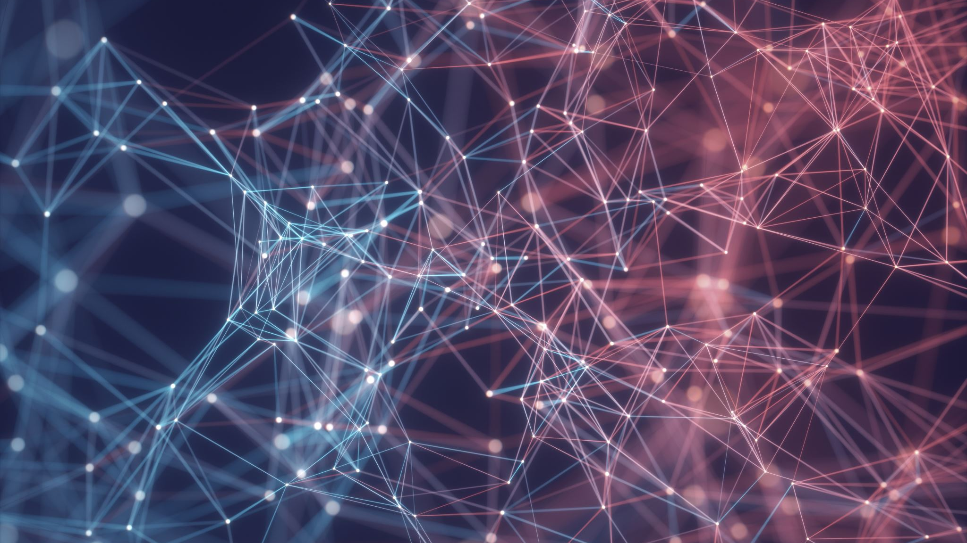
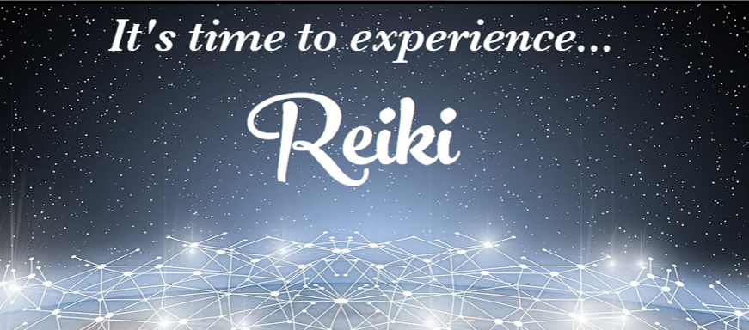

Slide 2

Welcome to Reiki III
Reiki Master
What you will learn and receive…
The meaning of the Usui Reiki Master Symbol
Introduction and drawing the Usui Reiki Master Symbol
The 3 new Reiki Symbols you will need to give attunements
Reiki 3 Attunement
What to do after class…resources.

Slide 3
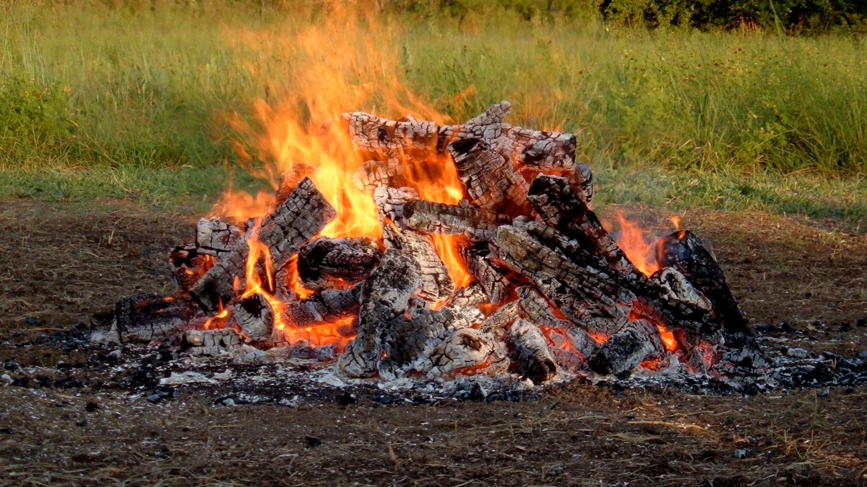
Calling In Sacred Space…
Open to receive…

Slide 4
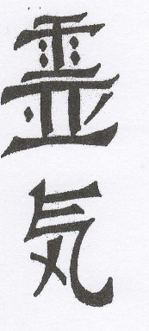
The Usui Master Symbol
Translating the meaning of this symbol from a Japanese/English dictionary, the secret name of the symbol means: “Great Being of the Universe, shine on me, be my friend.” The Encyclopedia of Eastern Philosophy and Religion lists a definition for this symbol as “Treasure house of the great beaming light,” and states that it is a Zen expression for one’s own true nature or Buddha-nature, of which one becomes cognizant in the experience of enlightenment or satori.
Use of the Usui Dai Ko Myo in conjunction with Reiki creates a noticeably stronger channel between the physical self and the Higher Self. This allows more of the unlimited wisdom and power of God to manifest directly on the physical plane. It intensifies and focuses the Reiki energy causing it to more firmly establish positive results in a definite, grounded and permanent way. It protects the healing work that it does.
All the qualities of Reiki, including the actions of the other symbols, are enhanced using the Usui Dai Ko Myo. It seems to print it a greater feeling of wholeness, fulfillment and completion. It is very satisfying to feel its power flow through and around you whenever you use it in conjunction with Reiki.

Slide 5
It is like Choku Rei in many ways except that it operates on a much higher frequency and brings into use a higher level of divine power. Once you have been attuned to using this symbol, you should always use it first before using the other symbols as it will empower them.
The Usui Dai Ko Myo can be used when giving Reiki treatments, and it can also be used to empower any other kind of healing, manifesting or personal transformation work. It can be used as part of a ritual and in conjunction with physical movement. It can be used to bless and empower all activities! Let your imagination help you create new uses for it.
Try this anytime after you have received the attunement for the Usui Dai Ko Myo. You can do this anywhere at anytime, even while driving. First think of Reiki. You do not have to have your hands on yourself as Reiki will simply begin flowing out of your hands regardless of what you are doing with them. Once you feel Reiki flowing, begin chanting Dai Ko Myo three times either out loud or to yourself, followed by: “I establish my divine presence on earth,” three times. Do this repeatedly allowing yourself to feel the power you are creating.

Slide 6
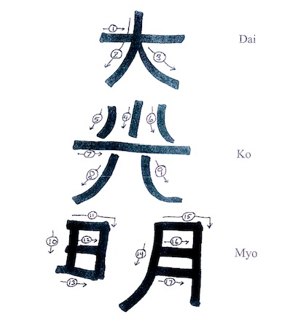
The Usui Dai Ko Mio
Practice Drawing

Slide 7
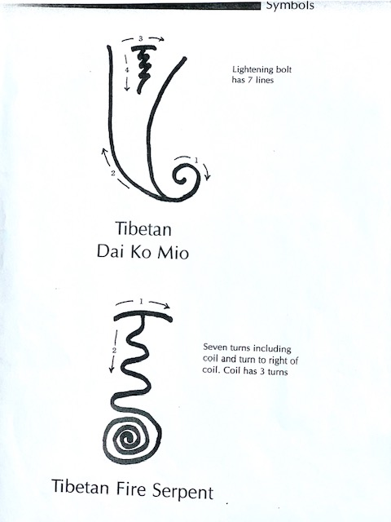
The Tibetan
Dai Ko Mio
The energy of this symbol is very similar in nature to the Usui Dai Ko Myo. However, many feel it has a gentler way of healing and yet it is more powerful. It is used in the attunement process as part of the Violet Breath. It can also be used as a treatment symbol. It creates a very holistic healing energy that has a higher vibration than the Reiki II symbols. It assists in healing a wider range of conditions more quickly and at greater depth. It has also been found to be useful in pulling out negative energy and because of this, it can be added to the symbols. To use this symbol for healing, draw it on the palms of your hands or visualize it in your mind or draw it in the air in front of you or on the client’s body where healing is needed.
Practice Drawing
(Lightening bolt has 7 lines)

Slide 8
The Tibetan Fire Serpent
This symbol is also used in the attunement process and is drawn down the back of the student. Doing this causes all the chakras to join together thus allowing the attunement energies to enter the person’s energy system more easily. It can also be used in this same way for treatments. Before starting a Reiki treatment, draw the Tibetan Fire Serpent in the air over the front of the client’s body with the arch over the crown and then coiling at the root chakra. This will join all the chakras together thus allowing the Reiki energies to flow more evenly throughout the client’s system. This symbol can also be used as a regular treatment symbol. Draw it on your palms before placing them on the person. This is a powerful healing symbol, and clients often report feeling the energy undulating through them. This undulating action seems to be able to clear blocks more easily and travel more deeply into the energy system.
Practice Drawing
(Seven turns including coil and turn to right of coil. Coil has 3 turns.)

Slide 9
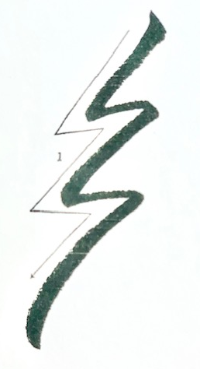
The Raku
The other Reiki III symbol is the Raku. Mrs. Takata did not use this Sanskrit symbol, but most or all American Reiki Masters use it today. Most Masters seem to have very little information on this figure, and do not realize its importance. It is only used in passing attunements, never in healing work. The symbol looks like a lightning bolt. Its definition is known as “banking the fire.” At the end of the attunement, the Raku is used to ground the receiver of the Reiki energy. This usually all you hear about this symbol but in fact it does much more. It activates the Hara Line, helping the student to bring the Reiki energy through her Ki channels, and grounds it in the Hara center (Tan Tien or navel).
During the attunement process also, the aura of the Master and student are joined, and something more happens while the auras merge. During these few moments, the Reiki guides use the energy to lift negative karma from the person receiving the attunement and the Reiki degree. The teacher doing the process receives what is released through her or his own aura and grounds it. The Raku at the ending of the attunement separates the auras. It also leaves both the Master and student with far more Original Ki energy than they each had before. This release of Karma during the attunement process explains the physical and emotional cleansing and reorganization that often follows.

Slide 10
Your Reiki 3 Attunement will be like a guided meditation but much deeper. It allows you to attune others to Reiki!
In the beginning I will open a circle and call in all the Reiki Guides and the Reiki Guardians. These Light Beings of great power can be found at the further most edges of your light body and are responsible for bringing Reiki to the Planet. They are also responsible for the evolution of Reiki as the planet’s energy continues to increase. At the beginning of the Attunement meditation, you will be asked to connect with them. They are not to be confused with your Reiki Guides who are closer to our physical reality. Reiki Guides can be people you knew who have transitioned or who were with you if you used Reiki in other lifetimes. Reiki guides can also be pets who have transitioned and continue to participate with you in your healing work. Your Personal Spirit Guides may also show up as the meditation progresses.
After you have connected with the Reiki Guardians who will be conducting much of the attunement, you will be asked to connect to the Microcosmic Orbit and your Hara Line. You don’t have to do anything but open to receive. There will be pauses between each command to allow the energy to move through your body.
Reiki is brought into your body at 2 points: Center Above and Center Below. These 2 chakras are located about 12 inches above the Crown Chakra and below the feet. The Reiki Guardians will anchor the Reiki Symbols into the hands, third eye and Hara Line. Also, during this attunement process, the Reiki Principles are anchored into your heart. These five principals are part of the Reiki Tradition that all practitioners and Masters aspire to live by. To have them anchored into your heart is pure magic.
Reiki 3 Attunement

Slide 11
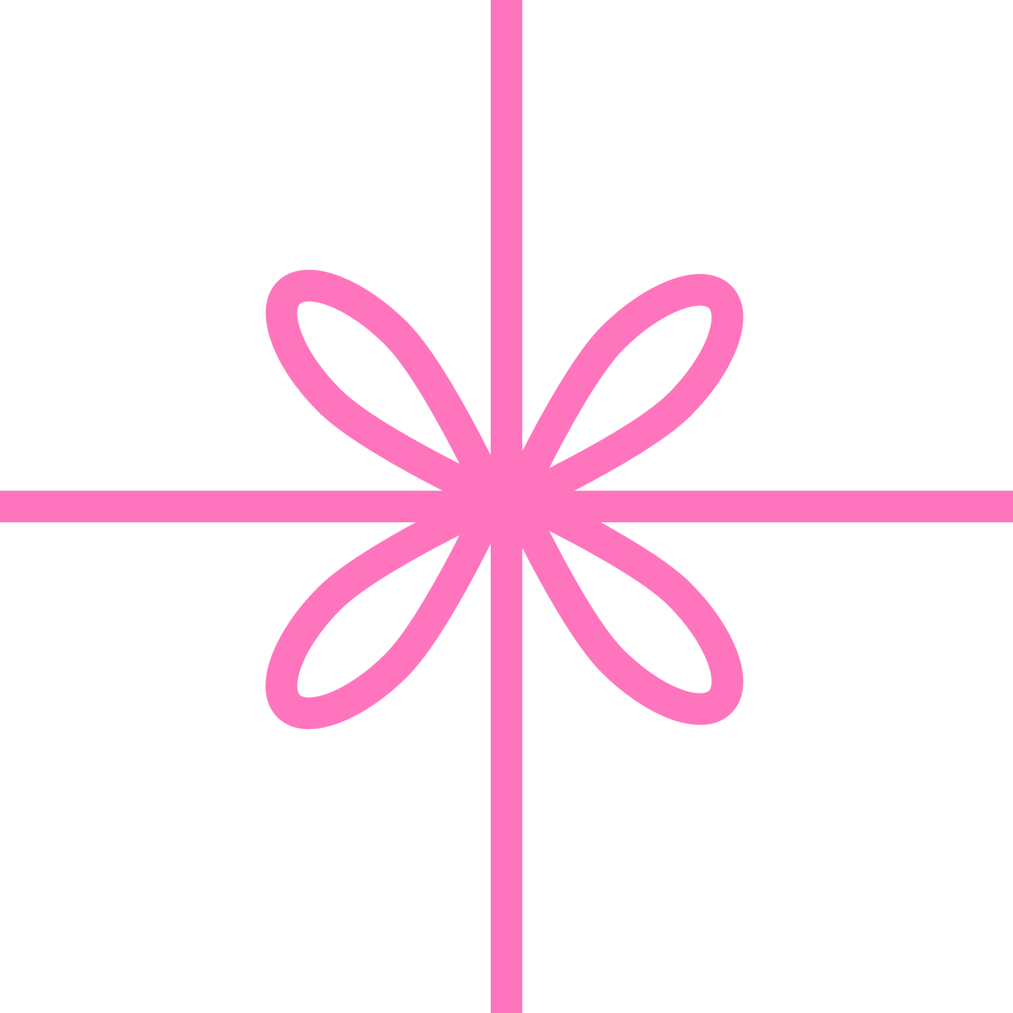
What to do between now & our next class.
Practice drawing ALL THE SYMBOLS, both with your hands and on paper.
Do the Reiki Master Meditation this time using the Dai Ko Mio!
Practice Contracting the Huy Yin. Learn to hold it while walking or doing other things.
Use Reiki on anything in your own environment…pets, appliances, vehicles, anything. Experiment.
Do Reiki on yourself and others. Be sure to include the
Dai Ko Mio when you are drawing the symbols.

Slide 12
Embodied Reiki Symbol Meditation
Use this meditation to embody and activate your own conscious and energetic connections with the symbols. After this meditation you’ll have a more innate sense about when and where to use the symbols. Essentially, they’ll begin to create with you as they speak through your consciousness. After each level, return to this meditation and embody the new symbols with it. Typically, once is enough when doing this meditation, but if you found yourself forgetting the symbols, do it several times.
Invoke Cho Ku Rei (say it three times and draw it in the air). Picture it above the crown of your head. With your intent, see, perceive or imagine the symbol coming into the crown, slowly moving down through your head, throat, chest, stomach and then into the small intestines. Here you will embody this symbol. Observe what shifts and changes for you. When the energy completes shifting, move to the next step.
Do this with the other two symbols, one at a time. Sei-He-Ki and Hon-Sha-Ze-Sho-Nen
State the Reiki Principles with both hands on your chest. Invite them to become embodied within you.
Reiki Principles
Just for today I will give thanks for my many blessings.
Just for today I will not worry.
Just for today I will not be angry.
Just for today I will do my work with integrity.
Just for today I will be kind to myself and every living thing.

Slide 13
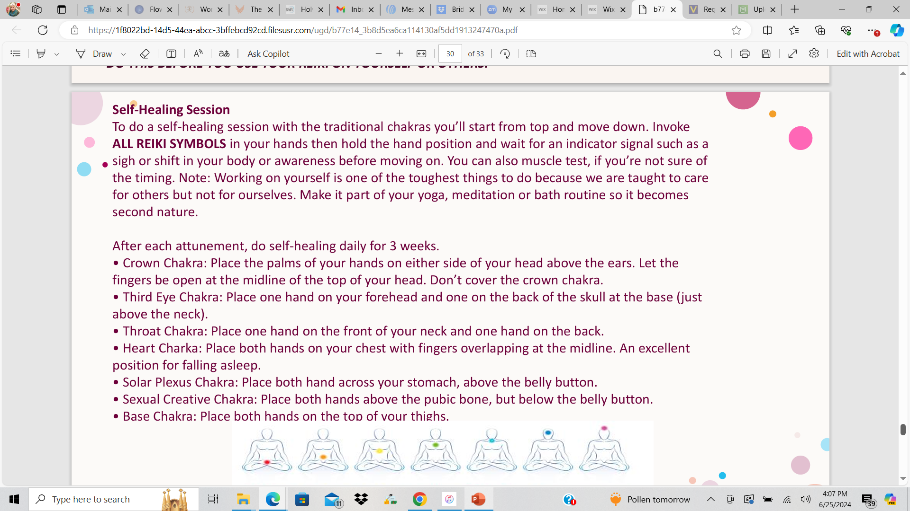
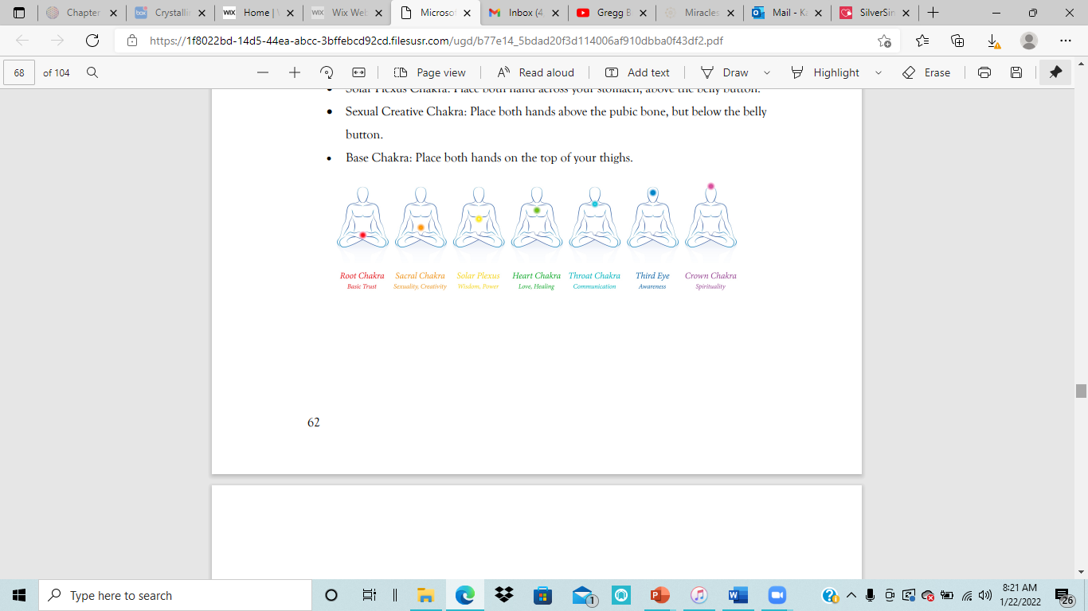

Slide 14
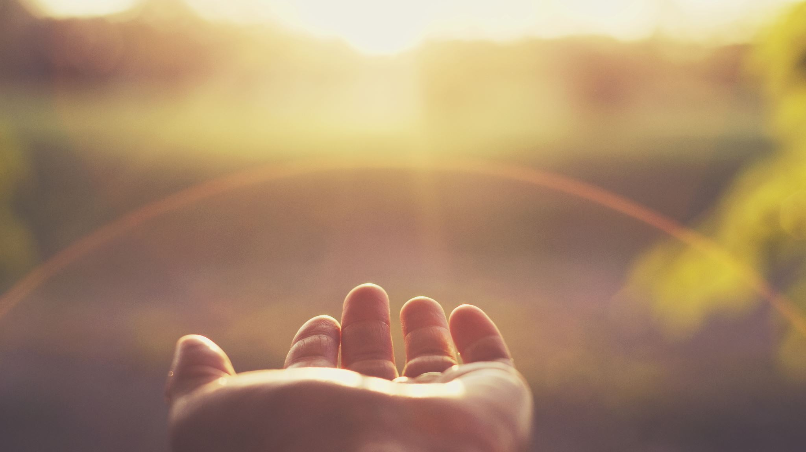
The Reiki Principles
Just for today I will give thanks for my many blessings.
Just for today I will not worry.
Just for today I will not be angry.
Just for today I will do my work with integrity.
Just for today I will be kind to myself and every living thing.

