Slide 1
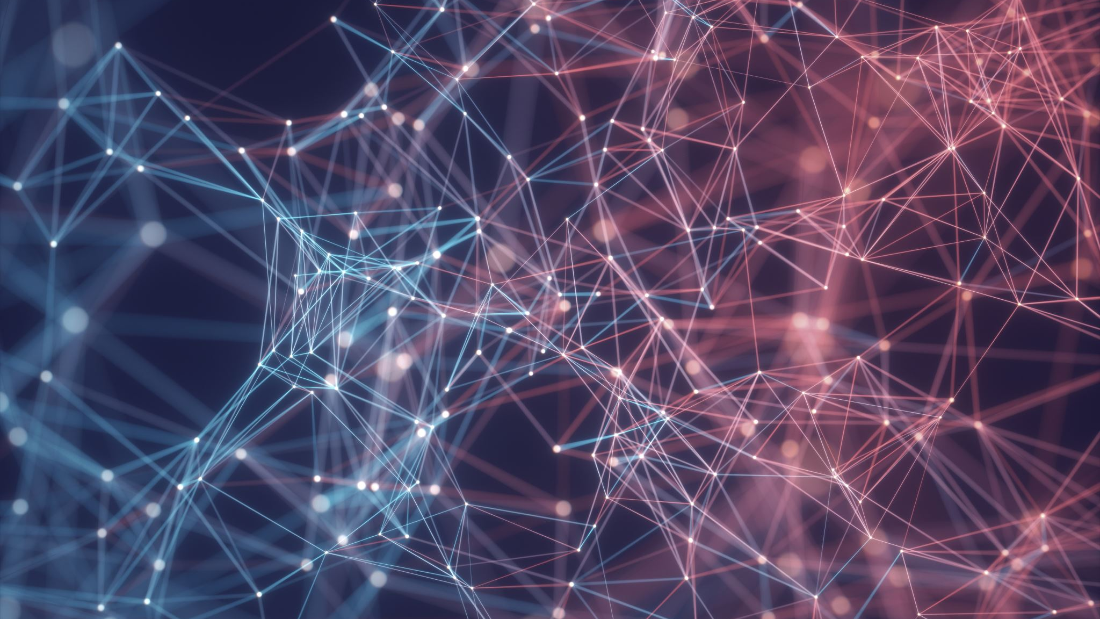
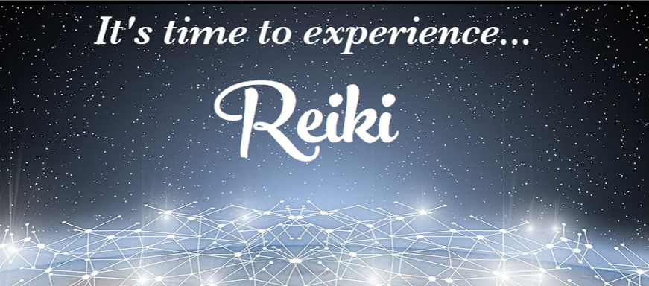

Slide 2

Welcome to Reiki Master Prep
What you will learn and receive…
An Overview of the Medicine Wheel & how to use Reiki with it.
A New Symbol – The Antahkarana – and how to use it
The Microcosmic Orbit and the Hara Line
The Violet Breath
Contracting the Huy Yin
The Reiki Master Clearing Meditation

Slide 3
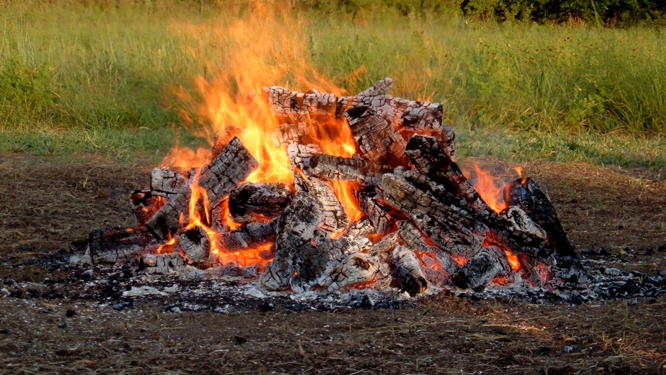
Calling In Sacred Space…
Open to receive…

Slide 4
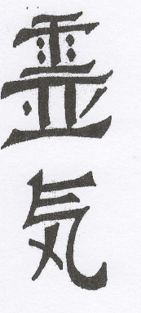
Introduction
By signing up for this class, you have said to the Universe that you want to be of service at a higher level. You have committed to clear your body, mind, and spirit at an even deeper level to be of service to the larger collective. Reiki Master is a privilege given to those who are willing to commit to it. The more you give to it, the more it gives back to you. The more I study and use Reiki, the more I am convinced that everyone on the planet needs it and needs to be using it. It is the perfect universal healing tool. It is the only spiritual tool I know of that is highly powerful and absolutely safe. It never has and never will be used for harm in any form. That’s built in. And it will take you as deeply as you want to go into the core of your being to clear and cleanse anything unlike what you came here to be. Since Reiki IS Universal Life Force energy, using the Medicine Wheel as a lens to understand it more deeply makes perfect sense. With that in mind, we will begin with a primer on how to use Reiki in the Medicine Wheel. We will spend the rest of our time, constructing our tools, learning how to use them, and learning how to prepare our body to “run” more of this energy to do attunements. Because this is a new level of work, you may want to start with a new journal to record all your experiences. Welcome to the process!

Slide 5
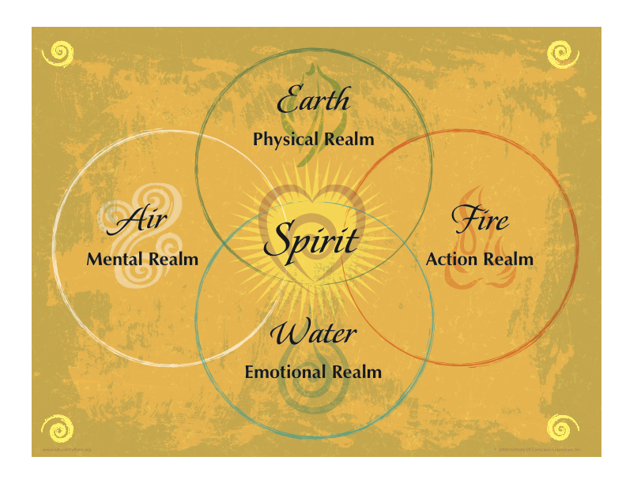
The Medicine Wheel…
Everything you know and understand to be physically real, and tangible is formed from the Universal Field of Creation. That sounds like a lofty statement but what it really means is that everything has five basic ingredients: forms of Earth, Water, Air, Fire, and Ether (Spirit/Intent). These are rock bottom…at the foundational core of everything and every person…every creation. Everything you can think of has a specific balance of these basic ingredients that make it what it is. If that balance changes, it changes the object. For instance, there is a certain configuration of these elemental energies that form spinach leaves. Change the balance by plucking those leaves from the ground and putting them in a pan of boiling water and you literally change the physical object into spinach soup – not bright shiny leaves.

Slide 6
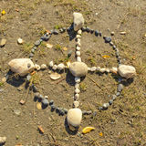
Historically, the energy or basic essence of anything was known as it’s “medicine.”
Hence this configuration is commonly known as a Medicine Wheel. Each of the larger stones represent one of the basic five elements. The smaller ones represent steps on the path to enlightenment by each of the elemental forces.
This pattern became a very powerful alchemical tool to harness vibrational information because of the nature of containment within the circle.
Thus this pattern is scene in various configurations throughout most spiritual traditions.

Slide 7
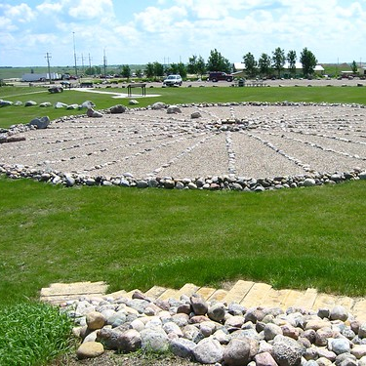
Everyone uses these elemental forces anytime they create anything whether they are aware of it or not. Knowing how to use them effectively and efficiently can make the difference in how successful our outcomes are and if you are really effective in creating what you truly want. And when you consciously connect with these forces and harness their energy to assist you, your outcomes can be greatly improved. Here’s why: The Elements: Earth, Air, Water, Fire, and Spirit or Ether are the messengers from Original Source. They have a consciousness bigger than their outward appearance, just like you!

Slide 8
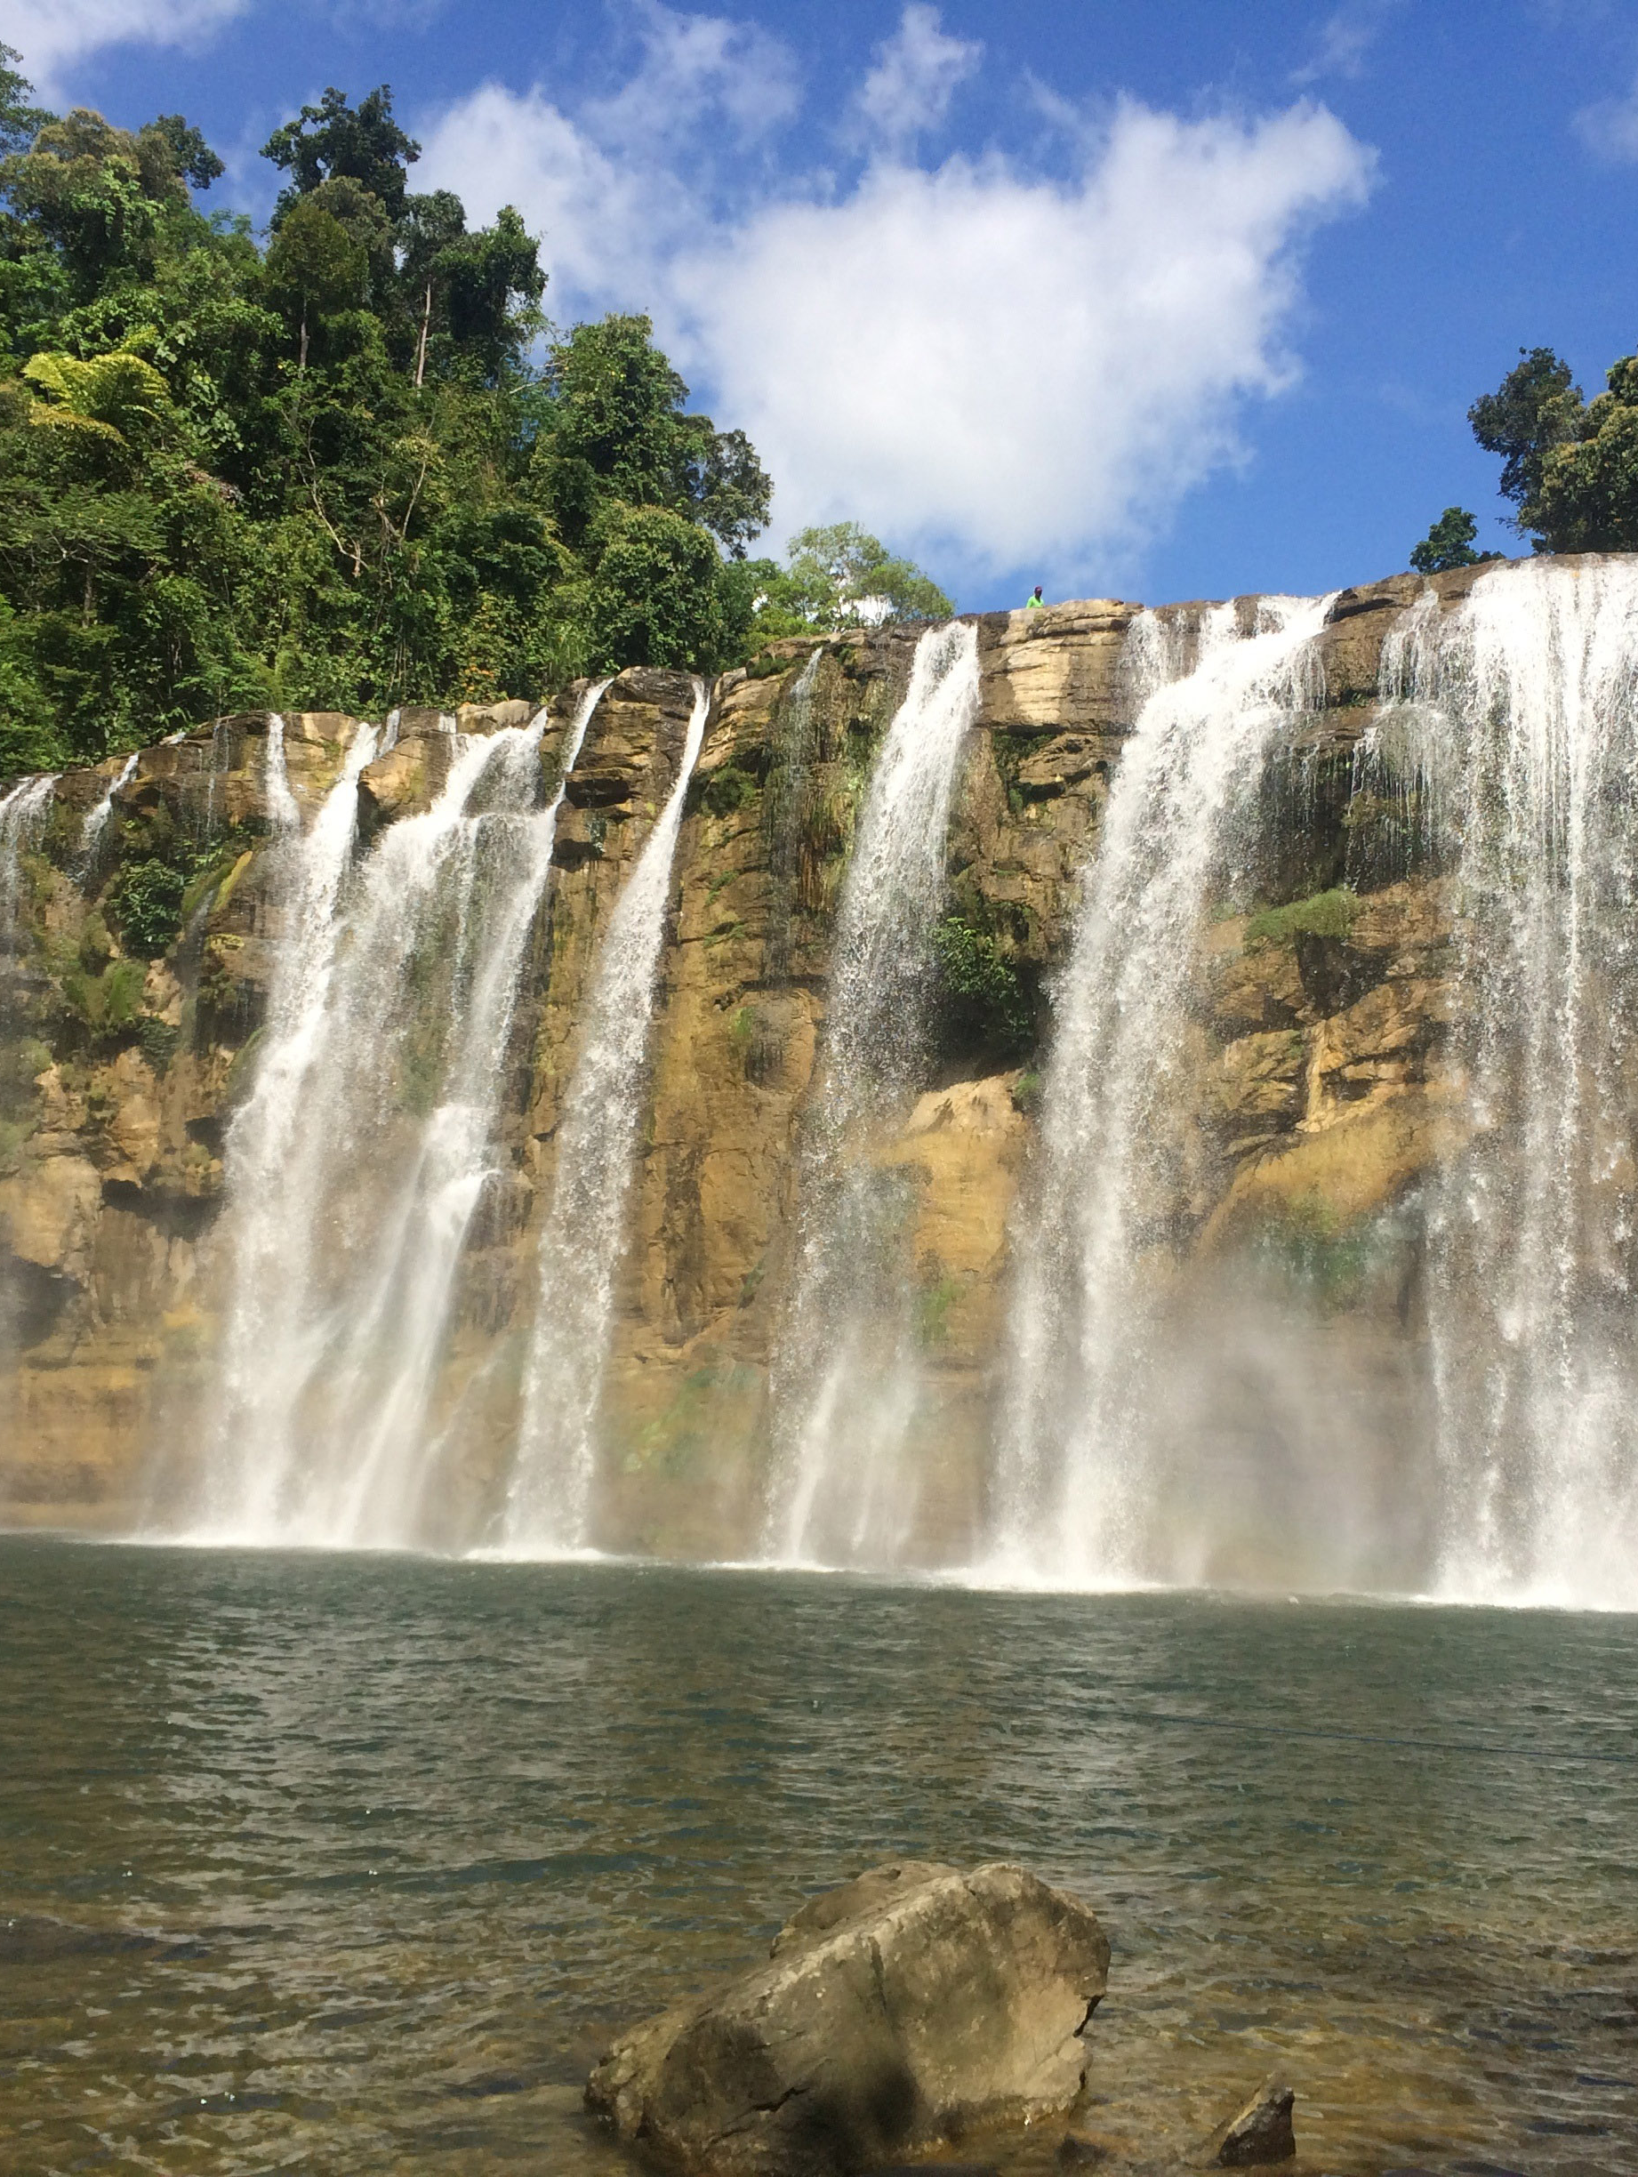
They were born billions of years ago out of the primeval life force. They understand creation and destruction. The have had time to learn how to come into alignment with their neighbors and to help their children—the planets—and their great-grandchildren—life-forms upon Planet Earth. They can teach us lessons of right relationship with one another – all sentient beings.
Most modern humans have forgotten our essential connection to nature to our peril. We have grown strong and powerful and are capable of affecting, through our collective actions, the natural balance of our planet. In our arrogance and greed, we have taken our species and many others to the brink of destruction.
This is why it is imperative for us, as Reiki Masters, to develop a relationship with our Great Grandparents, the elements. We are the leaders that will lead the human race to begin to take responsibility for our actions.

Slide 9
Our ancestors knew this basic truth and were deeply committed to utilizing this wisdom and leaving this information for future generations to follow. Because life on this planet is so precarious and information here can quickly become distorted, they left us a very versatile tool that can assist us as we learn to work with these energies in a conscious balanced way. We know it as the Medicine Wheel. The Medicine Wheel is many things to many people. Because of this, it can be a very powerful tool when used appropriately.
How does this apply to Reiki?
Reiki Is Universal Life Force Energy
Each of the symbols in Reiki resonates with a different Archetypal Elemental Force.
By incorporating what we know about how to use wheels and what we know about Reiki, we can create a powerful tool for enrichment for both ourselves, and our future clients.
Just like each of the Reiki symbols resonate with a particular attribute of our physical experience, so too do the elements.
Cho-ku-Rei = Earth = Physical Body
Sei-he-ki = Water = Emotional Body
Hon-Sha-Zi-Sho-Nen = Air = Mental Body
Dai-Ko-Myo = Fire = Spiritual Body/Action

Slide 10
Center
Balance
North
Receiving
East
Determining
South
Giving
West
Holding
Holding
In order to understand how to use Reiki in the Wheel, we simply need to think of the wheel as a map or a guide for our creation. Think of it as the “hard drive” in a computer or the basic structure that the elemental forces flow into. You will notice that on the template, there are five directional positions as well as a description of how energy works or flows in that particular direction. Another way to understand it is that, in a wheel, not only does the energy flow around it, in a circle, holding it together, it also flows from the East to the West, just the way the Sun appears to move across our sky, and South to North, just as plants grow from the ground up.

Slide 11
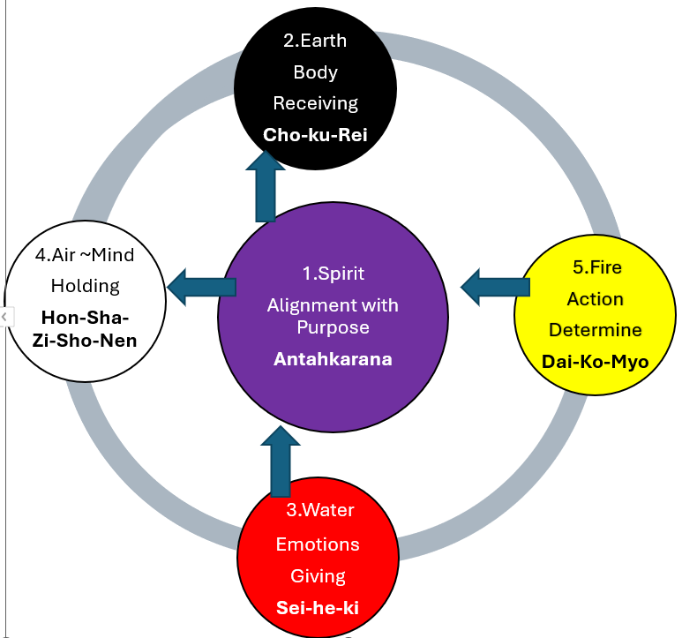
Placing the Elemental Forces of Earth, Air, Water, Fire, and Spirit in this basic template is how you determine how they are going to work with each other. If you have studied any Earth Traditions that use the Wheel as a template, you will see every configuration of these energies imaginable. They are all different because they were used for different purposes and to harness different outcomes. Where you place these energies does make a difference if you are working to have a specific outcome. It is important to note here that this wheel is set up to create or manifest something in your outside world. This does not have to be a physical object. It could be a relationship, a job, a different living situation, etc. But the point is that by calling it a creation template it is future oriented. However, when we focus on the future, we have a tendency to bring up faulty habits of our past that get in the way of our creation efforts. You can use this wheel to “get at” these habits and remove them simply by allowing the flow of information to guide you.

Slide 12



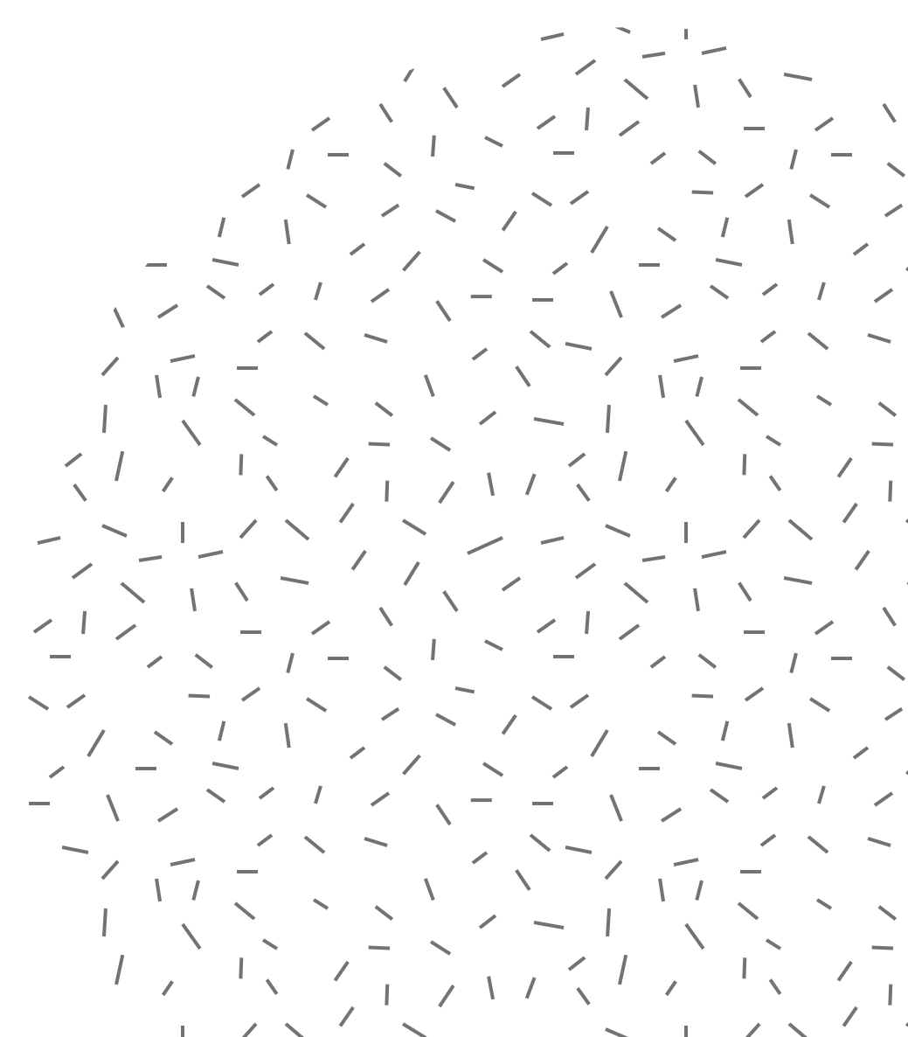
You will notice that I have numbered each of the elements since this is the order that we would want to follow if we were going to plan a creative endeavor.
First, we would spend time in the center, getting focused, clear and realigning with our mission and purpose. If we were focused on a specific creative activity, we would want to focus on our purpose for the activity and our desired outcome. This is the place of clarity. Today you will be introduced to a new symbol, the Antahkarana, and the Reiki Master Meditation to enhance and increase this alignment.
Second, we are going to determine and design the structures that are necessary for us to create and contain a flow, whatever that may be. For instance, we might want to create a flow of individuals to us that are going to need our services, or a flow of individuals to a class we are teaching. What structures need to be in place in order for us to do that?
Third, we are going to determine characteristics of that flow and how to draw it to us. So in our example we would be determining who those individuals are, what they need, and how we can meet those needs and call them to us.
Fourth, we are going to lay out goals and outcomes to focus our mind and work toward.
Fifth, we are going to decide on focused action steps that are going to give us the maximum amount of outcome for the least amount of effort. We are also going to make sure that we are doing the things that are going to bring the outcomes we desire.
(You will find an outline of the characteristics of each of the elements on pages 5-7 of your handout.)

Slide 13
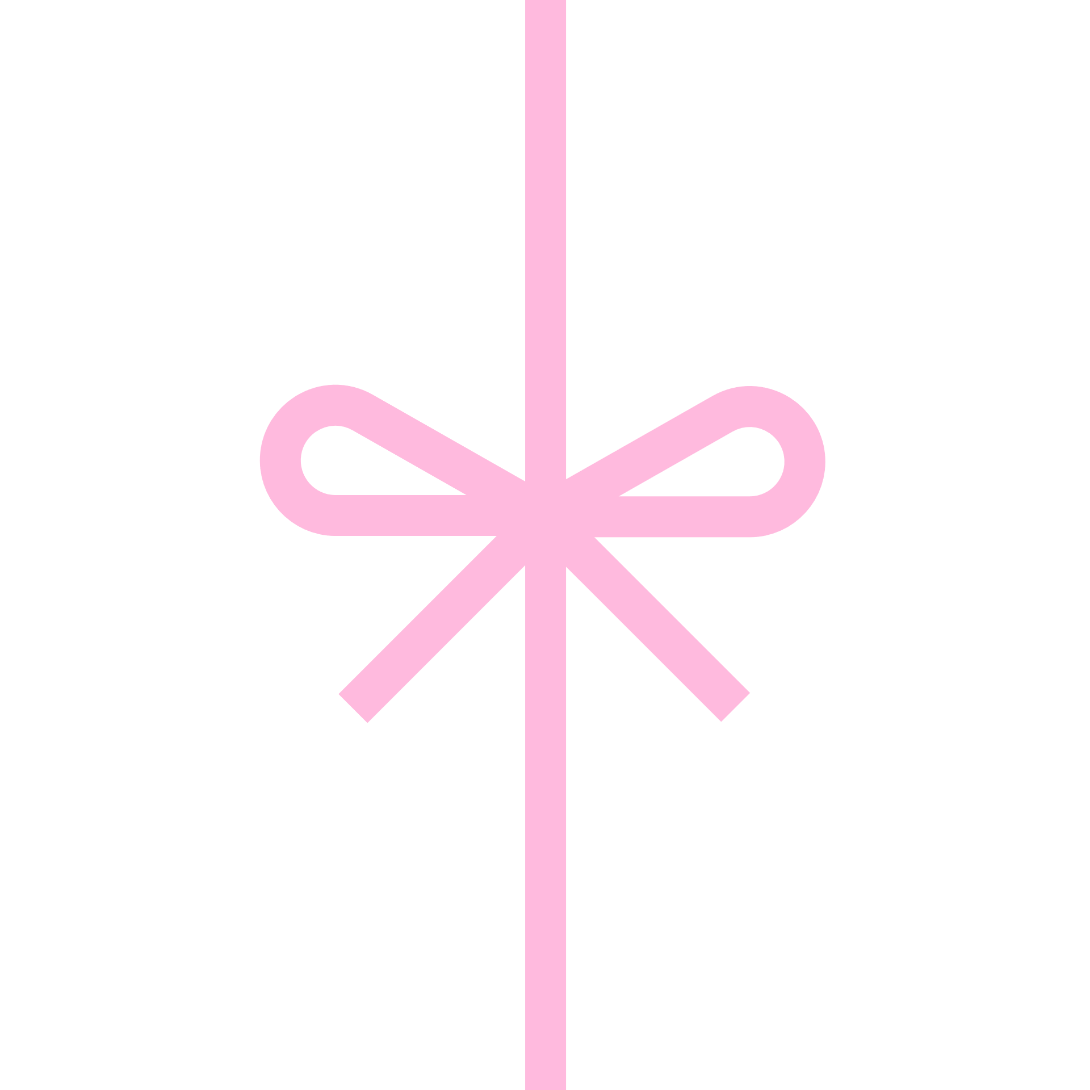


Using the Wheel
Once you have this basic information down then it becomes a matter of using the wheel. In truth this wheel lives inside of you. You can access it through meditation. However, setting up a physical representation of this tool and then actively “calling in” and accessing these archetypal forces (and your Reiki guides in each direction) in a deliberate way does much to enhance whatever you are endeavoring to do, be, or have. But before you begin it is important to remember and understand the fundamental nature of Reiki. In the words of Paula Horan, “Reiki is an energy incomprehensible to the intellect which flows through everything, transforming all realms of life, enriching them with an abundance of new perceptions and experiences. Reiki is an art of living, and at the deepest level, Reiki is ONENESS.” And in truth, WE ARE ALSO THAT ONENESS. So, “the more complete our surrender is to the Universal Life Force energy we are at heart, the more open we become to its transformative power.”
AND…

Slide 14
In the words of Black Elk, “the Medicine Wheel represents the circle of all life. When you sit in the wheel and evoke the sacred, all life comes to sit in council. The human, only one member of the web of life, can use the ceremony of the wheel to restore contact with all the relations of life. The animal relations, plant relations, stone people, spirit relations, all things come to sit in council. Our connections with the world are thus restored and the healing of the Earth begins anew. The wheel of life, the medicine wheel, is a map for everything in the universe, a blueprint of the web of life. As Black Elk said, this wheel exists in all things. Within each of us, too, the Medicine Wheel exists as our inner council.”
Thus, using the wheel is an act of surrender. You are combining the use of two ancient and very powerful forces!
BE REVERENT!
When you open the wheel and enter it with the intent of calling guidance, expect to get it. Then do your best to follow through and act upon it. Be willing to be patient with yourself. Spend as much time as you need I each doorway.

Slide 15
Steps to a personal Reiki in the Wheel Session:
Set aside some time, at least 30 minutes to an hour or more to go deeply into this process. You will need your journal and 5 stones as place holders for each of the directions. I will provide you with Reiki Crystals until you receive them you can just use any crystals to practice.
Set up the wheel structure, preferably so you can sit within it, with your Antahkarana symbol (which will be taught next) in the center and your Reiki stones in the configuration laid out in the example template we just discussed. (If you don’t have the room to set up your wheel to sit within it, you can set it up on your desk and sit on the outside of it.) It is also good to try to put the stones in the true directions.
Call in the Archetypal Elemental Forces and your Reiki Guides in each direction. Don’t be surprised if more Reiki guides show up when you do this step. (I will show you how in class.)
Then, using your template, begin in the center and get centered. You may want to engage in the Reiki Master Preparation Meditation to clear your chakras and run light through your body. Then focus on the purpose of your intention.
Go through the elements in the order listed, beginning in the north and focusing on structures necessary for your creation. Remember during this process to call in the symbol that corresponds to that doorway and the guides that live there. Then with your back to that doorway, sit in meditation and allow guidance to flow. Record in your journal. Know that your guides may also use this time to instruct you on blocks that still need to be cleared from your path. Just be in a state of allow, and trust that your guidance is coming. The whole universe feels your presence and is happy you are doing this work.

Slide 16
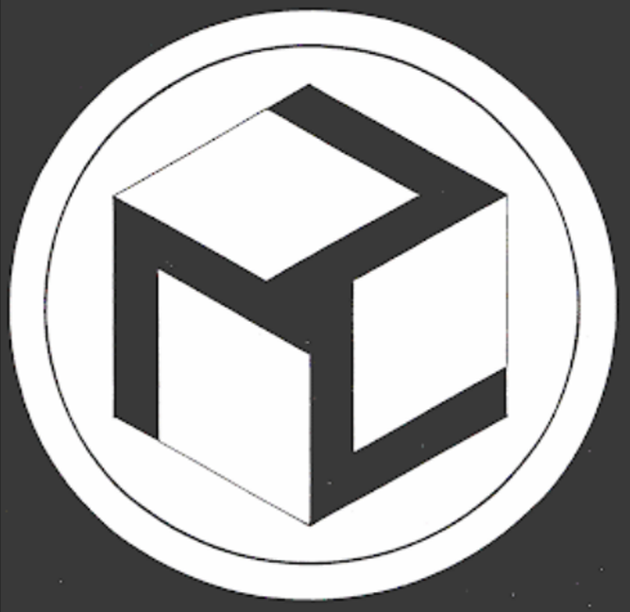
The Antahkarana
Ancient Symbol of Healing

Slide 17
The Antahkarana is an ancient healing and meditation symbol that has been used in Tibet and China for thousands of years. Alice Bailey and several other authors describe it as a part of spiritual anatomy. It is the connection between the physical brain and the Higher Self. It is this connection that must heal and develop if we are to grow spiritually. The Antahkarana symbol represents this connection and activates the Antahkarana whenever you are in its presence. It is very powerful and simply by having it in your presence it will create a positive affect on the chakras and aura. When doing healing work, it focuses and deepens the actions of the healing energies involved. When meditating with the symbol on your person or close by, it automatically creates what the Taoists call the great microcosmic orbit wherein the psychic energies that would normally enter the crown chakra enter the feet and travel up the back of the body to the top of the head and then down the front to the feet again, thus grounding the person to the earth and creating a continuous flow of energy through the chakras. It will also neutralize negative energy that has collected in objects such as jewelry or crystals simply by placing the object between two symbols. In addition, it will enhance all healing work including Reiki, Manikari, Jim shin, Polarity therapy Chiropractic, Hypnotherapy, and Past Life Regression.

Slide 18
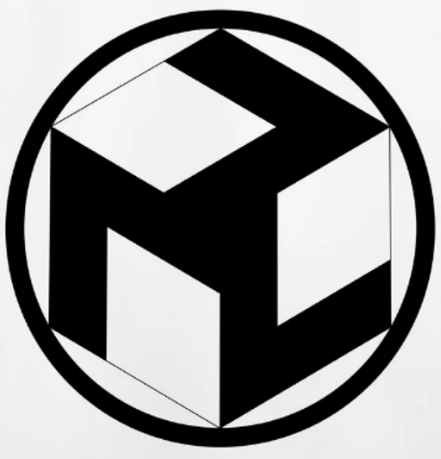
The symbol is multidimensional. From one perspective it appears to be two dimensional, being made up of three sevens on a flat surface. The three sevens represent the seven chakras, the seven colors and the seven tones of the musical scale.
From another perspective this symbol appears as a three-dimensional cube. Its energy moves up from two to three dimensions that can be seen and continues up through unseen dimensions all the way to the highest dimension – the dimension of the Higher Self.
There are 2 versions: The Masculine and Feminine. The large symbol is more female and creates its healing in a gentle way. The smaller single symbol is more male and more direct, focused and penetrating. Use your intuition in deciding which one to use.
Female Male

Slide 19
Directions for Use
The Antahkarana is a special symbol that has its own consciousness. It works directly with your aura and chakras and varies its healing affect depending on what you need at the time of use. Since it is directed by the Higer Self, it always has a beneficial effect and can never be misused or used for harm. The symbols an be placed under a Reiki/massage table, or under the bottom of a hair. They can also be placed on the wall or they can be held against your body with the print facing the area that needs healing.
Using the Antahkarana for Meditation
You can meditate directly on the Antahkarana by gazing steadily at it with your eyes relaxed, gently brushing away any thoughts that may come up. With continued practice the image may begin to shift and change or to fade in and out, or it may disappear completely. This is good because it indicates you have entered a deeper level of meditation and are receiving greater benefit. Do not allow this to disturb you. Continue your steady relaxed gaze. You may even begin to see pictures in front of the image that are very pleasant and relaxing. A simple meditation with the symbol will be beneficial during times of stress. However regular use is best, setting aside 10 to 30 minutes each day for meditation on the Antahkarana. The value you receive will develop along with your mental clarity and a sense of peace and security will stay with you throughout the day.

Slide 22
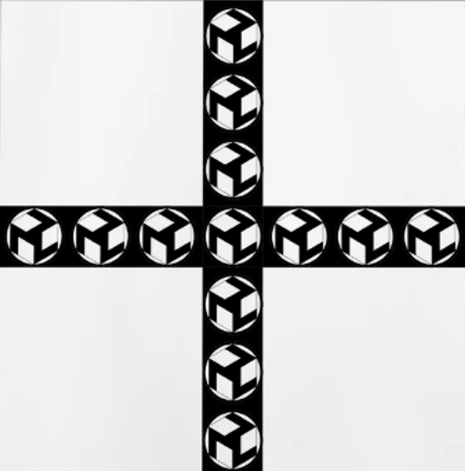
Multiple Symbols
The Sacred Cross is made of seven symbols crossing each other. This represents the seven major chakras. This symbol will purify your energy and can be used to open the heart.

Slide 23
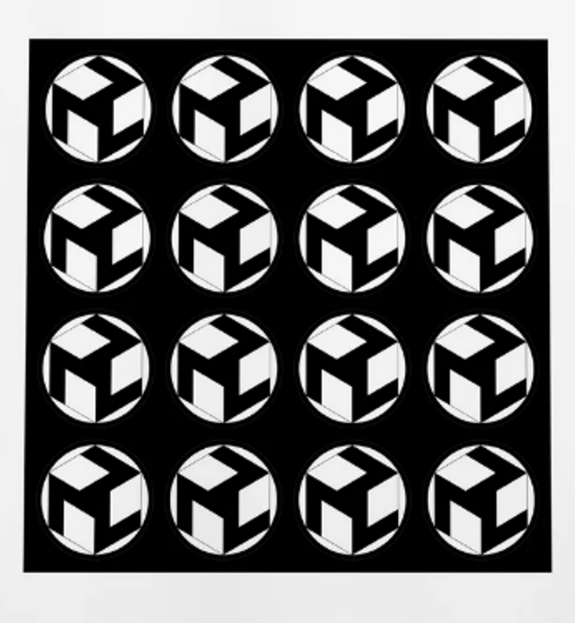
The square multiple symbol made of sixteen symbols will break up blocked and congested energy and get stuck energy moving. This symbol can also scatter your energy so it is recommended that you follow its use with the single male symbol to create centering and grounding.
If you want to experiment with these, feel free to make copies of them. For durability, use firm paper or laminate them. The Antahkarana is a symbol that gives freely to all. You will benefit greatly as you explore its use in your journey back to Light.

Slide 24
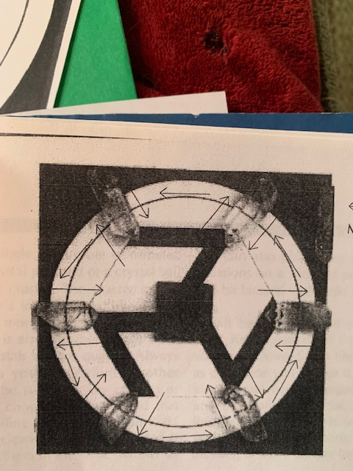
Using the Antahkarana to make a Reiki Grid
Quick Guide
Choose 8 crystals: 6 for the outer section, one central and one Master. Use intuition, pendulum, muscle testing, or scanning or simply choose ones you like.
Cleanse them if needed. Then charge them with Reiki using all your symbols and especially Hon Sha Ze Sho Nen.
Place the 6 outer crystals in a hexagon pattern on a stiff piece of cardboard or a sturdy Antahkarana symbol. Fix them in place with a tiny drop of rubber cement.
Place a picture of yourself or your intention or anyone you are working on in the middle with a positive affirmation on the back. Place the central crystal on top.
Charge your grid by charging the Master Crystal and them using it to charge the grid. Some suggest doing this daily. I find that if I do it once and leave it alone for awhile it works for me much better because I don’t get my ego/mind involved.

Slide 25
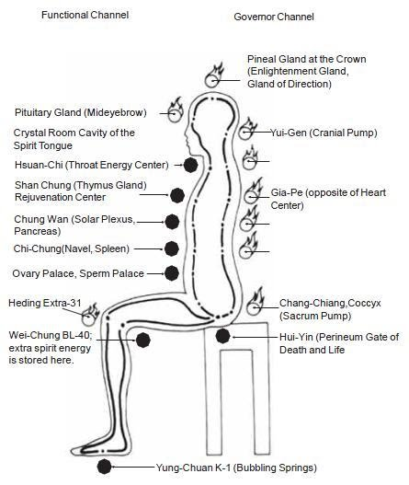
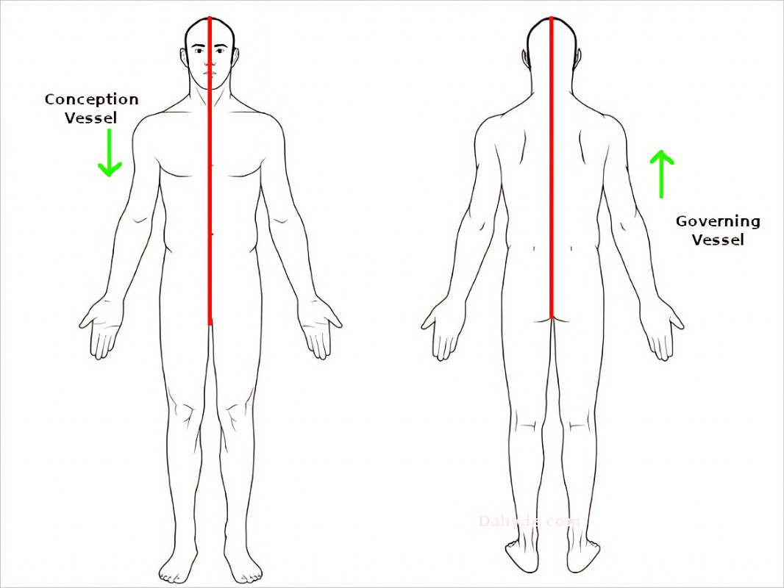
The Hara Line and the Microcosmic Orbit

Slide 26
The following exercises are given to help you begin to strengthen your Microcosmic Orbit so that you can hold it and run it in your body in order to give Reiki Attunements in Person…
The Reiki Master Attunement Exercise ~ Contracting the Hui Yin
A muscular contraction of the Hui Yin (pronounced way yin) point is a necessary part of giving Reiki attunements (in person). The Hui Yin point is between the anus and the genitals. When giving attunements, a special type of high frequency Ki enters your system and passes through the Hui Yi point as part of the process. This point must be held for the entire time you are giving the attunements, to prevent Ki from escaping from this point. Therefore, it is important to practice holding this point to buildup your coordination and muscular strength in this area.
Practice contracting the muscles in this area twenty times in a row and then holding them as long a you can. Also practice contracting these muscles continuously while you go about your daily activities. As you continue, it will become easier and easier, and you will be able to contract them for longer periods of time. Also, your muscular coordination will develop so that you will be able to isolate the different muscle groups into back, middle, and front. It is the middle area that is important to hold for attunements.

Slide 27
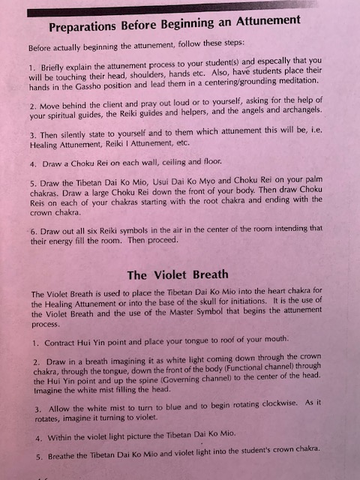
These are the beginning preparations for doing an attunement, just so you can see the format and why we are practicing some of this before the big class. You are going to have a lot of things to manage at once, so practicing contracting the Huy Yin and the Violet Breath before can be helpful.

Slide 28
The Violet Breath tones the recipient’s body and gets it ready to receive the attunements.

Slide 29
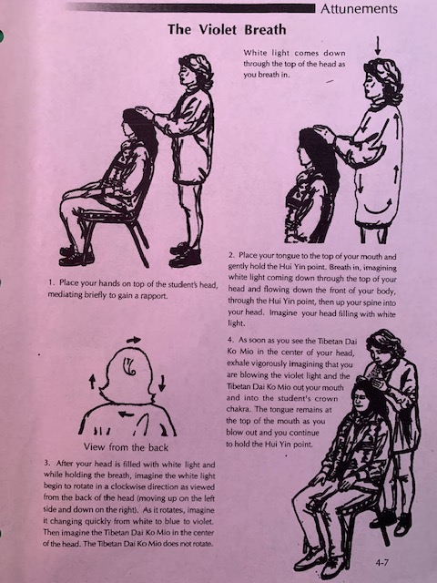

Slide 30
Reiki Master Preparatory Meditation
This is a modified form of the Taoist Microcosmic Orbit Meditation. It works with the seven basic chakras including their back sides along with energy channels on the front and back of the body. The purpose of this meditation is to open and clear the chakras and create a clear pathway for energy to flow throughout your system. This is a preparatory format so you can begin to prepare your body to hold and run the higher energies of Reiki in order to pass on attunement to others. It can take a student 4 to 6 months to open the energy pathways, but because Reiki has been added, namely the use of Choku Rei, the process is greatly accelerated.
This meditation is designed to begin to prepare your body to run Reiki energy. We will be using the basic Reiki I and II attunements that you already have, specifically Choku Rei. Later we will add the Master Symbols to increase the frequency of the energy you run through your body. However, this practice needs to be in place, the pathways cleared, and your body prepared before you begin to run a higher frequency. Doing this exercise will allow higher energies to flow more easily and strongly. Doing this will also allow higher energies to be fully and prevent problems caused by too much energy in the head or other parts of the body. It will also purify and/or release any negative energy from within yourself that you may have created or attracted. By circulating your energy, the negative energy is transmuted in the chakras as it passes through them and may also be released from the chakras. This happens automatically as you circulate it. This is a very worthwhile meditation and will create harmony and balance at the same time it brings in greater levels of clarity and vitality.

Slide 31
The channel on the front of the body is called the “Function” or “Conception” channel and starts at the tongue and flows down the front side of the chakras to the root chakra and the HuYin point. The back channel is called the “Governor” channel and starts at the Hui Yin point and flows up the spine through the back sides of the chakras to the top of the head and ends at the top of the mouth. These channels are normally unconnected, but by placing the tongue to the roof of the mouth and lightly contracting the Hui Yin, the channels connect and form a circuit or what is called the microcosmic orbit.

Slide 32
Part I
To enhance this meditation you can also open a circle and call in your Reiki Guides, and/or place one of the Antahkarana symbols under your feet. Choose the one you feel guided to use.
Focus on your root chakra and the chakras on the bottom of the feet and send roots down to the earth to maintain a good grounded connection to the earth and to draw energy up from the earth.
Call in and/or draw the 3 Reiki II symbols on your hands and place your hands on your legs intending that these energies will continue to flow throughout the meditation.
Say a prayer to God/Goddess, your Reiki Guides, and/or any enlightened being giving thanks for the healing and higher consciousness they are sending you.
Steadily hold an image of the Choku Rei on your solar plexus chakra. If thoughts arise, gently brush them aside and return to the image of Choku Rei. Do not be disturbed if thoughts arise as this is natural, but as soon as you realize thoughts are present, let them go and return your attention to the image of Choku Rei on your solar plexus chakra. As you continue to practice this meditation, your ability to hold the image for longer periods of time without thoughts will improve. By steadily holding this image in your mind, your mind will become calm, steady and powerful. The chakra will also open, clear, and heal. Hold this image for approximately 2 to 5 minutes.
Then move your attention down to the sacral chakra and repeat step 4. Continue this process with each chakra moving down to the root and then up the spine all the way around to the heart chakra.
As you proceed with this process, you may notice different sensations at each chakra point. You may feel heat, or coolness, see colors or images etc. These are indications that healing or releasing is taking place. The important thing is to not be distracted but continue to steadily hold the image. If you have any trouble visualizing, just do the best you can. As you continue, your ability to visualize will improve.

Slide 33
Part 2
After completing part one, place your tongue to the roof of your mouth and lightly contract the Hui Yin point.
Visualize a beautiful ball of white light in your solar plexus.
Then imagine the ball of white light moving down to the sacral chakra, then to the root chakra, then up the spine through the back sides of each chakra to the crown and down through the tongue and down the front. See this ball of light traveling around and around the energy pathway. The flow is always down the front and up the back.
Continue visualizing the ball of light traveling around the energy pathway for 10 minutes or more.
When you are ready to end the meditation, intend that the energy will continue to flow in this pathway. Then release the tongue and the Hui Yin point. Take a deep breath and open your eyes.
The value of this meditation increases with regular use. Over time you will find an increase in your ability to concentrate, increased vitality, better sleep, improved health and ability to deal with stress, and most of all, it will increase the strength of your Reiki energy! I suggest you use it every day for at least two weeks to experience its value. Even better, incorporate it into your daily practice in preparation for your Reiki Master Attunement and Practice.

Slide 34
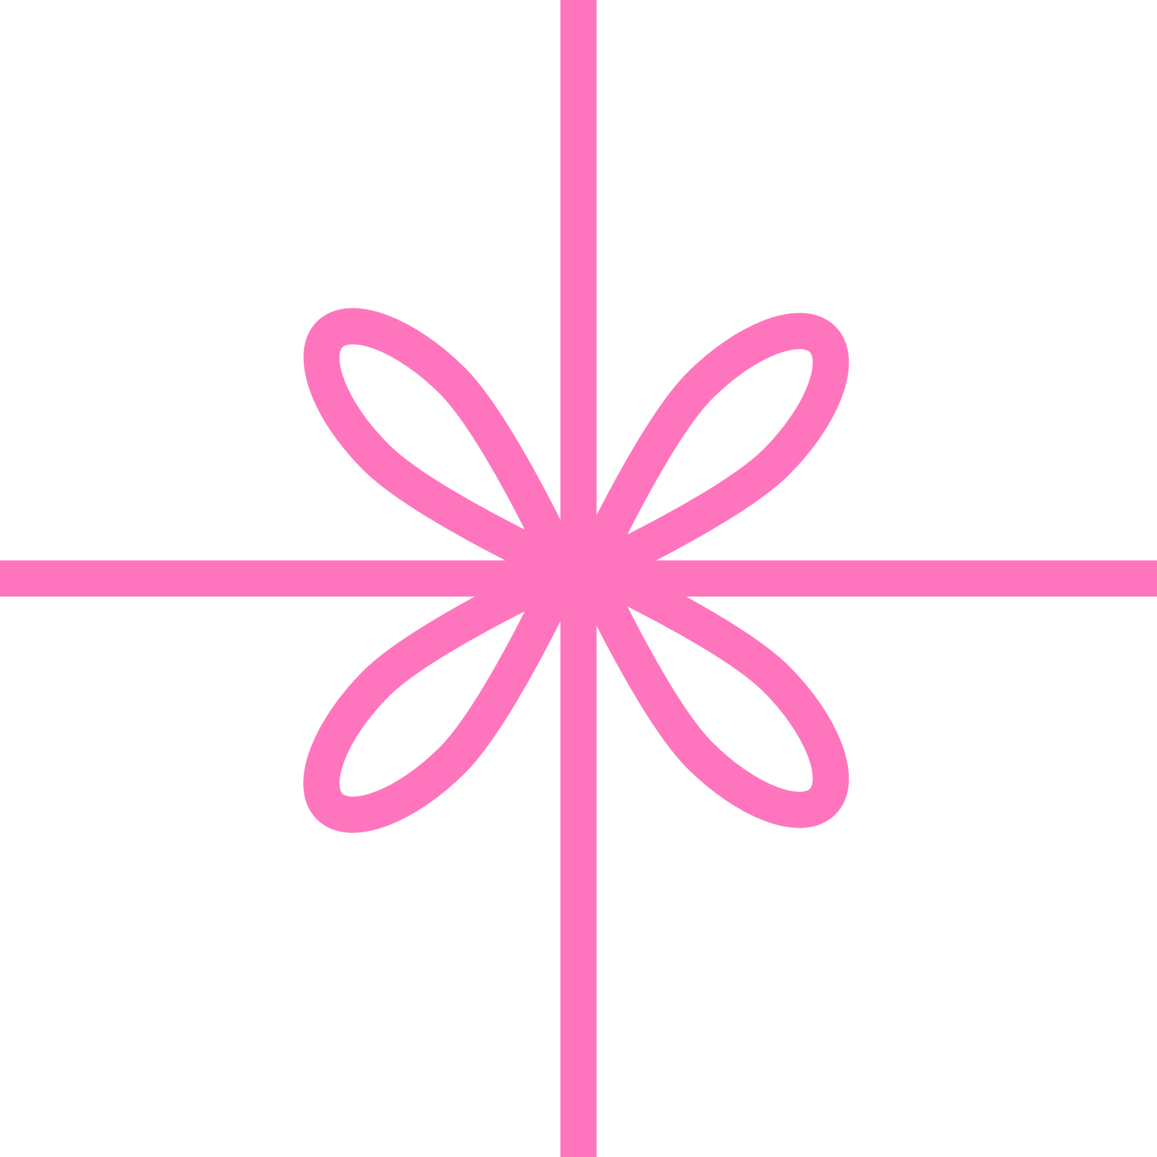
REIKI MASTER PREP CHECK LIST…
If you are serious about making Reiki a business and/or a way of life that includes being a Reiki Master, there are a few simple but IMPORTANT practices that you should try to adhere to:
DO REIKI! If you are not working actively on clients, at least work on yourself daily. This will go a long way to raise your vibration, clear your own blockages, and keep you in the Reiki vibration
Even if you are working on clients send yourself Reiki on a regular basis. I find doing this at night before I go to sleep is a good time and a way I always remember to do it.
Do the Reiki Meditation regularly. Shoot for 5-7 times a week. The more you do this meditation, the more you will begin to build the energy necessary to hold space for others to receive attunements. This meditation can propel your spiritual practice forward in ways you cannot imagine.
Practice doing the violet breath. Once you get this down, you can use it in Reiki healings to clear stubborn things that don’t want to leave.
PRACTICE DRAWING THE MAIN REIKI SYMBOLS so you can do it without looking: Choko Rei, Seheki, and Hon She Ze Sho Nen.
Practice contracting and holding the Hui Yin.
Attend Reiki shares and/or receive Reiki.

Slide 35
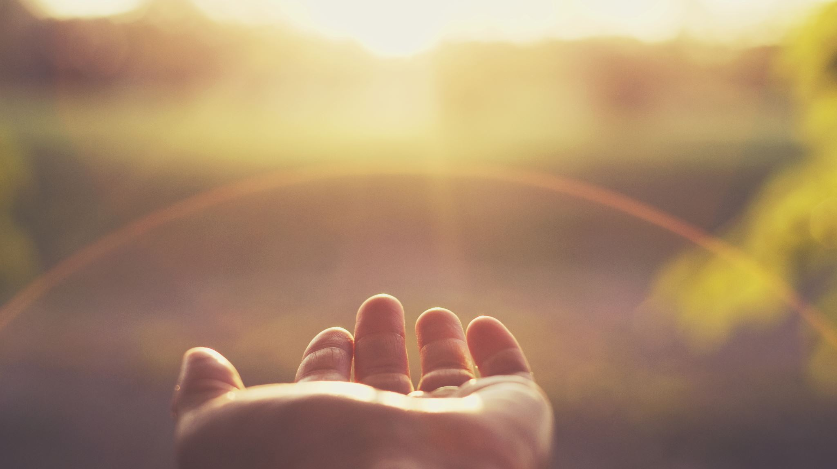
The Reiki Principles
Just for today I will give thanks for my many blessings.
Just for today I will not worry.
Just for today I will not be angry.
Just for today I will do my work with integrity.
Just for today I will be kind to myself and every living thing.

